Slide 1

Today: Intro to How To Read & Use Your Benefits Book
June 28th – Insurance Terminology and Definitions
July 26th – Explanation of Benefits (EOB)
August 23rd – Denial Letters and Your Appeal Rights
Lunch & Learn w/ OHA

Slide 2


TODAY’S TOPIC
The Benefits Book Part I brought to you by
Ted Doolittle
State Healthcare Advocate presented by
Jill Hall
OHA Nurse Consultant

Slide 3




Important Plan Documents
Authorization and Precertification Letters
Certificates of Creditable Coverage
Clinical Guidelines
Explanation of Benefits (EOBs)
HIPAA & Disclosure Forms
Insurance Claim Forms
Misc. Surveys & Questionnaires
Non-coverage Decision Notices (aka denials)
Open Enrollment Notices/Disenrollment Warnings
Schedule of Benefits
Summary of Benefits & Coverage

Slide 4
The Most Important Plan Document Of All!
The Benefits Book

Slide 5
What’s Your Benefits Book Called?
Benefits Plan or Medical Policy
Subscriber Agreement
Certificate of Coverage
Evidence of Coverage
Member Handbook
Summary Booklet
Summary Plan Description (SPD)

Slide 6
Caution about Similarly Named Documents
Summary Plan Description (SPD)
Vs.
Summary of Benefits & Coverage (SBC)

Slide 7
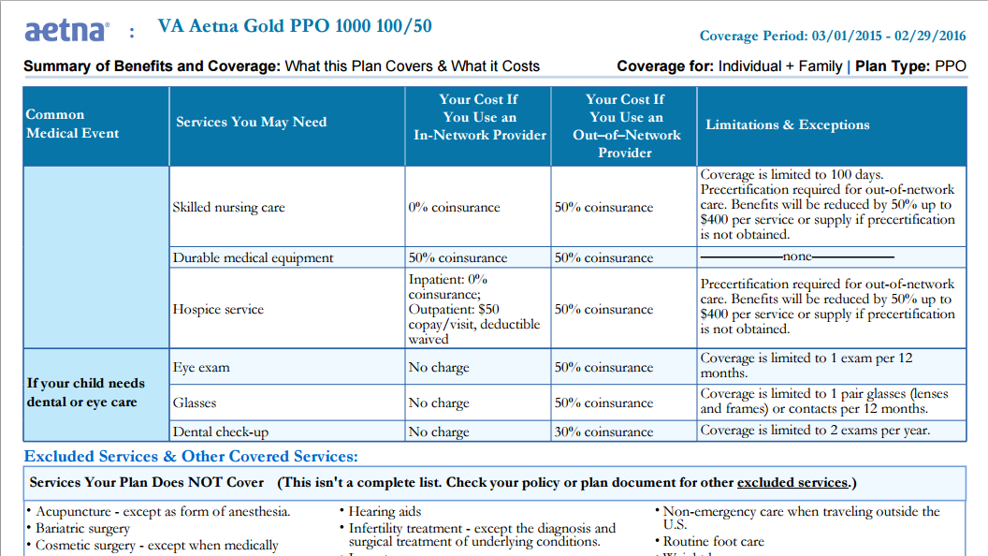
Summary of Benefits & Coverage

Slide 8
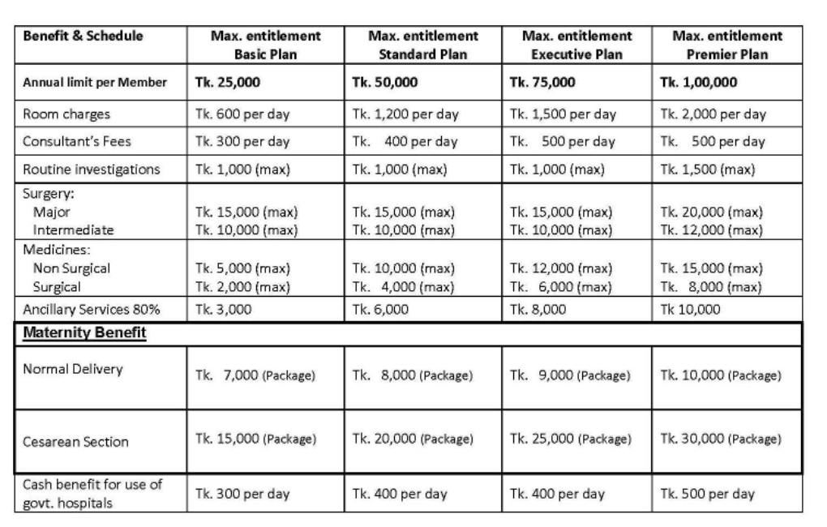
Schedule of Benefits

Slide 9
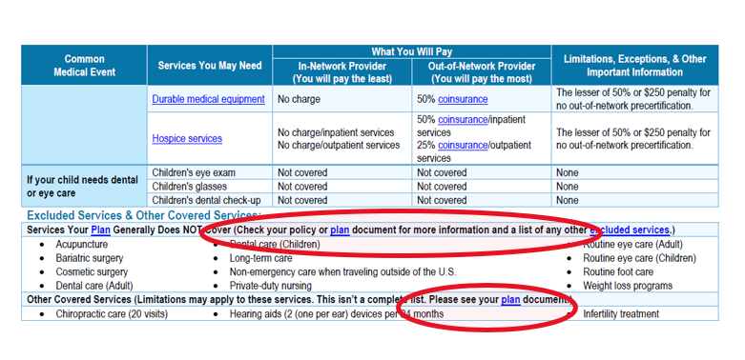
Example SBC

Slide 10



Health Plan Benefits Book

Slide 11
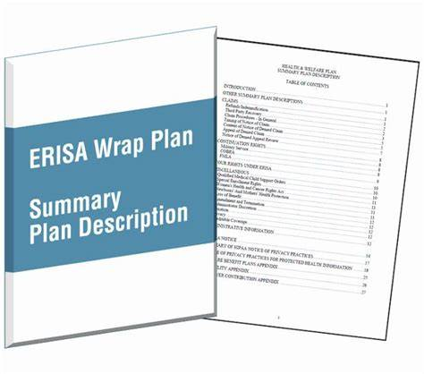
*EXAMPLE*
Table of Contents
How Your Health Plan Works
What is Covered, Limited or Excluded
Rules:
  Precertification Requirements
  Using Out-of-network Providers
Directions:
  How to Submit Insurance Claims
  Where to Direct Questions or Submit Complaints
  How to Appeal Denials of Coverage
Legal Notices
… and much, much more
Notes:
CONTAINS All Rules and Requirements of the Medical Plan and your Rights as a Member of the Medical Plan.

Slide 12


The Benefits Book

Slide 13
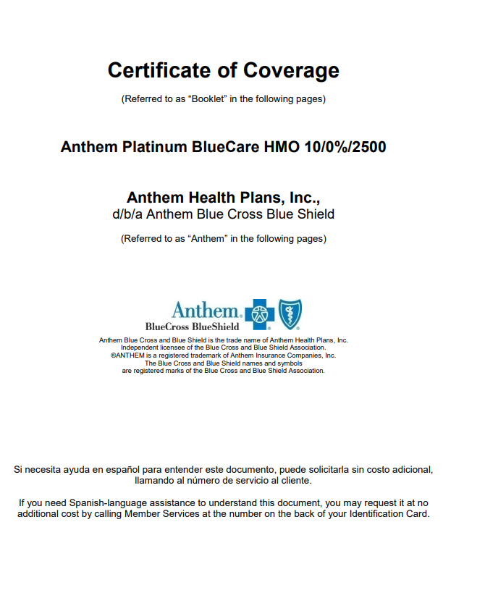


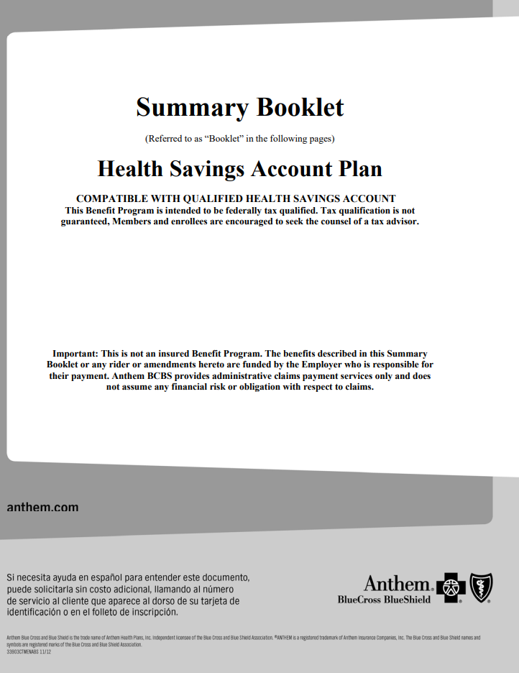




Slide 14


Where Do I Find My Benefits Book?
Health Plan Carrier
Employer

Slide 15


How do I use the “User Manual”

Slide 16


Key Points

Slide 17
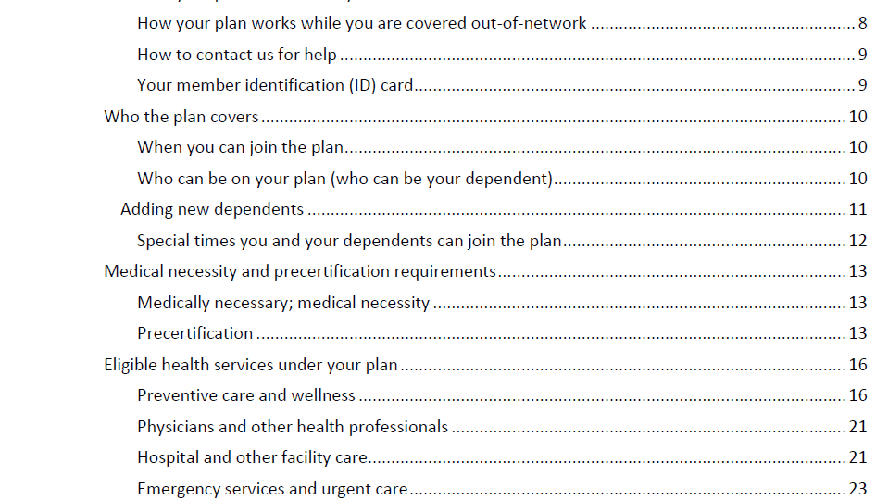


Slide 18
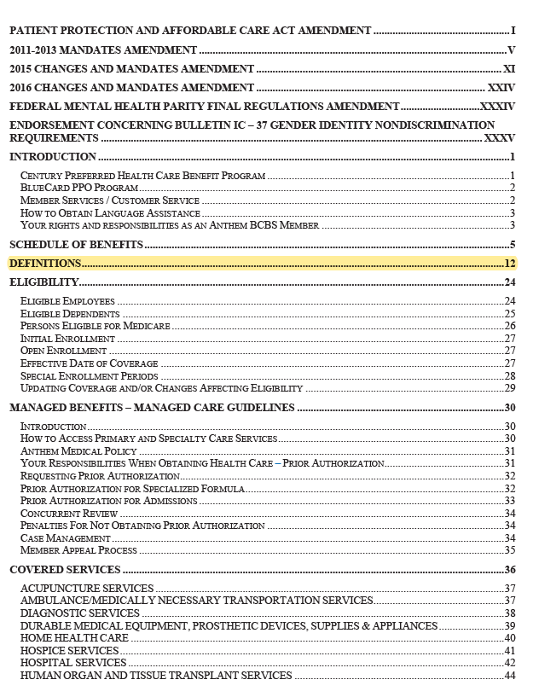
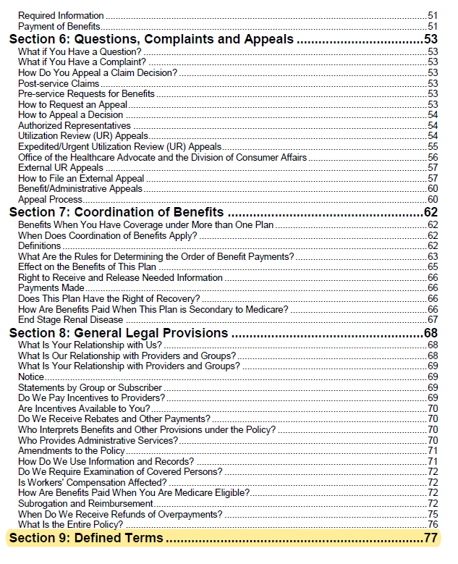
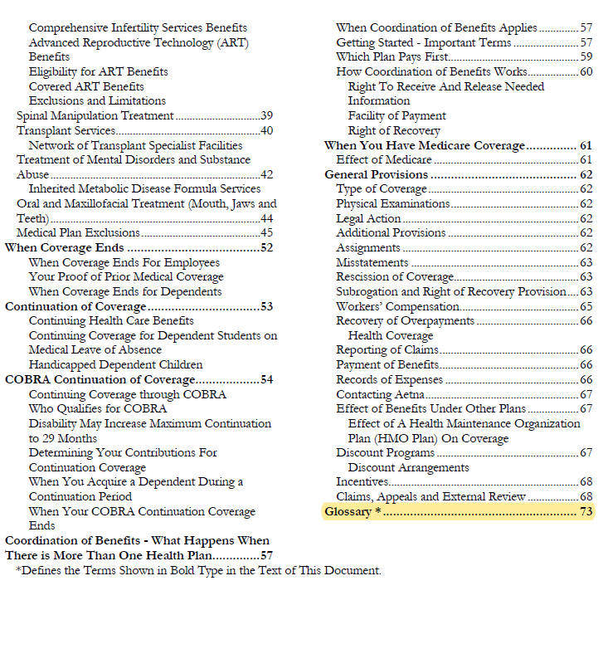
Pay Close Attention to Definitions
Combined COC Anthem
“Definitions”
Choice Plus HSA UHC
“Defined Terms”
POS II CIGNA
“Glossary”

Slide 19
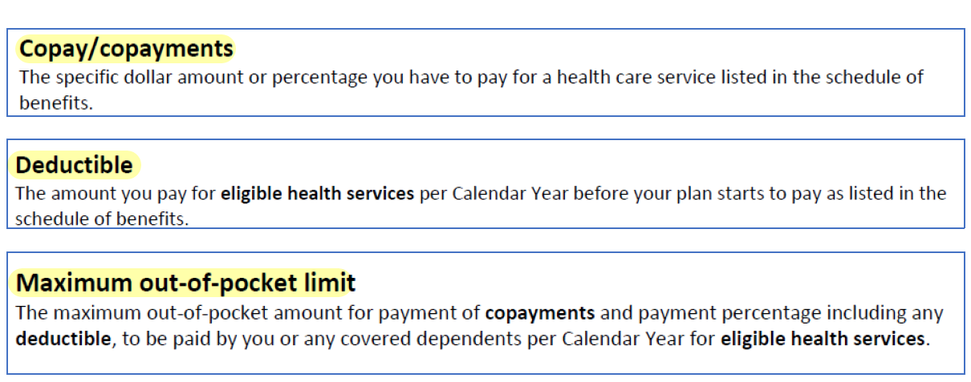
Usual/Expected Definitions

Slide 20
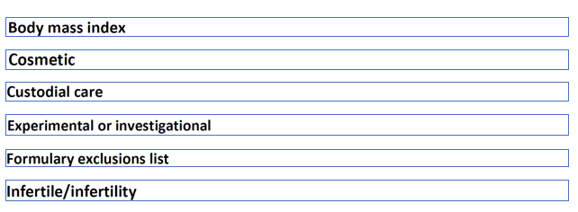

Unexpected/Unfamiliar Definitions
Notes:
These “unexpected, mostlikly unfamiliar words is why I suggest that you start reading your book at the definitions section. If a word or a phrase is defined, its defined for a reason! The reason might not be clear, but it is somehow IMPORTANT!!
Words and phrases that are defined in your benefits book suggests that there are rules about those services and/or there are limits or possible exclusions all together.
Reading the definition pages alone wont answer all questions you have about your benefits, but it gives you important hints about the rules that apply and the questions you might need to be asking about your benefits to get clarification.

Slide 21
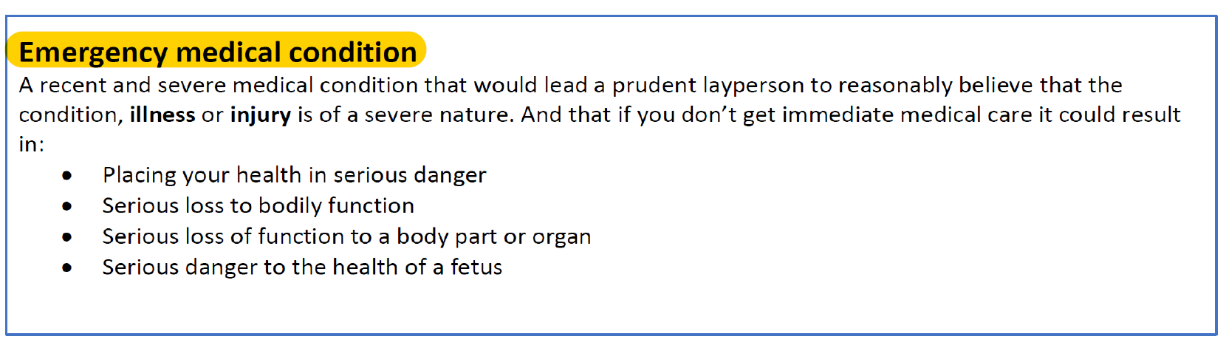
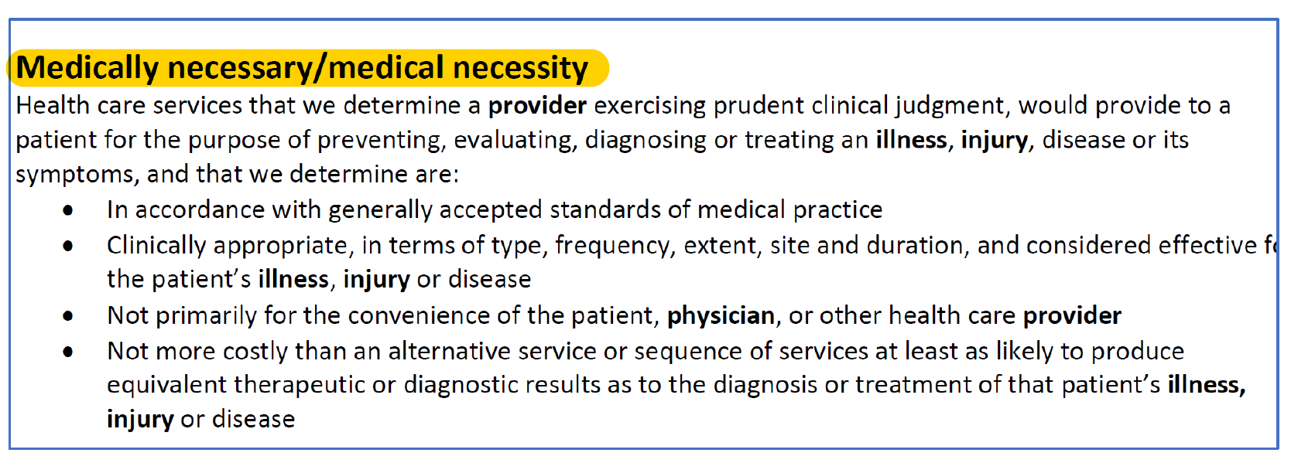
Defined Terms Suggests Plan Rules Will Apply

Slide 22

If you want to dive deeper and learn more about health insurance terminology and the common definitions used by our Health Plans, join us next month:
OHA Lunch & Learn
June 28, 2022

Slide 23



Slide 24

Notes:
You don’t have be an expert at insurance jargon and healthcare lingo to become better at navigate your health benefits. It all starts with reading and using your benefits book.

Slide 25

Carrier Responsibilities
Plan Rules
&
Member Rights

Slide 26


What’s Included?

Slide 27


What’s Excluded or Limited?

Slide 28
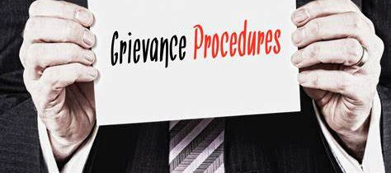

Grievances &
Appeal
Rights

Slide 29
Maximize Your Benefits Using Your Benefits Book
Become familiar with the entire document.
If reading cover to cover is overwhelming, begin by reading the Table of Contents. Then, locate the Definitions section and start there!
Become familiar with:
  All Your Health Plan Definitions;
  Which services/supplies are covered;
  Which services/supplies are limited and excluded;
  Your Rights to Appeal Non-coverage Decisions, and
  The Health Plan Rules and Any Special Provisions
Refer to the Benefits Book whenever you need directions about how to use your insurance.
If you don’t understand the directions or descriptions, ask questions, AND expect nothing less than good customer service from your health plan carrier!
Notes:
Rules, such a timeframes allowed to submit insurance claims or appeals
Sometimes State Mandates apply to your Policy. That would be a special provision.
Remember, Health Insurance is Complicated.

Slide 30

What Do I Do If I Get Confusing, Conflicting or Incorrect Information?

Slide 31

Don’t Worry Alone!
Notes:
OHA was established to offer Free, Expert Assistance & Representation for any type of health insurance questions or problems.

Slide 32

Thank you for joining us today.
Any Questions?
Email: Healthcare.Advocate@ct.gov
Phone: 866-466-4446
Web: www.ct.gov/oha
Notes:
Thank you for joining us today for this brief overview of the health plan benefit book and why its important.
That concludes today’s presentation. I hope you enjoyed our introduction to the importance of having and using your benefits book.
I encourage you to join us again next month when we will be discussing other important Plan documents and in future months when we begin diving deeper into how to understand and use your benefits book.

