Slide 1

Vision Zero Council
3/13/24
10:00a.m. – 12:00p.m.

Slide 2

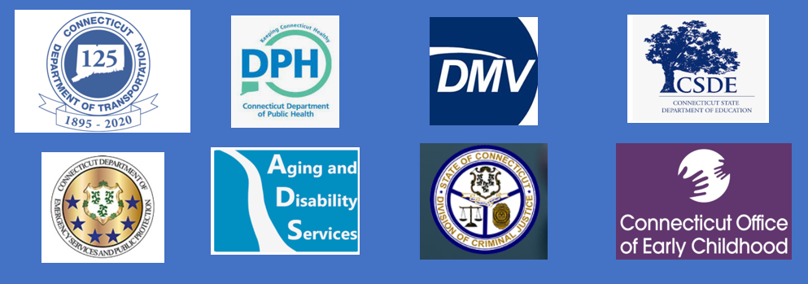
Vision Zero Council – Welcome and Introductions

Slide 3
Vision Zero Council – Meeting Agenda
Committee Chair Welcome and Introductions
Adoption of 12/16/24 Meeting Minutes
Transportation Committee Leadership
Agency Legislative Updates
  CTDOT
  DMV
  Other Agency Updates
DESPP Update
  Heightened Enforcement Efforts
Automated Traffic Safety Enforcement Device Update:
  CTDOT – Office of the State Traffic Authority
Sub-Committee Areas of Focus
  Sub-Committee Reorganization or Tasks
  Guidance From Council
Next Steps
  Meeting Topics
  Meeting Dates
  Questions from Council
Public Comment
Adjourn

Slide 4
Vision Zero Council – Adoption of 12/16/24 Meeting Minutes

Slide 5

Transportation Committee Leadership

Slide 6
Vision Zero Council - Agency Legislative Updates
Philip Mainiero – Legislative Director, Connecticut Department of Transportation

Slide 7
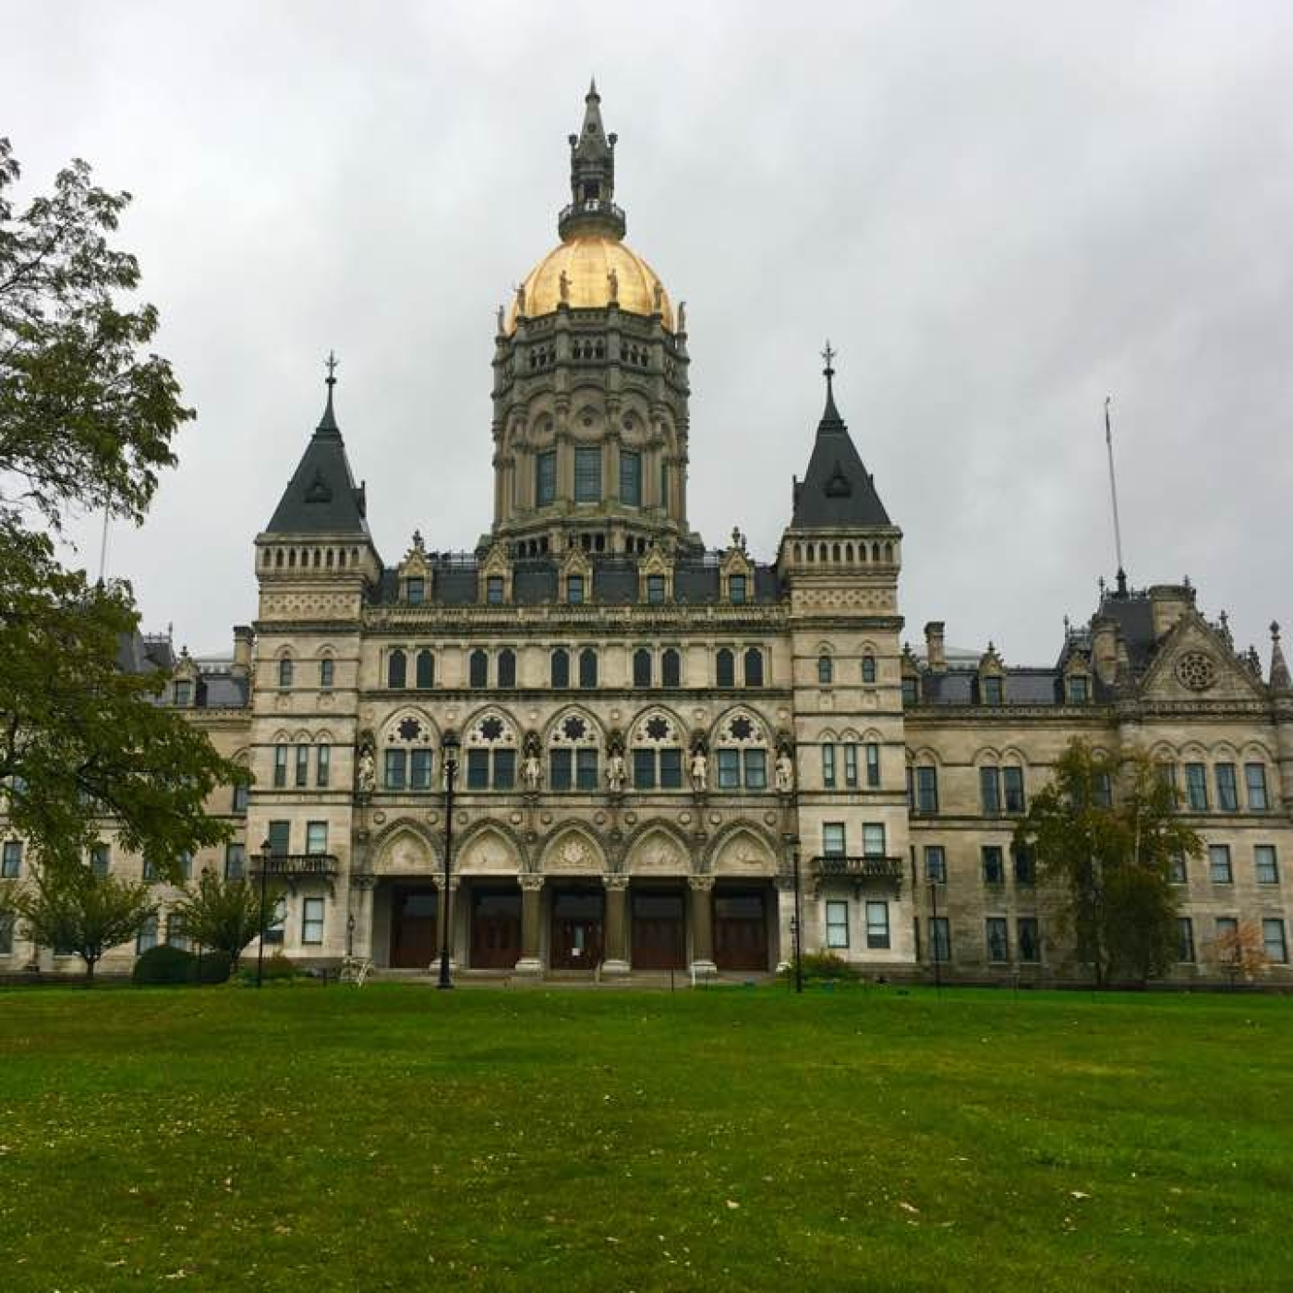
2025 CTDOT Legislative Proposals
SB 1376
  0.08 → 0.05 BAC limit for MV
Hb7060- Transportation Worker Safety
  Driver Safety Training
  WZRVSC
  Reckless Driving- cell phones
  Increased Penalties for "SDMO“ & endangerment of Highway Worker
Sb1375- Highway and Pedestrian Safety
  Crosswalk fines, Left Lane camping, Motorcycle Helmets, Video Converters, Open Containers
Notes:
The majority of ConnDOT's legislative proposals in 2025 are focused on safety.
DUI: S.B. 1376 calls to lower the BAC from 0.08 to 0.05. Conditions on our roadways have not improved since this bill first came before the Transportation Committee. Connecticut continues to be among the worst in the nation when it comes to drunk driving rates. This bill seeks to help reduce drunk driving across the state. Lowering the BAC is proven to be effective. Lowering the BAC acts as a deterrent and encourages people to plan ahead. Every day 37 people in the U.S. die in drunk driving crashes, which comes to every 37 minutes.
CTDOT Statutes: S.B. 1377 has numerous provisions requested by ConnDOT to help conform our state statues to new federal rules. It would allow for service improvements at ConnDOT. This includes updating the state coordinate system and map production purposes to align with national standards; eliminating special crosswalks no longer in use; allow us to administer federal grants received directly by towns and cities who are seeking ConnDOT support to administer those federal grants. Lastly, we want to repeal a provision on transit district funding that was passed a few years ago but doesn’t achieve what we believe the attempt was. This change would reduce funding to transit districts across the state.
Transportation Worker Safety (Driver safety training, reckless driving revisions): H. B. 7060 proposes establish a work zone and roadside vehicle safety awareness program. If someone is newly licensed, they’d have to take a course, and if they violate the slow down, move over laws, they’d have to take a re-education course. This proposal also makes distracted driving on a limited access highway a reckless driving violation. Lastly it will increase the penalties for endangering a highway worker and violating the "move over" law. According to the Federal Highway Administration, over 800 fatalities occurred in work zones nationwide last year alone. Many of these tragedies could have been avoided with better driver awareness and education.
Highway and Pedestrian Safety (Left-lane, helmets, video converters, open containers): S.B.1375 clarifies that the left lane in a multi lane highway is meant for passing, not camping out. This will help CTDOT expand signage and make it more clear to motorists. This proposal also clarifies statutes to keep up with video technology being watched by drivers. Lastly, motorcycle helmets are included in this bill—this year ConnDOT is proposing a compromise to only adjust the helmet rule to capture those up to age 21. Head injury is the leading cause of death in motorcycle crashes and an un-helmeted motorcyclist is 40% more likely to suffer a fatal head injury than a helmeted motorcyclist. Helmets are 69% effective in preventing brain injuries and 42% effective preventing fatal injuries.

Slide 8
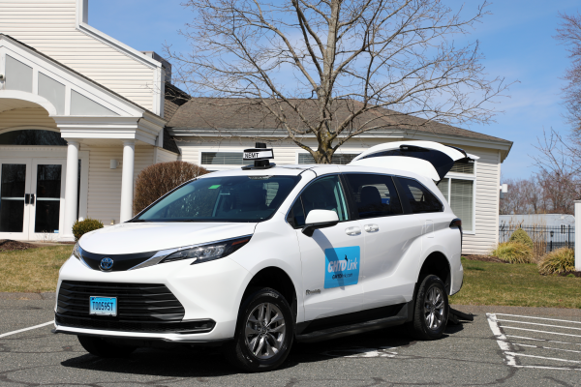
Updates to Prior Legislative Initiatives & Reports
Reports:
Work Zone Speed Camera- June Special Session Public Act 21-25
Vision Zero Council Recommendations- Public Act 21-28
No Turn on Red Report-Public Act 23-116
Micro Transit – Public Act 22-40
Idaho Stop Study -Public Act 23-116
Wrong Way Driving Detection Notification & Broadcasting Pilot Study-Public Act 23-51
Rumble Strips- Public Act 23-51
Other initiatives:
LTA Training & Continuing Education - PA 23-135 (Ongoing)
Drug Recognition Expert and ARIDE training
Law Enforcement Phlebotomy
Micro-Transit Program
Notes:
We also have been working to deliver on the various reports that have been asked of us by legislative process. As you see on the screen, this is the list of reports and initiatives we submitted to the legislature in recent years.
Pictured: Governor Ned Lamont and the Connecticut Department of Transportation awarded $19.5 million to fund nine transit districts and municipalities in Connecticut for a two-year pilot program for on-demand microtransit services.

Slide 9
Vision Zero Council - Agency Legislative Updates
Other Vision Zero Council Agency Updates

Slide 10
Vision Zero Council – Safety Updates
Department of Emergency Service and Public Protection – Heightened Enforcement Efforts

Slide 11
Vision Zero Council – Safety Updates
Connecticut Department of Transportation, Office of the State Traffic Authority – Automated Traffic Safety Device Update

Slide 12
Vision Zero Council – Sub-Committee Update
Engineering
Enforcement
Equity
Education

Slide 13
Vision Zero Council – Next Steps
Future Meeting Dates:
  Tuesday, June 17 10a.m.
  Friday, September 12 10a.m.
  Thursday, December 10 10a.m.

Slide 14
Vision Zero Council – Public Comment
Please Raise your hand to be called upon or enter your question in the Q&A field
In person questions will be prioritized over those entered in the Q&A field

