Slide 1

CT Highway Safety Office
FY 2019 DUI ENFORCEMENT GRANT APPLICATION REFERENCE GUIDE
September
2018

Slide 2

WHAT’S NEW FOR
2018 & 2019
ADDITIONAL PROBLEM ID INFORMATION REQUIRED.
WORKSHEET TABS SIMPLIFIED.
GREATER FLEXIBILITY IN GRANT ACTIVITY DATES.
BILLING PERIODS REVISED FOR CONSISTENCY.
TOWNS NO LONGER REQUIRED TO COVER 25% OF COSTS.

Slide 3

THE PROCESS
GRANT
GRANT APPLICATION IS DOWNLOADED FROM:
  http://www.ct.gov/dot/safety
ELECTRONIC (EXCEL FORMAT) AND HARD COPY SUBMITTALS ARE REQUIRED.
GRANT IS REVIEWED THEN SUBMITTED TO FINANCE AND ASSIGNED A PROJECT NUMBER.
GRANTEE RECEIVES A LETTER WITH AN ASSIGNED PROJECT NUMBER AND A PDF VERSION OF THE GRANT.
EMAIL IS SAVED FROM EACH GRANTEE REQUESTING ANY IN-TOWN CHECKPOINT CHANGES.

Slide 4
STARTING THE GRANT
PROCESS
THESE ARE THE TABS YOU WILL SEE WHEN YOU OPEN THE GRANT PACKAGE.

Slide 5
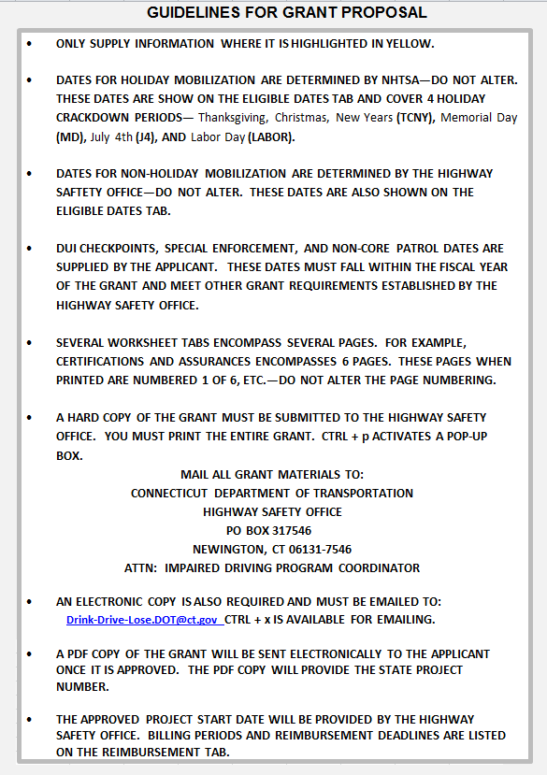
INSTRUCTIONS
THESE ARE THE INSTRUCTIONS INCLUDED IN THE GRANT PACKAGE. REFER TO THEM AS OFTEN AS NECCESARY.

Slide 6
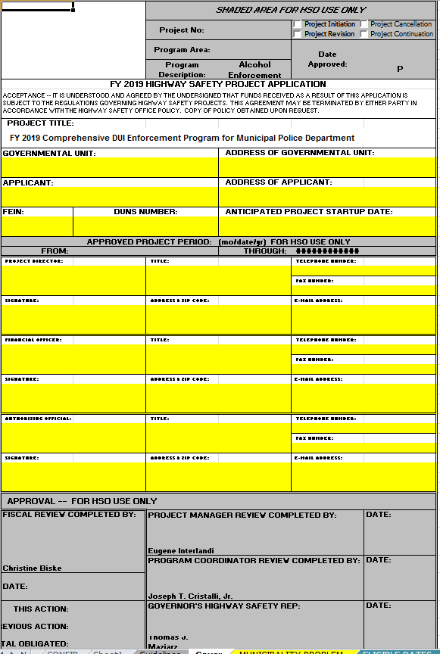
COVER
FILL-IN ALL YELLOW…

Slide 7
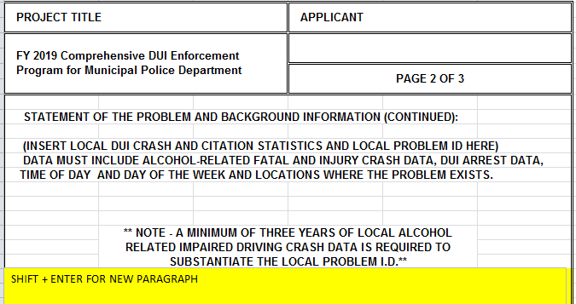
MUNICIPALITY PROBLEM
A NARRATIVE INCLUDING PROBLEM IDENTIFICATION AND BACKGROUND INFORMATION IS REQUIRED.

Slide 8
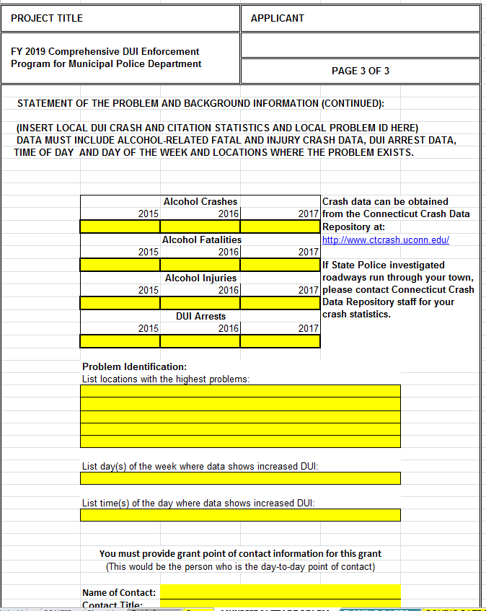
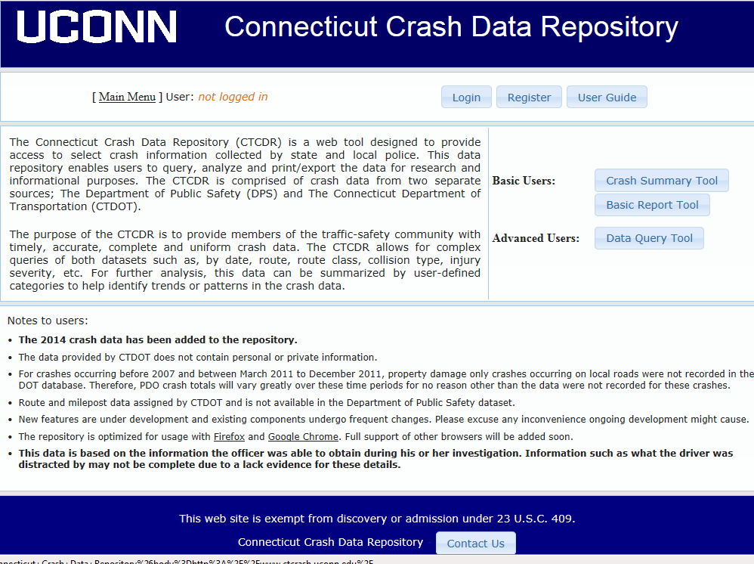
MUNICIPALITY PROBLEM
http://www.ctcrash.uconn.edu/
ADDITIONAL INFORMATION ON PROBLEM IDENTIFICATION IS REQUIRED.

Slide 9

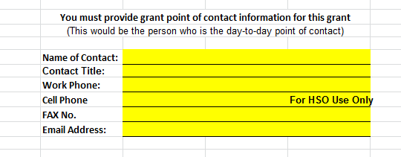
MUNICIPALITY PROBLEM
DAY-TO-DAY POINT OF CONTACT
THE PERSON TO CONTACT REGARDING ANY ISSUES WITH THE GRANT.

Slide 10
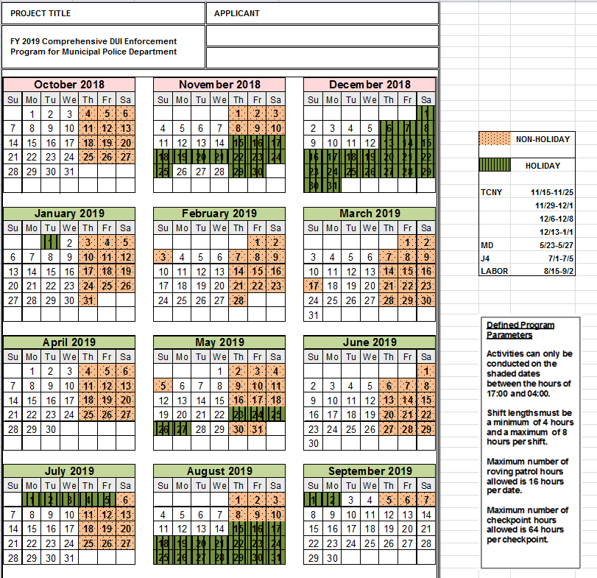
ELIGIBLE DATES
REFER TO THE CALENDAR AS OFTEN AS NECESSARY.

Slide 11
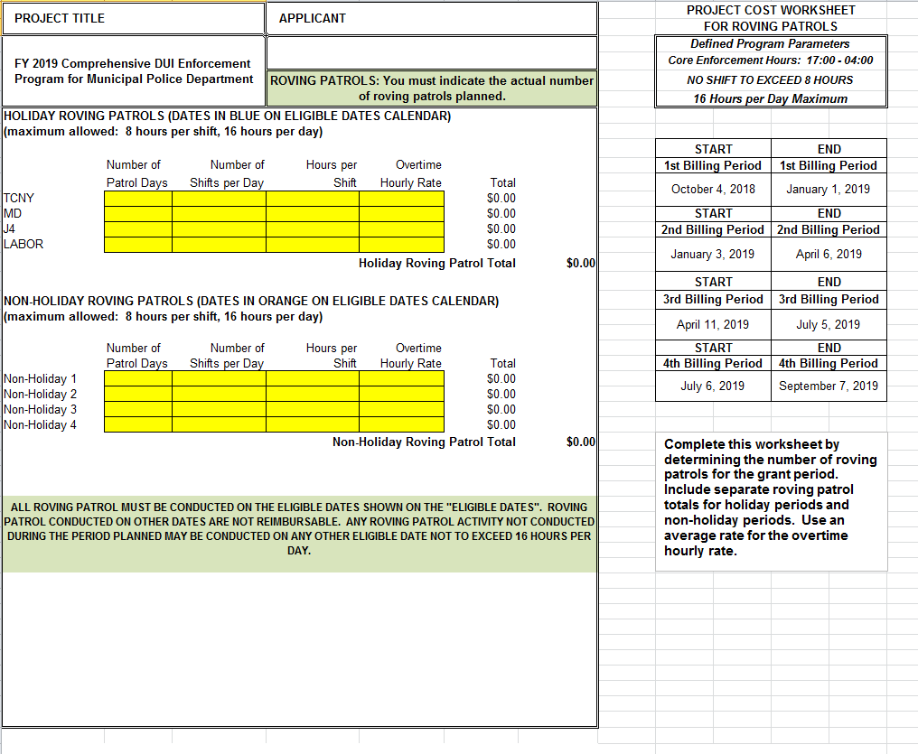
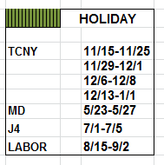
ROVING PATROLS-MUNICIPAL
ESTIMATE ROVING PATROL COSTS BY COMPLETING THIS WORKSHEET.

Slide 12
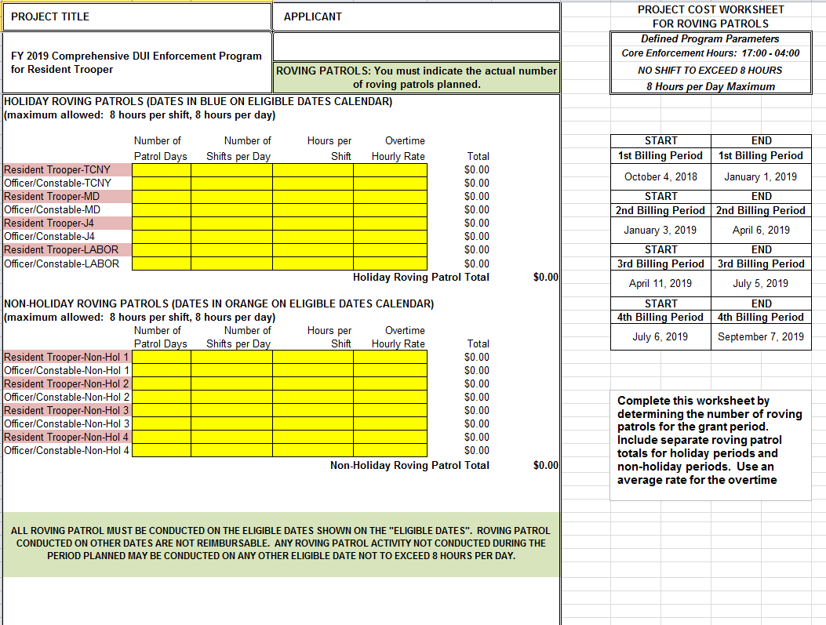
ROVING PATROLS-RESIDENT
ESTIMATE ROVING PATROL COSTS BY COMPLETING THIS WORKSHEET.

Slide 13
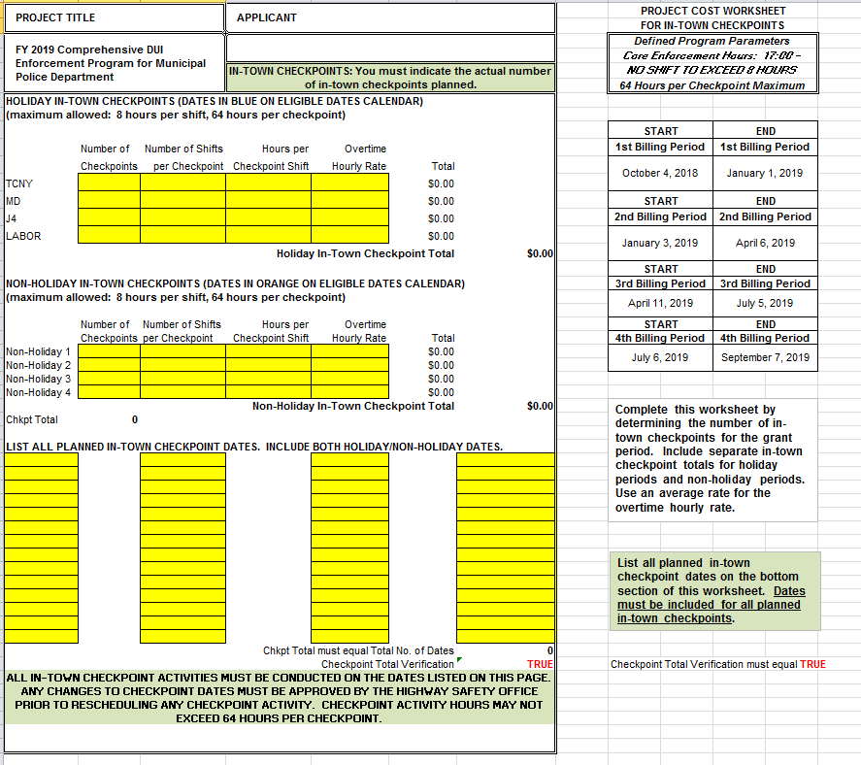
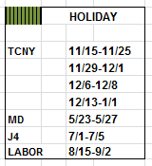
IN-TOWN CHECKPOINTS
(MUNICIPAL)
ESTIMATE IN-TOWN CHECKPOINT COSTS BY COMPLETING THIS WORKSHEET. CHECKPOINT DATES MUST BE INCLUDED.

Slide 14
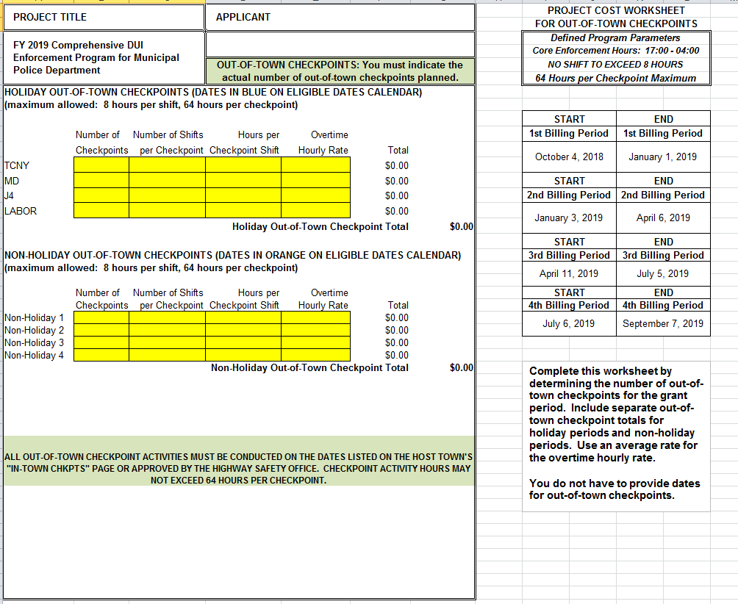
OUT-OF-TOWN CHECKPOINTS
(MUNICIPAL)
ESTIMATE OUT-OF-TOWN CHECKPOINT COSTS BY COMPLETING THIS WORKSHEET.

Slide 15
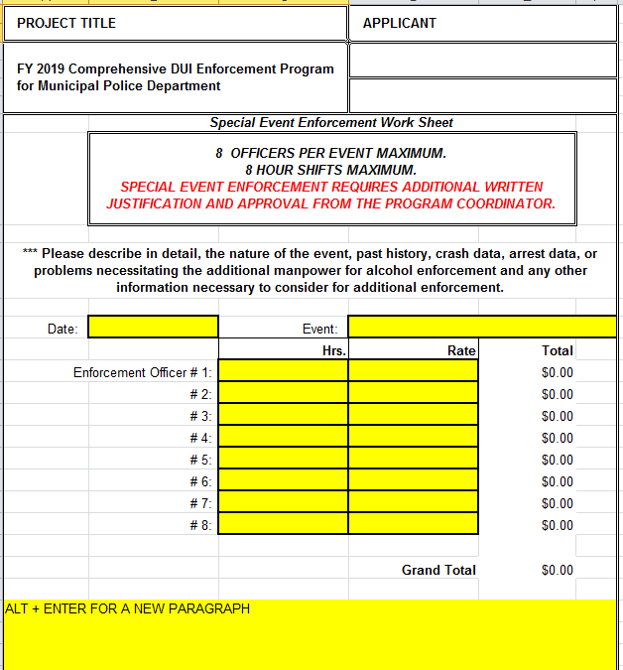
SPECIAL ENFORCEMENT
ONLY COMPETE THIS WORKSHEET IF REQUESTING SPECIAL EVENT ENFORCEMENT.

Slide 16
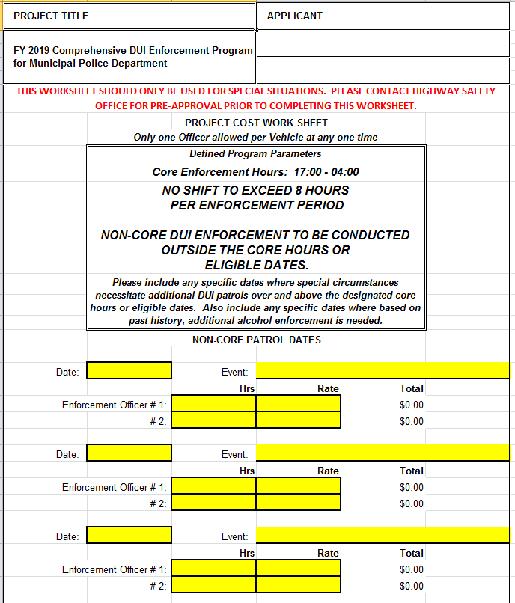
NON-CORE PATROLS
FOR SPECIAL SITUATIONS ONLY. DO NOT USE THIS WORKSHEET FOR EXPANDED DUI ENFORCEMENT ACTIVITY.

Slide 17
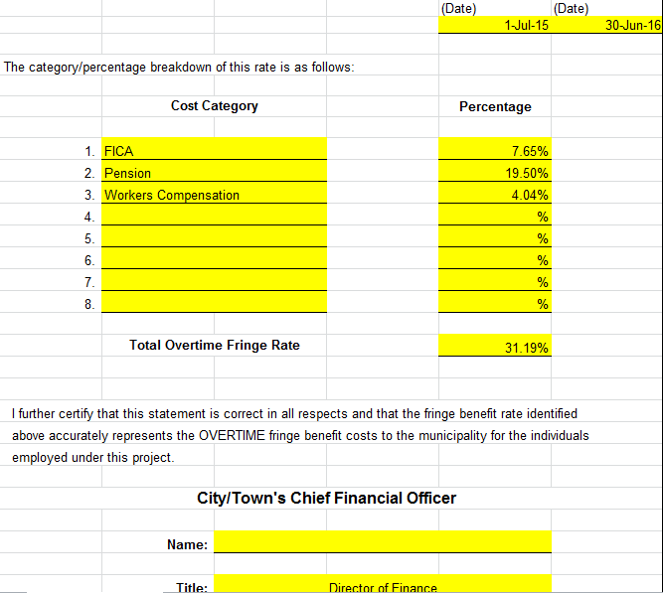
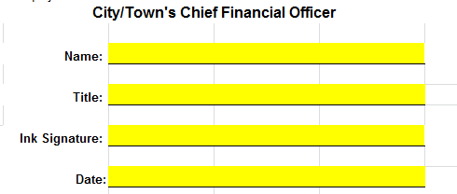



FRINGE BENEFITS
IF YOUR FB RATE CHANGES OR EXPIRES DURING THE FY GRANT PERIOD YOU MUST SUBMIT A NEW FB SHEET.
FRINGE RATE SHOULD BE THE SAME IN ALL HIGHWAY SAFETY GRANT PROGRAMS.
ITEMIZE

Slide 18
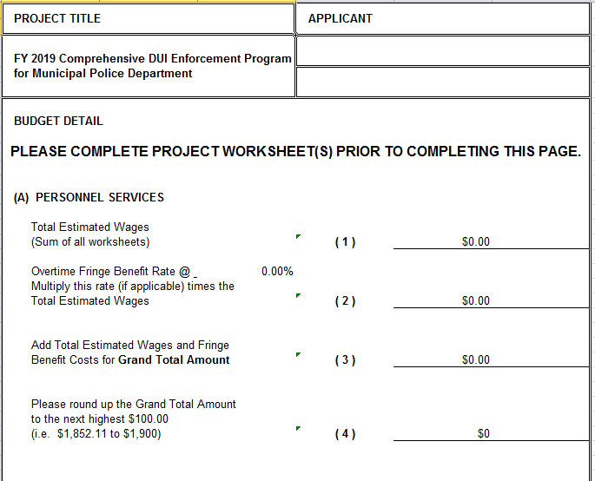

BUDGET-MUNICIPAL
AUTO POPULATES

Slide 19
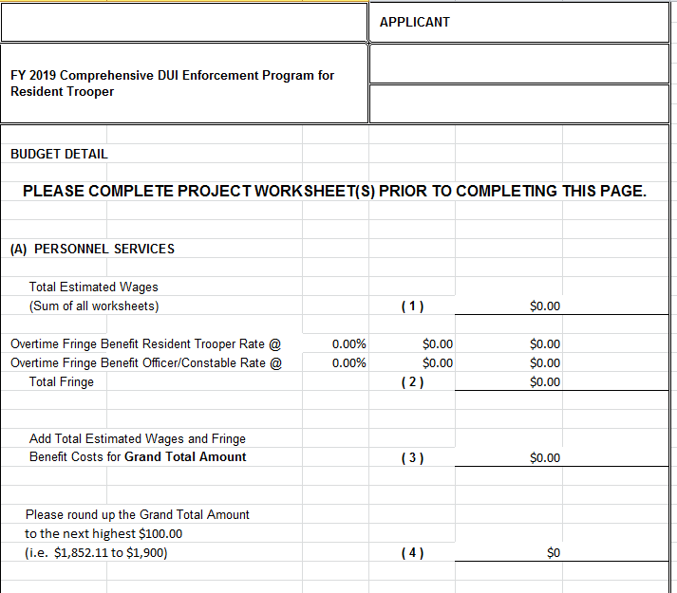
BUDGET-RESIDENT
AUTO POPULATES

Slide 20
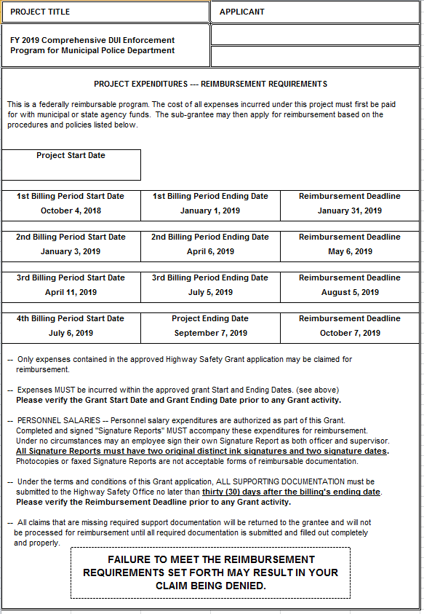
REIMBURSEMENT
IMPORTANT DATES …

Slide 21
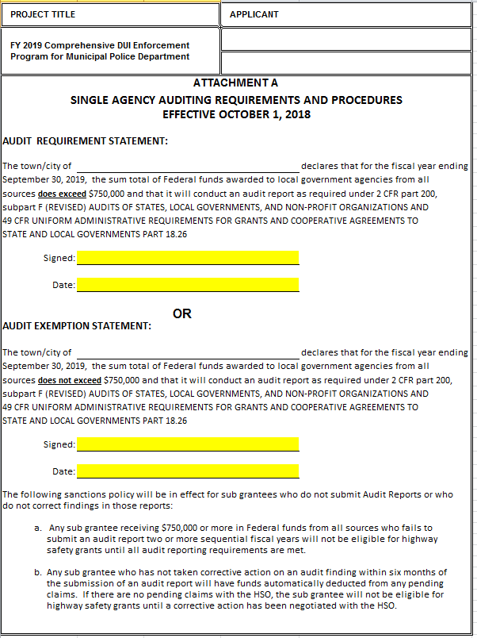

AUDIT REQ
DO NOT SIGN IN BOTH AREAS.

Slide 22
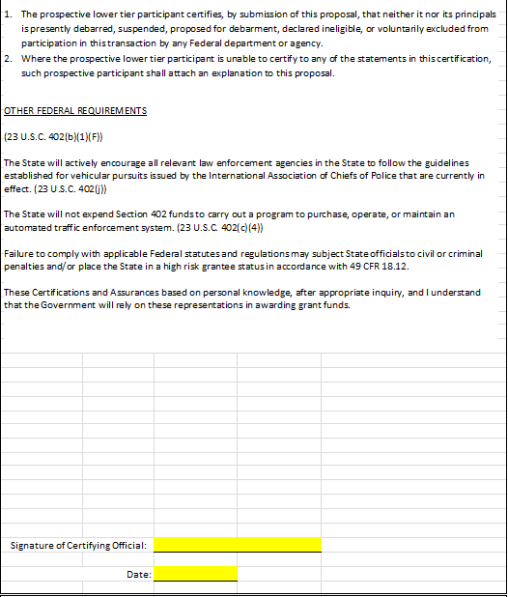

CERT ASSURANCE
BOTH SIGNATURE AND DATE ARE REQUIRED.

Slide 23
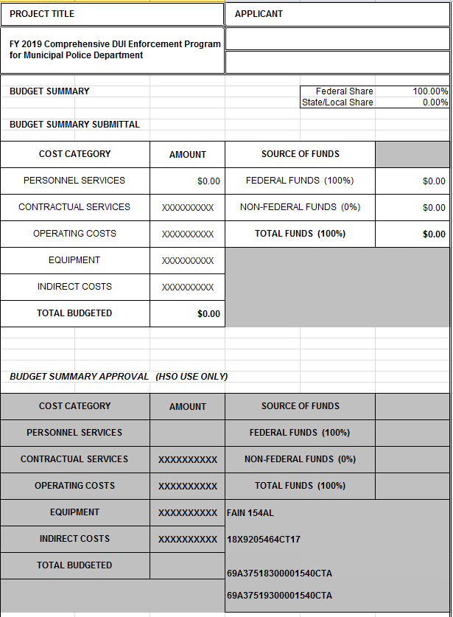


SUMMARY
25% TOWN MATCH IS NO LONGER REQUIRED.

