Slide 1
AASHTOWare Project Estimator Presentation
Introduction
Obtaining an Estimator user ID and password/ Log in
What’s new in Version 2.13a-1
Estimator set up
Opening a catalog
Creating an Estimate
Submittal into ProjectWise

Slide 2
Definition of Estimator
Estimator is an interactive, PC-based, stand-alone cost estimation system for highway construction.
Part of AASHTO Trns•port Suite
Many U.S. states use Estimator including:
  NY, Maine, Maryland, Ohio, Pennsylvania, Vermont, Virginia, and District of Columbia

Slide 4
What’s New in Estimator 2.13a-1
Global option “Catalog” tab added
Global option “Verifications” tab added
Global option “Numeric rounding” - Default now set to wT Precon settings
Agency users can now open estimates submitted by non-agency users without “wild card” user
Spreadsheet imports/exports now include estimate- level, item-level and extra data options

Slide 5

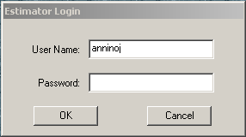
Estimator® Log In
Obtain User Id/Password
  Use e-mail link on Estimator Webpage
Click on the Estimator Icon
  Contact Helpdesk if no icon on desktop
Log in with the credentials that were supplied to you

Slide 6
CTDOT Estimator Webpage
*Estimator User Guide *
Templates
New Item request Form
E-Mail Address for Questions/Information/User Id-Password
Estimator Checklist
Navigation:
  http://www.ct.gov/dot/site/default.asp
  Navigate to “Doing Business with CONNDOT”
  Go to CTDOT AASHTO Trns*port Environment listed under the Engineering Resources
  Select Estimator

Slide 7
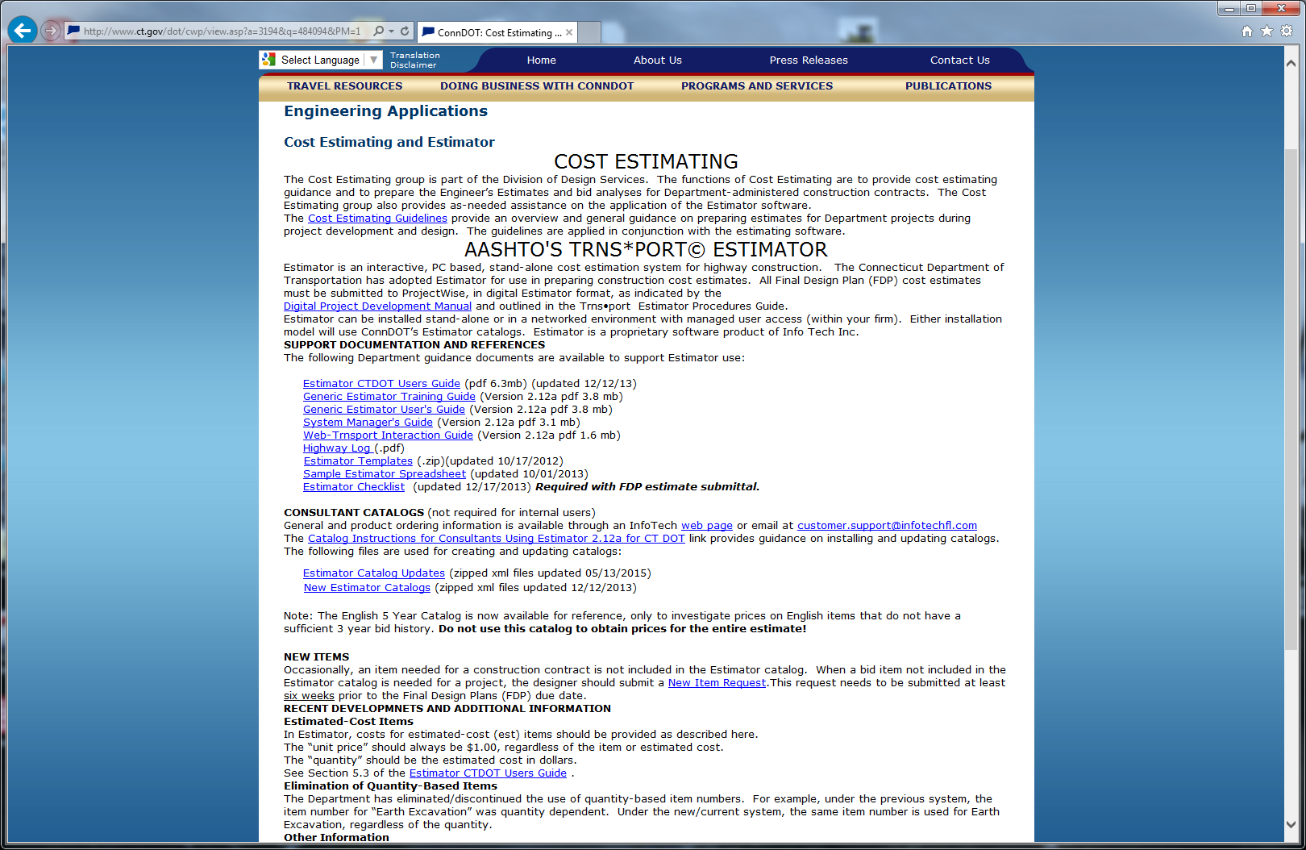

Slide 8
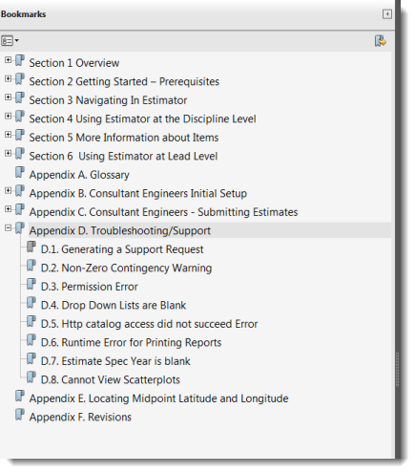
User Guide Contents

Slide 9
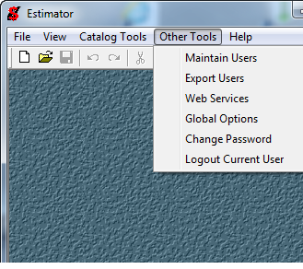
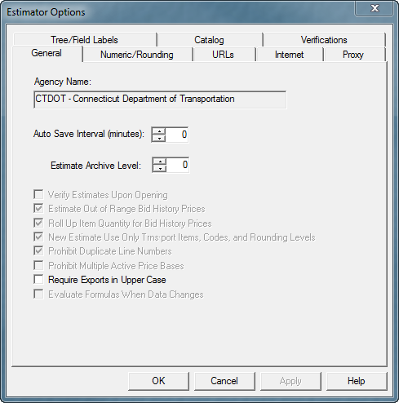
Global Options – General Tab
On the main menu, select Tools->Global Options

Slide 10
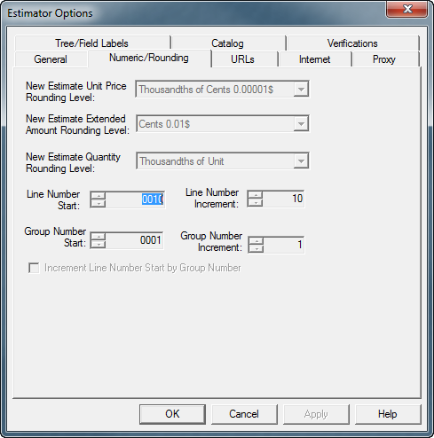
Global Options – Numeric/Rounding

Slide 11
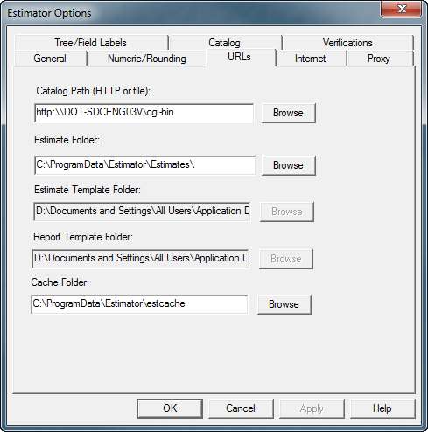
Global Options – URLs

Slide 12
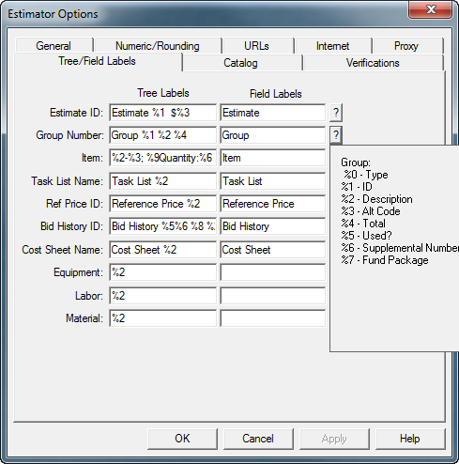
Global Options – Tree Labels

Slide 13
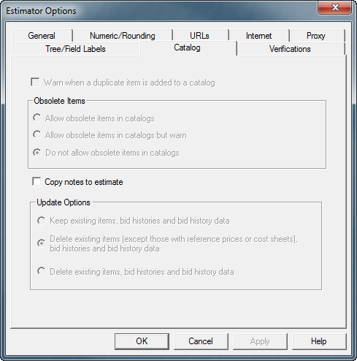
Global Options – Catalog

Slide 14
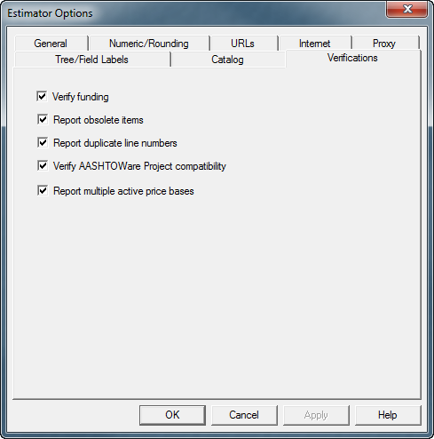
Global Options – Verifications

Slide 15
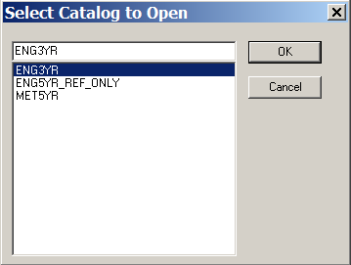
Open a Catalog
Catalog Tools>Open A Catalog or Switch Current Catalog
Select one of the following:
English 3 Year (ENG3YR)
Metric 5 Year (MET5YR)
English 5 Year (ENG5YR_REF_ONLY)
- Reference catalog for individual items only
- Do not use for entire estimates
Can open more than 1 catalog at a time – not recommended
Catalog updates will be done for in-house users by an Estimator Administrator on or about the first Wednesday of the month

Slide 16
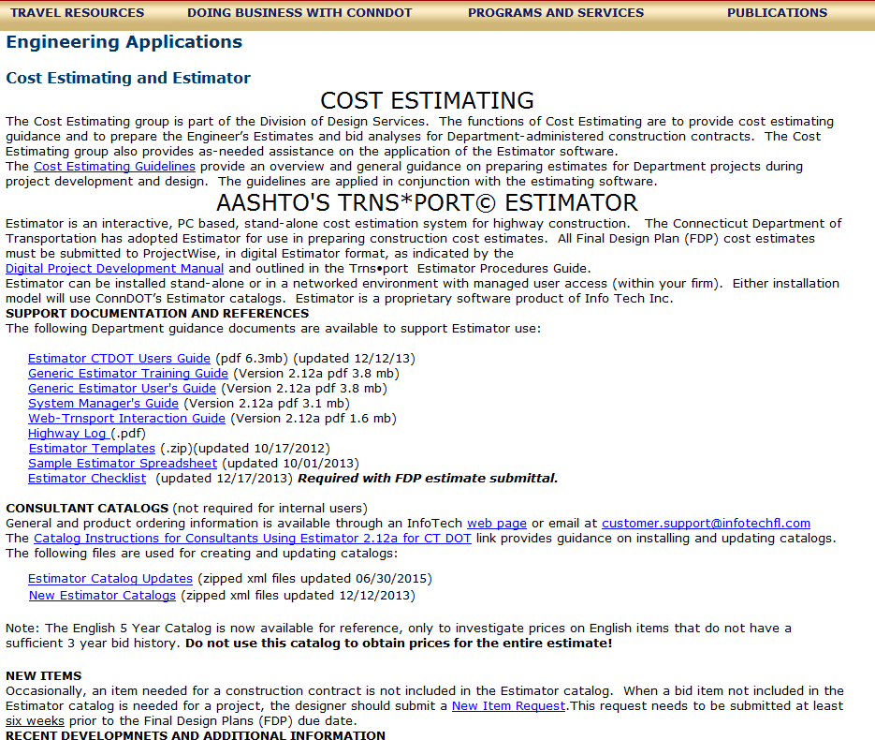
Catalog Items
New Item Requests
  Fill out “new item request”
  form on webpage & forward
  to Processing
  Must be requested at least
  six weeks prior to FDP

Slide 17
Creating An Estimate
Estimates are made up of an estimate header, a group list, and a group’s item list
Four ways to create:
  New Estimate: File>New
  Template: Download Templates,
  Open >Save As *.est
    Templates have the common items filled in
    Templates are located on the Estimator web page
  Import Excel spreadsheet
  Copy an existing project
Save Often!

Slide 18
Using Templates
Download template zip file from Estimator webpage
File>Import. Select template .xml file
Save
Add or delete items as necessary and update prices

Slide 19
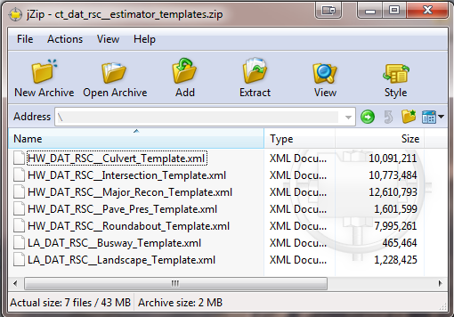
Templates
File>Import. Select template .xml file

Slide 20
Creating an Excel Spreadsheet for Import
Item numbers must be formatted as
text with leading 0’s
“A” items numbers replaced with
** See Special Provisions **
in Supplemental Description column

Slide 21
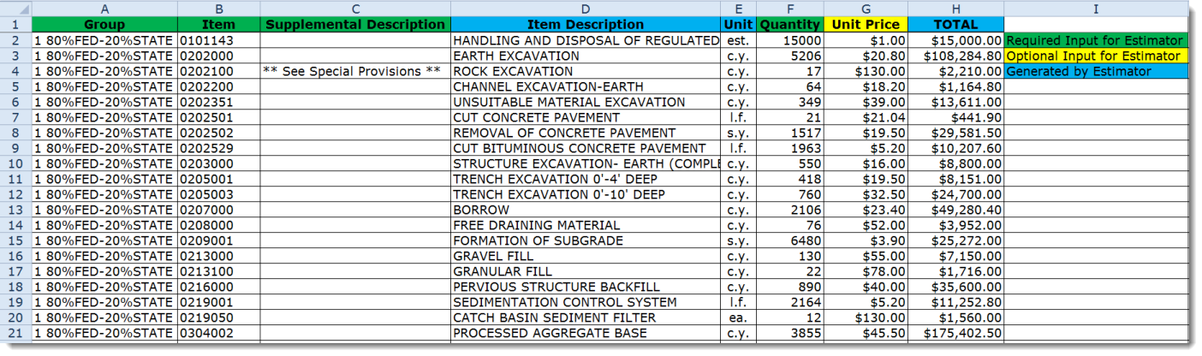
Sample Spreadsheet
CTDOT Estimator Webpage

Slide 22
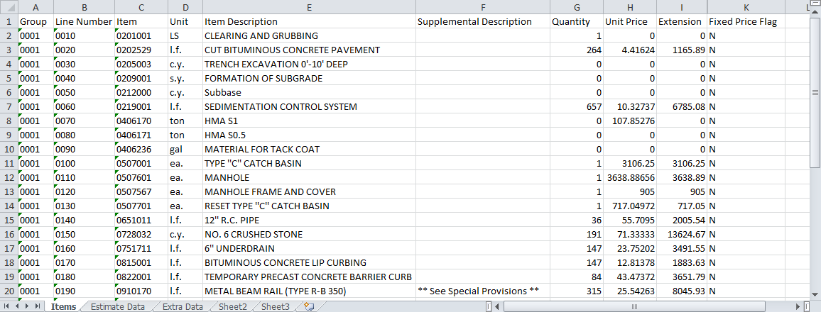
Spreadsheet Tabs
Items Extra Data
Estimate Data

Slide 23
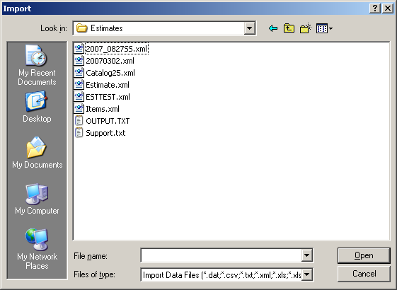
File Import
Import Dialog Box

Slide 24
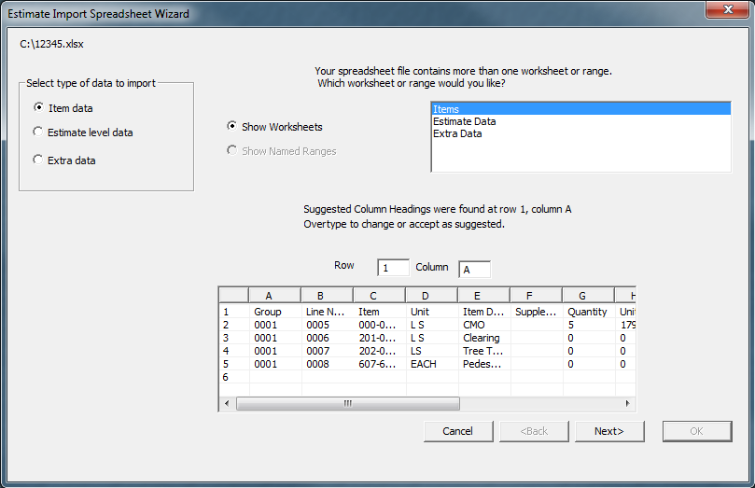
Estimate Import Spreadsheet Wizard
Importing “Item-Level” Data

Slide 25
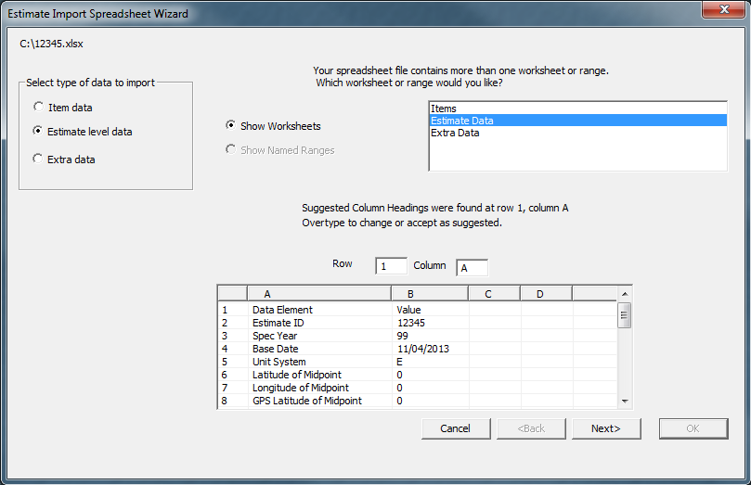
Estimate Import Spreadsheet Wizard
Importing “Estimate-Level” Data

Slide 26
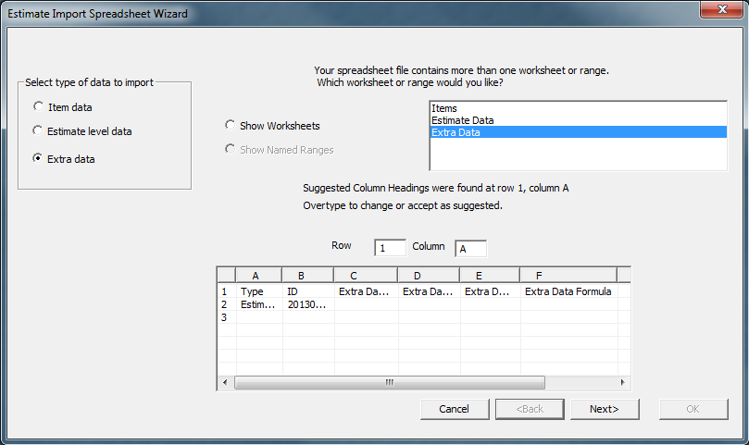
Estimate Import Spreadsheet Wizard
Importing “Extra Data”

Slide 27
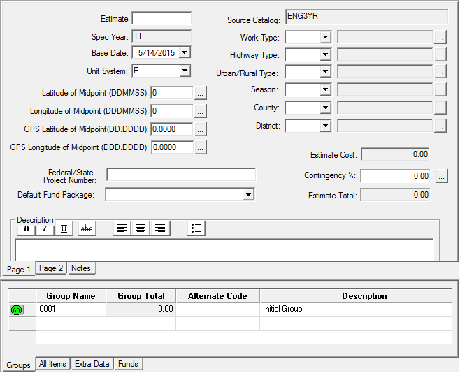
Project Header Information
Important – Information entered (or not entered) in this area may have a significant impact on total cost.
Fill out completely & accurately as possible!!

Slide 28
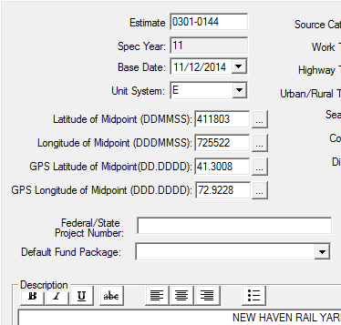
Header Information
Estimate ID – Project number
Spec Year – 11 for English, 10 for metric
Automatically sets Base Date – must be reset to anticipated Letting date
  If Letting date not known, use FDP date + 70 days
Unit System – English or Metric
Latitude/longitude of Midpoint – Google Earth
  GPS latitude/longitude of midpoint fields are the decimal degree (DD:DDDD) equivalents of the latitude/longitude of midpoint fields. These fields fill in automatically.
Federal/State Project Number – Use Federal Aid Project (FAP) number if known; otherwise leave blank
Default Fund Package – Not being used (Leave blank)
Description – Same as project title

Slide 29

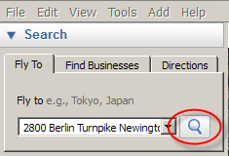
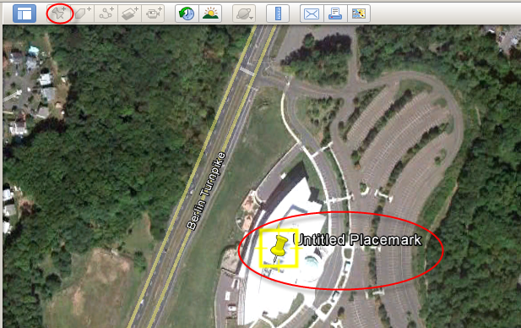
Obtaining a Midpoint (Lat/Long) for Project
Open Google Earth
Type address in search box
Add a placemark

Slide 30
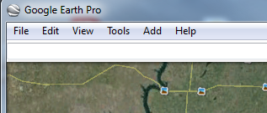
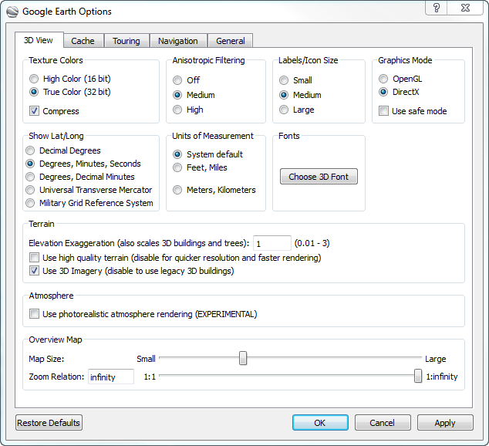
Tools>Options
3D View Tab
Default setting

Slide 31
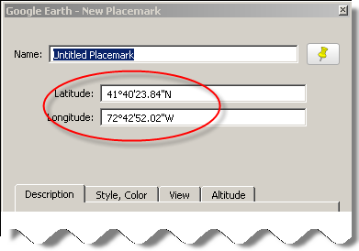
Obtaining a Midpoint (Lat/Long) for Project continued
Center the placemark within the project limits.
  Note the latitude and longitude of the midpoint of the project – round to nearest second

Slide 32
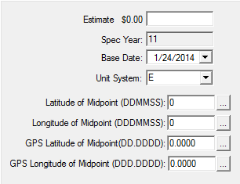
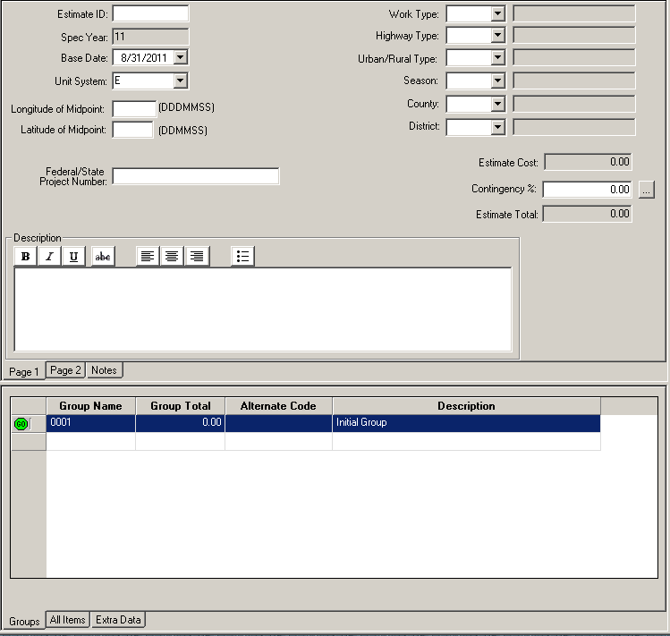
Obtaining a Midpoint (Lat/Long) for Project continued
Enter the coordinates (lat/long) in the Estimator project header
The GPS lat/long of midpoint fields are the decimal degree (DD:DDDD) equivalents of the lat/long of the midpoint fields. These fields fill in automatically.

Slide 33
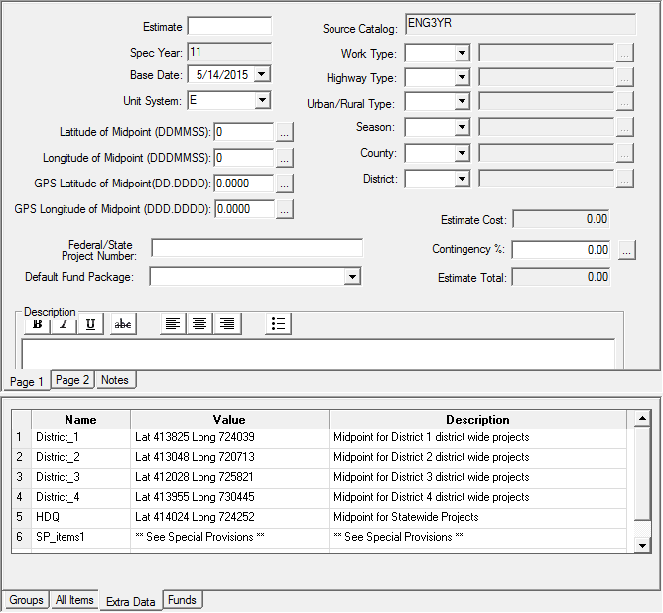
Header Information

Slide 34
Header Information Continued
Work Type – Selection based on the work of the “most costly” items
Highway type – based on Functional Classification (Highway Log – link on Estimator webpage)
Urban/Rural Type (Highway Log)
Season – Season of the letting date (should coincide with base date)
  Fall (9/21 – 12/20)
  Spring (3/21 - 6/20)
  Summer (6/21 - 9/20)
  Winter (12/21 - 3/20)
County – Town, Statewide, District wide, Unknown
District – (1, 1A, 2, 3, 3A, 4, HDQ)
Contingency – Done at lead level, list in notes section
  Using Contingencies for inflation
Description –same as project title

Slide 35
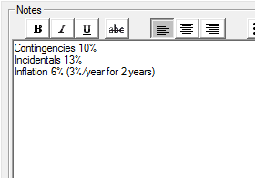
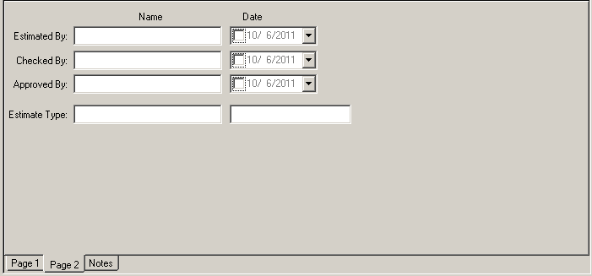
Header Information Continued
Estimated by – automatically filled with User ID
Checked by – Optional
Approved by – Optional
Estimate type – Scoping, 30%, 60%, 90%, Final, Addendum, change order, other
Notes page – list contingency/incidental percentages breakdowns/inflation; other notes
User ID

Slide 36
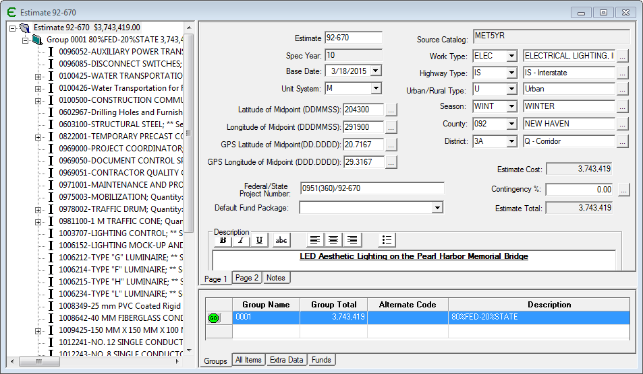
Estimator Windows & Views
Estimator displays catalogs and estimates in windows
  Can open several estimates at a time
  Arrange windows (cascade or tile)
Tree View vs. Grid View
Tree
View
Grid View
Grid View

Slide 37
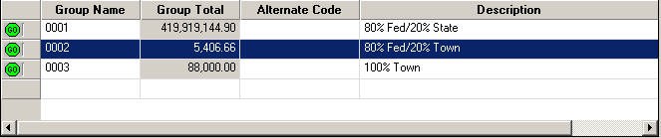
Groups
Groups are based on funding source
  Add a description to each group – this field required
Each group can have an unlimited number of items
To add a group, select “Add Group” from the Edit menu
Group Descriptions

Slide 38
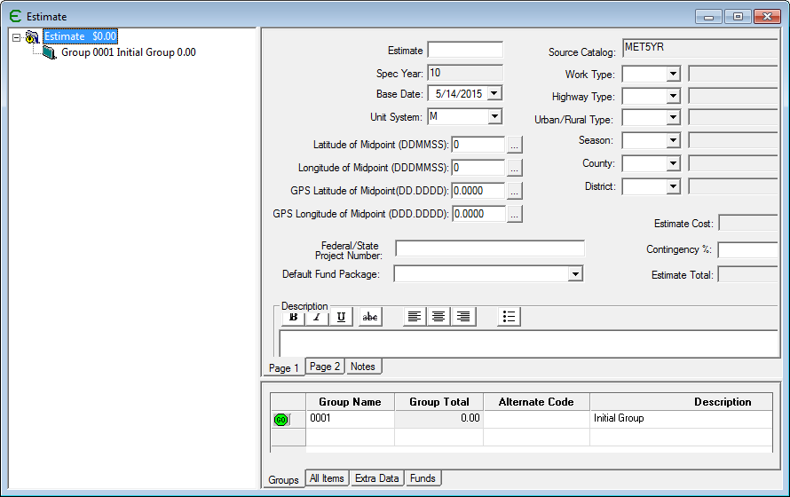
To expand on a group, Click on GO

Slide 39
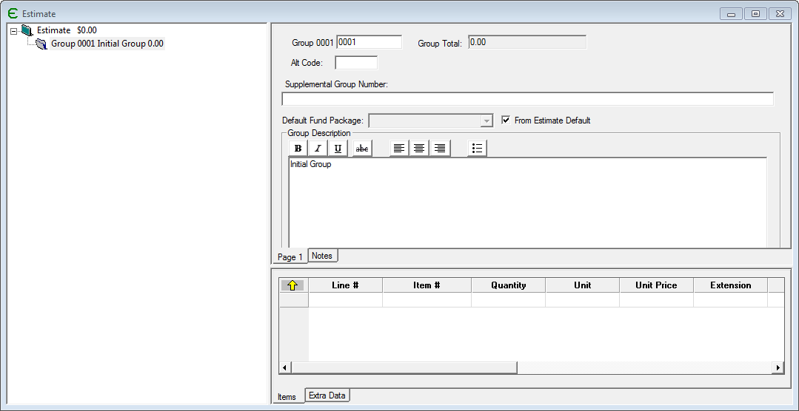
Group Header
List the items for each group. Click on the yellow up arrow to go back to all groups.

Slide 40
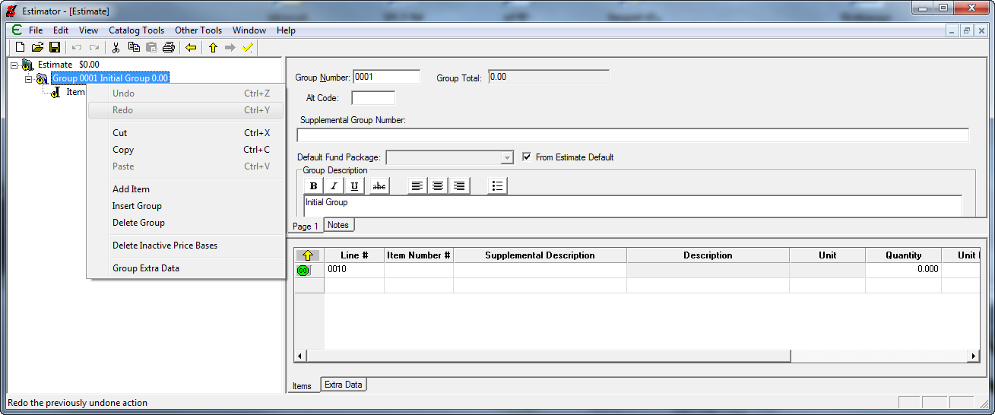
Items
Adding Items
  From Tree View
  From Grid View
  From All Items
  Using Go Button
  Drag and Drop from Catalog
(Tree view)
Right click and select “Add Item”
(Grid view)
Type in item number(with leading 0)
or use drop down list

Slide 41
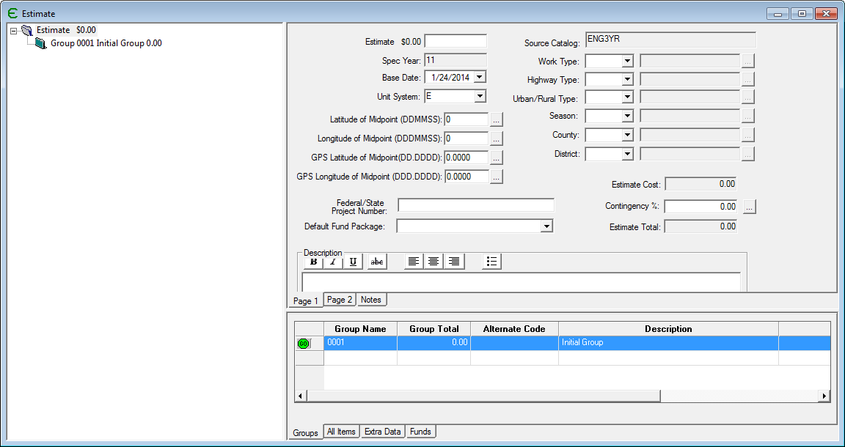
Items Continued
All Items Tab
Highlight
Estimate
Go Button
Select All Items Tab

Slide 42
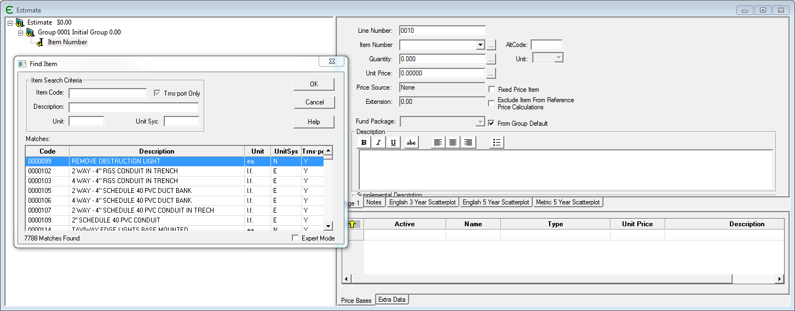
Items Continued
Find Item Button

Slide 43
ITEM Properties
Item Properties
  Line Number
    Code used by other Trns*port software
  Item Number
  Supplemental Description
    Old “A” items
  Description
  Unit
  Quantity

Slide 44
ITEMS Properties Con’t
  Unit price – cost of one unit of item
    Determined by the estimator or calculated from a cost sheet, bid history or reference price
  Extension – Unit price X Quantity
  Alt Code – if item is part of an alternate item list
  Price Source
    None – no active price basis
    Multiple – more than one type of active price basis
    Cost Sheet – based on equipment, labor and materials
    Reference Price – based on quotes or percentage
    Bid-based Price – based on historical bids
    Price Basis list
    Ad Hoc – entered by user

Slide 45
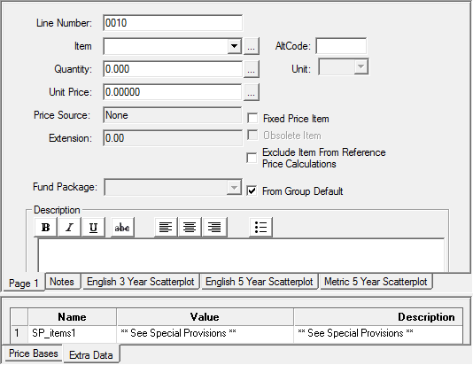
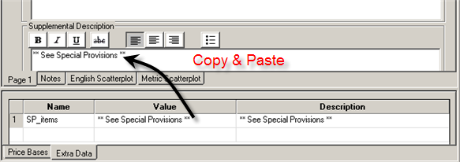
Special Provisions
Former Special Provision item designation was “A”
  Current notation for Special Provision items is “** See Special Provisions **”
  Added in the Supplemental Description

Slide 46
Reference Prices and Percentages
Check Exclude Item From Reference Price Calculations
Add Reference Price
Add Reference Price ID name, Check Percentage and enter % amount

Slide 47
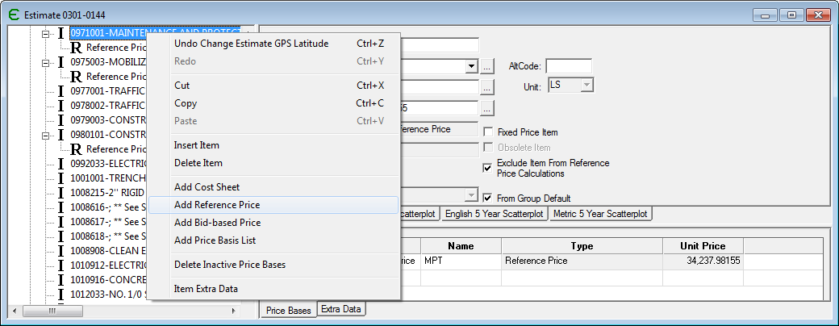
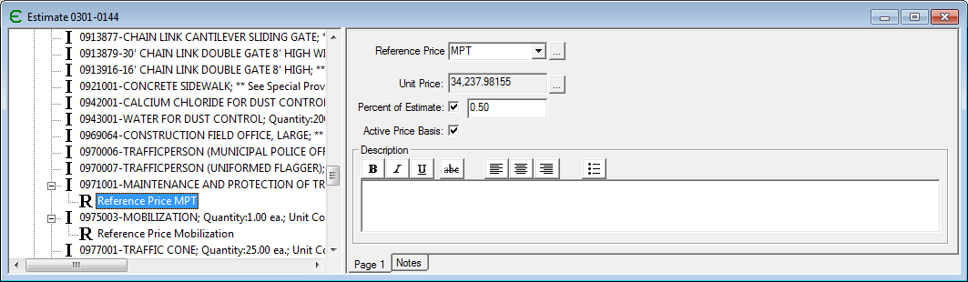

Slide 48
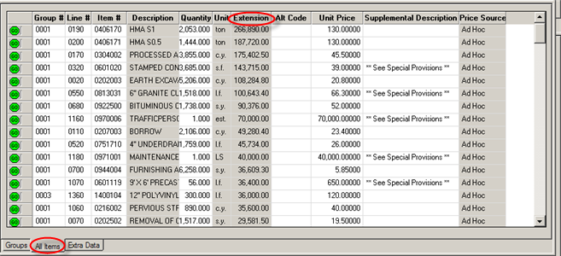
Sorting Items
Highlight Estimate in Tree View and select All Items tab
Sort by selecting any column heading
This example was sorted by Extension

Slide 49
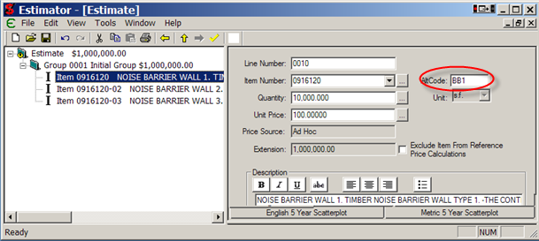
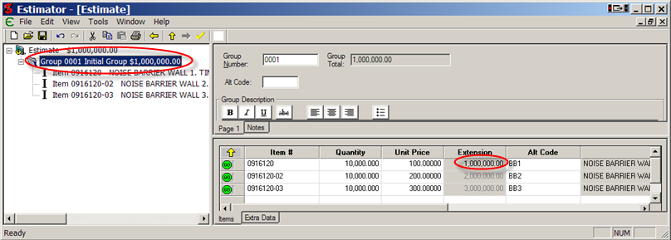
Alternate Items
Alternate items – bidder bids on one alternate
Can have alternate items or alternate groups

Slide 50
More on Pricing
Bid Based Prices – Estimator puts updated bid histories of items at users fingertips.
Ad hoc
Updating prices

Slide 51
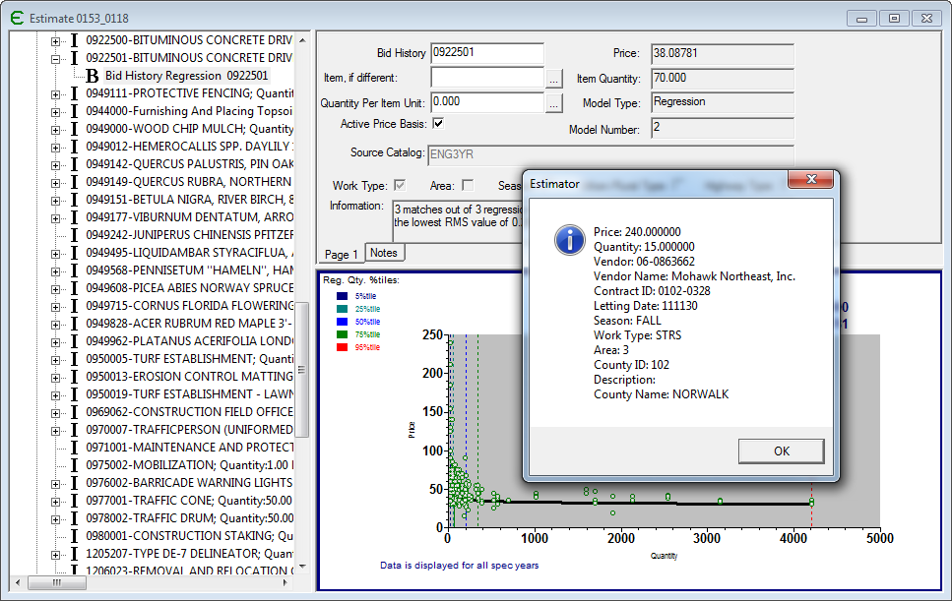
Estimator Pricing
Bid History Regression

Slide 52
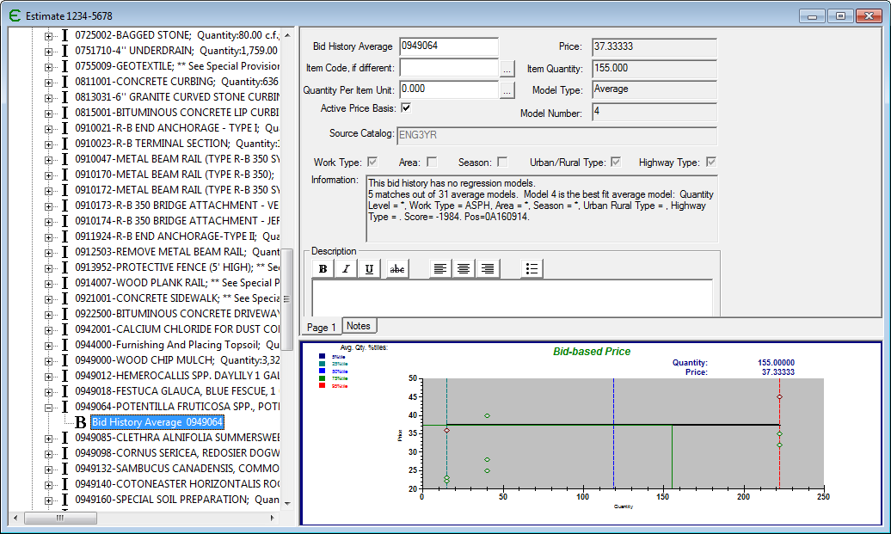
Estimator Pricing
Bid History Average

Slide 53
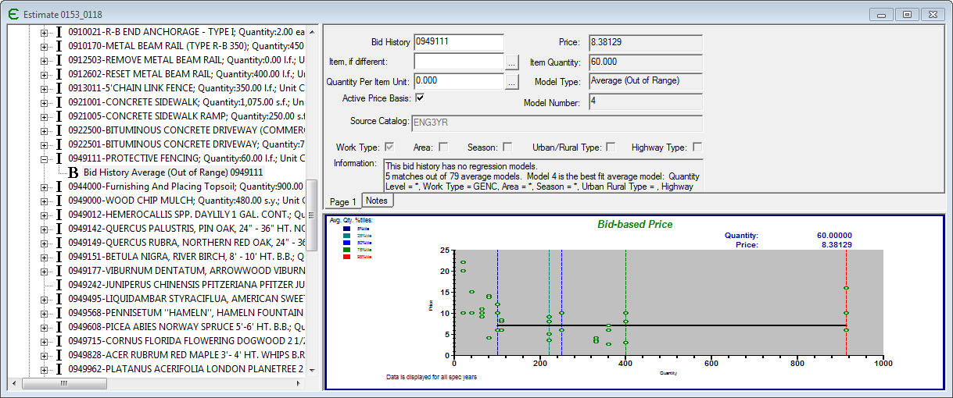
Estimator Pricing
Quantity out of range

Slide 54
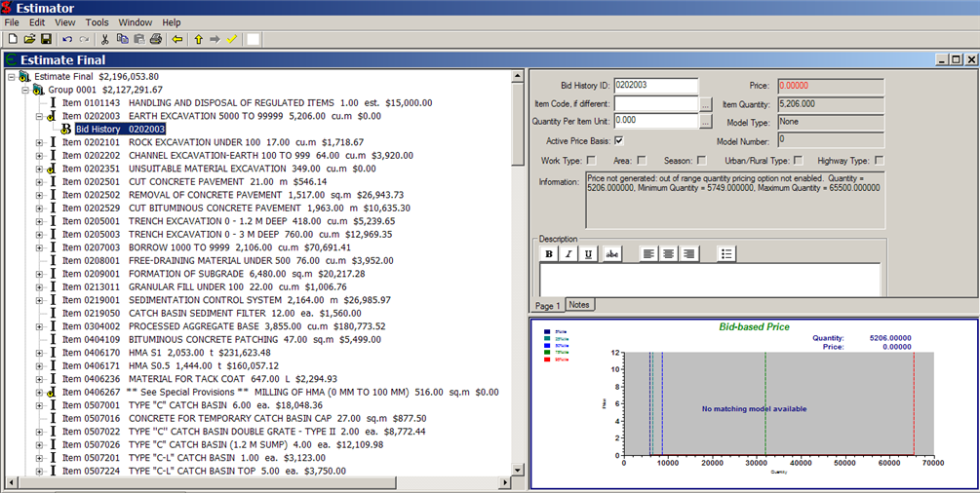
Estimator Pricing
No History Available

Slide 55
Updating Prices
Pricing Updates are done when:
  Catalogs are updated
  Estimate imported from Excel spreadsheet or template
Can be done at
  Estimate Level
  Group Level
  Item Level
Must be initiated by the user - not automatic

Slide 56
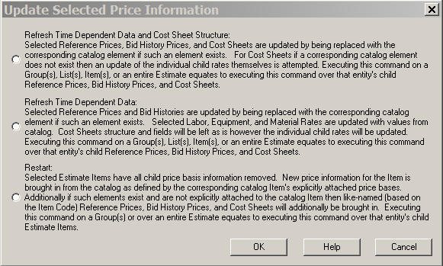
Updating Prices Continued
Highlight Estimate, Group or Item
Select Edit> Update Price Information
Detailed description in User’s Guide

Slide 57
Item Reports
Must be run by Estimator administrator or Processing
Provides specific information on an item’s history
  Project Numbers
  Bid History

Slide 58

Example Report

Slide 59

Final Estimate Submittal at FDP
Log into ProjectWise
  Projectwise ID/Password
  Julie.Annino@ct.gov
  (860) 594-2730
Follow the steps
outlined in Section 6.8
of Trns•port Estimator
Procedures Guide

Slide 60
Contact Information
Email at: DOT.TrnsPortEstimator@ct.gov
Ron Tellier
  Ronald.Tellier@ct.gov
  (860) 594-3285
Kathy Zimmerman
  Kathleen.Zimmerman@ct.gov
  (860) 594-3326
Julie Annino
  Julie.Annino@ct.gov
  (860) 594-2730

