Slide 1

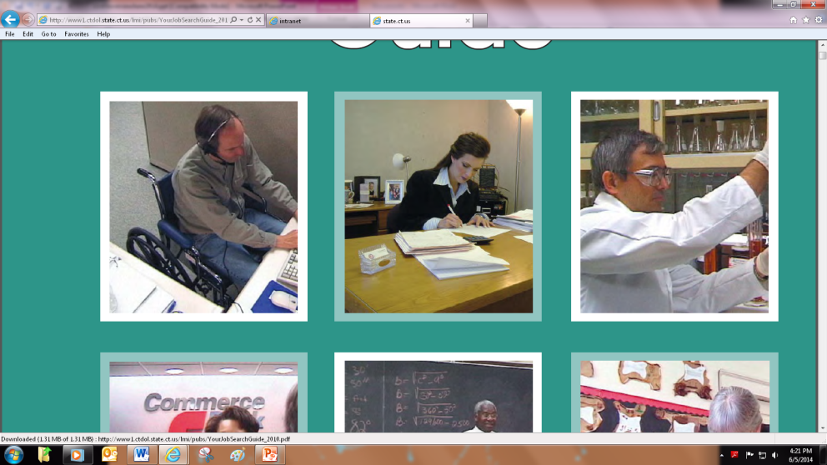
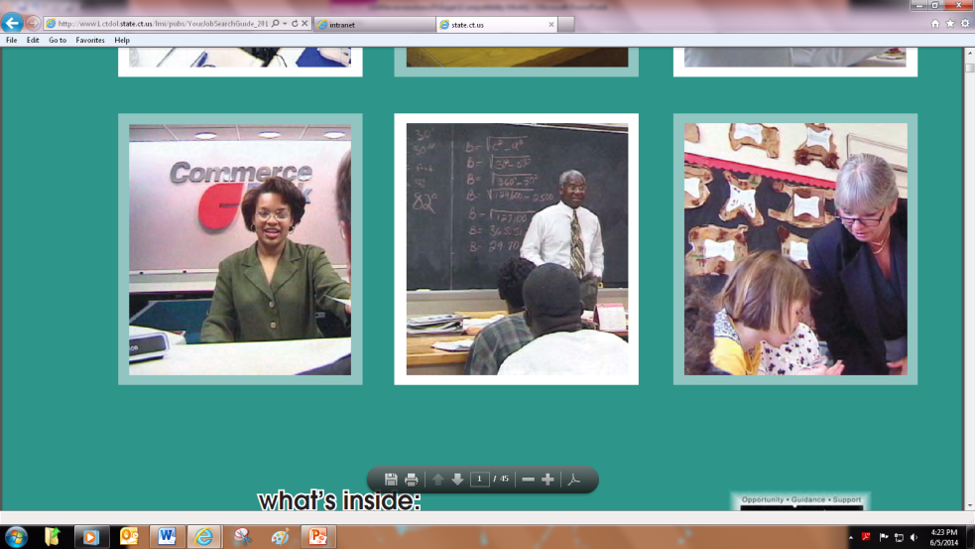

The Office of Apprenticeship Training

Slide 2

What is apprenticeship?
Earn while you learn
Combination of on-the-job
learning (OJT) and related
instruction (RI)
Minimum of 2,000 hours of OJT
and 144 hours of RI

Slide 3

What is an apprentice?
Employed full-time by a company
Registered with the DOL Office of
Apprenticeship Training (DOL OAT)
Minimum of 16 years of age
Follows an agreed upon work schedule between the company and DOL OAT

Slide 4

Apprenticeship is right for your company….

Slide 5
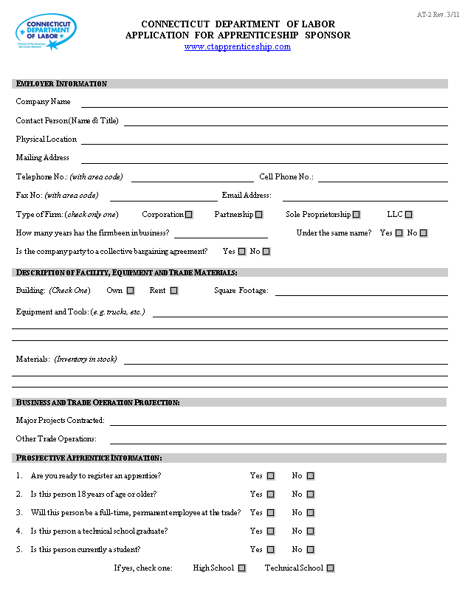
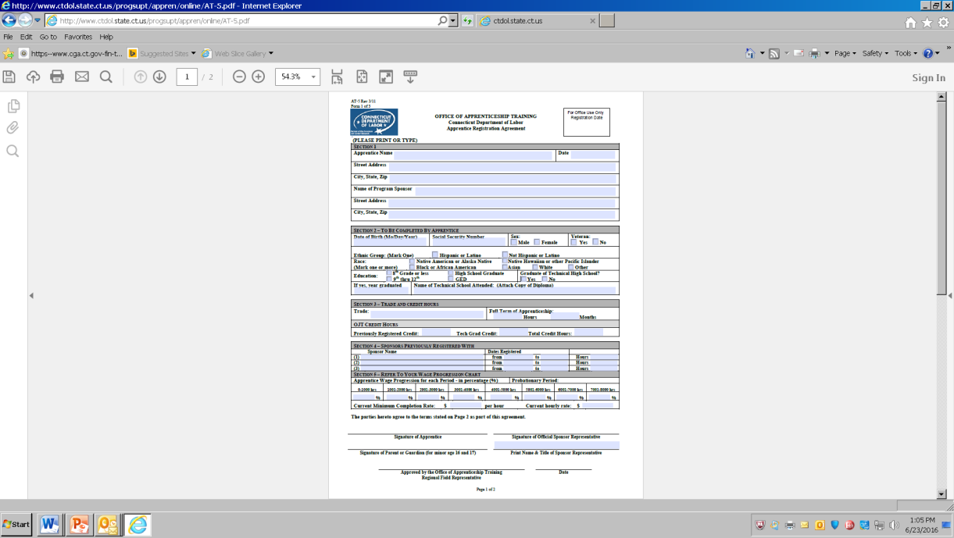
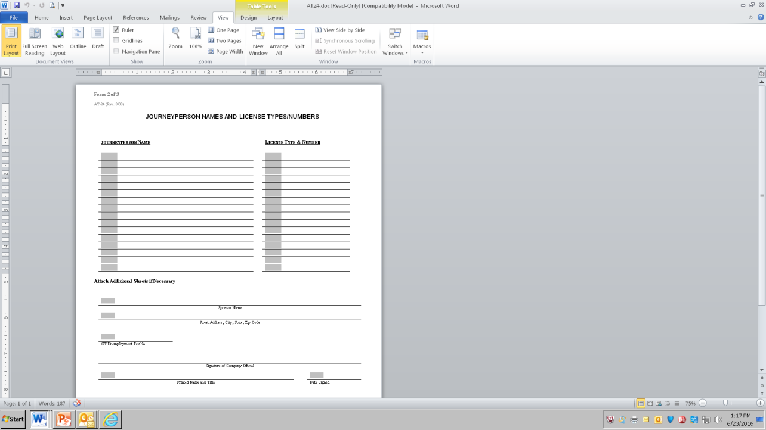
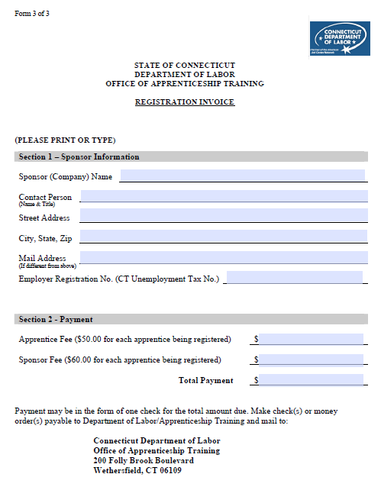
Registration Packet
Form | Name
AT-2 | Application for Apprenticeship Sponsor (company)
AT-4 | Wage Progression Scale
AT-5 | Apprentice Registration Agreement
AT-24 | Journeyperson List (skilled employee(s))
 | Registration Invoice

Slide 6

Office of Apprenticeship Training
Assure programs provide quality training and produce skilled workers
Provide guidance and support to sponsor companies and registered apprentices
Issue nationally recognized Certificate of Completion

