Slide 1








Your Pathway to a Great Career
Trade Adjustment Assistance
Notes:
Good morning/afternoon and welcome to the presentation on The Trade Adjustment act and all its benefits. My Name is _______________________________________ and I am the _______________________ for the CT Department of Labor TAA program.
If you are on your computer please take a minute to get comfortable with the ZOOM meeting program.

Slide 2
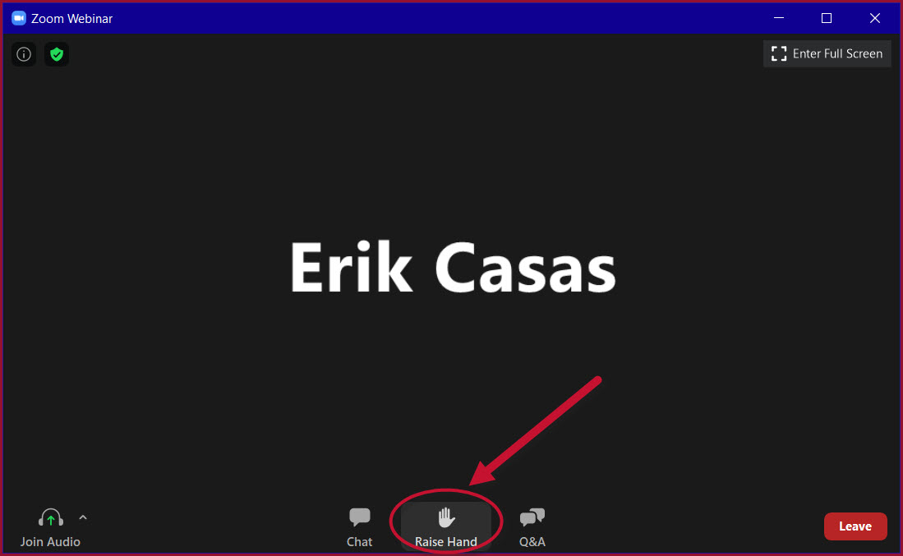
Navigating Zoom
Notes:
You will notice at the bottom center of your screen there are three icons, Chat, Raise Hand, Q&A.
Feel free to Chat a question to the group by clicking on chat
You can use the Q& A to ask a question of the presenters
You will notice at the bottom center of your screen there are three icons, Chat, Raise Hand, Q&A.
Feel free to Chat a question clicking on chat and typing in your question. If you would like to ask a question verbally, please click on the Raise Hand Icon
Please make sure to keep your microphone on Mute during the presentation

Slide 3

Notes:
Over the next 45 minutes we are going to do our best help you understand the TAA program. The program is very complex and detailed.
Our main goal is for you to retain the most important features of the Program and procedures that need to be followed to access the services.
Try not to be distracted by your cell phone, television, pets, etc…
Let’s focus on the information presented!

Slide 4
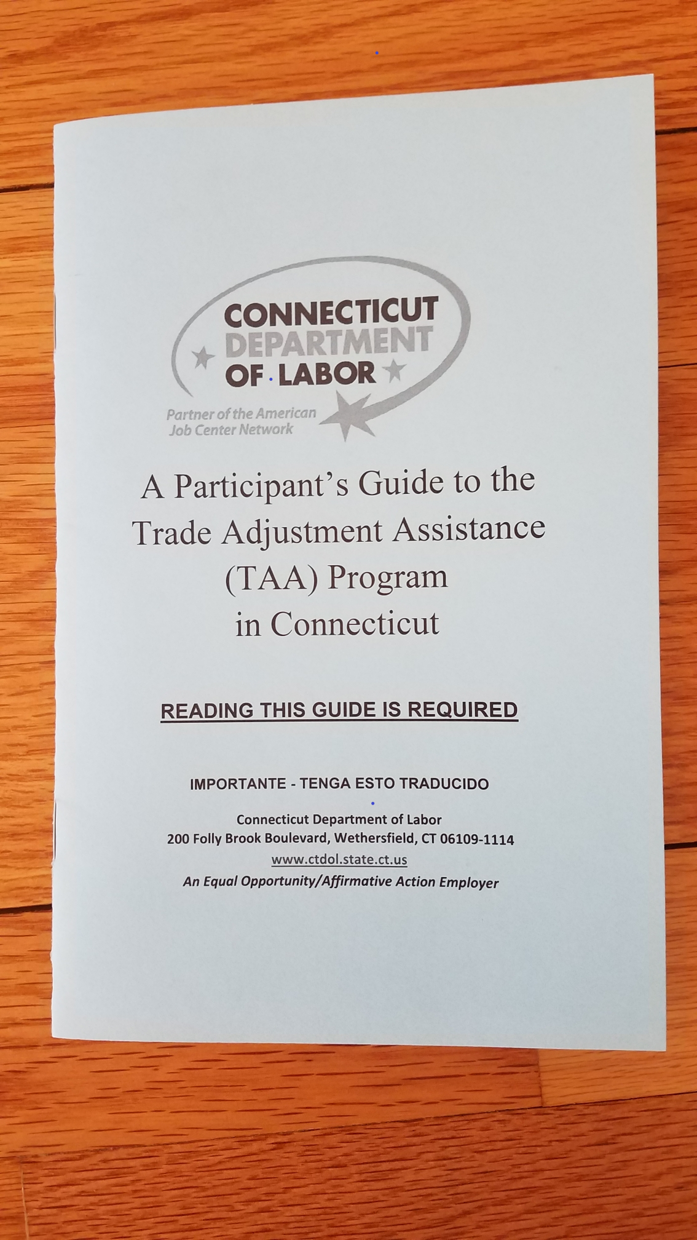
The Nuts and Bolts
Trade Adjustment Assistance (TAA) ** Trade Readjustment Allowance (TRA)
Notes:
Throughout the program we will be referring to pages in the supplemental materials you will receive in the mail once you complete your application and receive your official determination in the mail for benefits. The booklet is also available on-line through our website.

Slide 5

What is TAA?
Federal Employment Program administered by the CT Department of Labor
Only available to eligible workers who lost their job due to foreign trade or in danger of being totally or partially separated.
Notes:
US Department of Labor sponsors and funds the program and CT DOL administers it in our state.
All the regulations are governed by the Federal Government.
In order to be eligible, you must be part of a worker group certified in the TAA certification by the US DOL. Your position must have been lost or will be lost due to foreign trade and you must have worked for a manufacturing company.

Slide 6

Program Goal
Return to
“Suitable Employment”
Equal Skill Level
80% of Last Wage
Notes:
The main goal of the program is to return to suitable Employment.
Suitable employment is defined as work that is equal to or of a greater skill level of your Trade-impacted job and pays at least 80% of what you were being paid at that job.
***Or if you relocate out of state, the job must pay at least 75% of national wages as determined by the National Occupational Employment Wage Estimates.

Slide 7

What are the Benefits?
Reemployment Services
Trade Readjustment Allowances (TRA)
Job Training
Notes:
There are a variety of robust benefits that may be accessed to help you obtain your reemployment goal.
We will discuss the main 7, which are…
(Read the slides)

Slide 8

What are the Benefits?
Reemployment Trade Adjustment Assistance (RTAA)
Relocation Allowances
Job Search Allowances
Healthcare Premium Tax Credit ( if available)
Notes:
(Read the slides)

Slide 9

TAA Benefits
Let's take a closer look
Notes:
Let’ s break down each of the benefits in greater detail

Slide 10

Reemployment Assistance
Career Assessments
Career & Employment Planning
Job Search Skills Workshops
WIOA Co-enrollment
American Job Center
Services
Notes:
Reemployment Assistance is the first step of the program as you will need to look for work and see if there is suitable work available. You will be assigned a TAA Counselor, together you will develop a reemployment plan. Your plan may include a variety of services including the ones listed on this slide.
You may explore your interests and skills through career assessments and other resources to see what opportunities you may want to pursue.
Looking for work has changed over the years, you may need to update your resume to the latest format or attend some job skills workshops.
You will be co-enrolled with the Workforce Innovation and Opportunity Act or (WIOA). WIOA offers additional services that may be included in your reemployment plan.
Your local American Job Center is available to any job seeker and offers Employer recruitments, Veteran Services, and self-service resource centers such as access to computers, copy and fax services.

Slide 11

Trade Readjustment Allowance
(TRA )
Financial Support while in
training
Continuation of your Unemployment Compensation Weekly Benefit Rate
Up to 130 weeks of benefits while in training (if qualify)
Notes:
Trade Readjustment Allowance provides you with income support while you are in FULL TIME TRAINING. In certain situation you may be eligible for TRA if you choose not to attend training but apply for the program by the outlined eligibility dates on your determination letter.
Your weekly payments are based on the weekly UI rate you have already received (or will receive when you file)
You could possibly receive 130 weeks of income support if you are in a training program that lasts that long. Or the additional 26 weeks if you do not attend training.

Slide 12
TRA Eligibility
Covered under a TAA Certification
Had at least 26 weeks of employment with the company at wages of $30 or more per week in your trade impacted employment, prior to your layoff
Must be enrolled in training or waived from participating in training, or have met application deadline. (basic TRA only)
Notes:
To be eligible for TRA payments, you must be covered under a TAA certification and have had at least 26 weeks of employment at wages of $30 or more per week prior to your layoff and be enrolled in training or waived from participating in training due to certain conditions. We will explain this in more detail in a few minutes.

Slide 13
Applying for TRA Benefits
Apply for TRA benefits through www.reemployct.com
There are application deadlines associated with receiving the additional income support payments
Do not delay in filing.
Notes:
You will receive a “Notice of Potential TAA Eligibility letter in the mail from the CT Department of Labor. As soon as you receive the letter, you must file an application for TRA benefits through www.reemployct.com

Slide 14
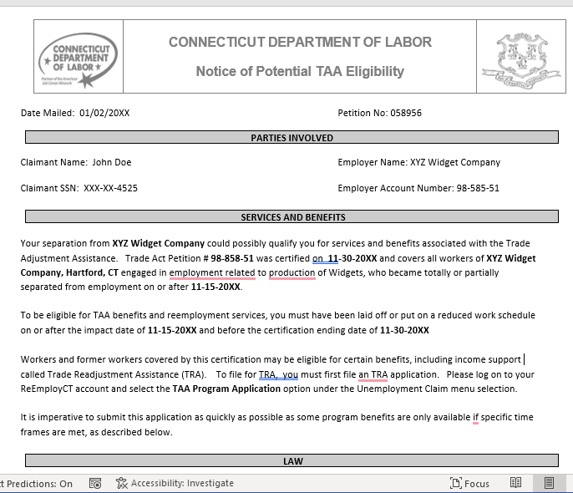
Invitation to Apply
Notes:
This slide shows what your invitation to apply for TRA additional income support looks like; you will receive this in the mail when you apply for unemployment. Please let us know if you did not receive this letter. We will go through the steps to apply for the TRA, the income support portion of the program.

Slide 15
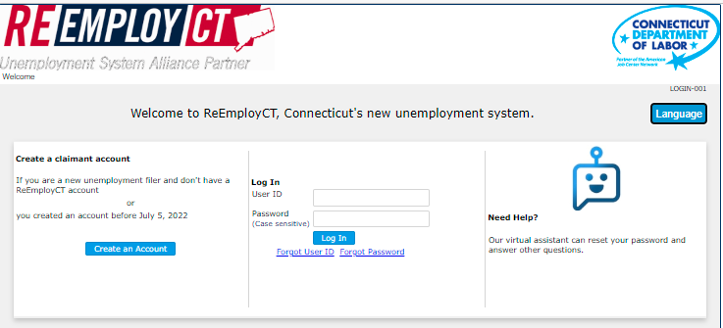
Log in with your
User ID and Password
Notes:
In order to apply for TRA, you must have filed for Unemployment Benefits already and received an invitation to apply. Sign into the reemployct website with the credentials you use to manage your unemployment claim.

Slide 16
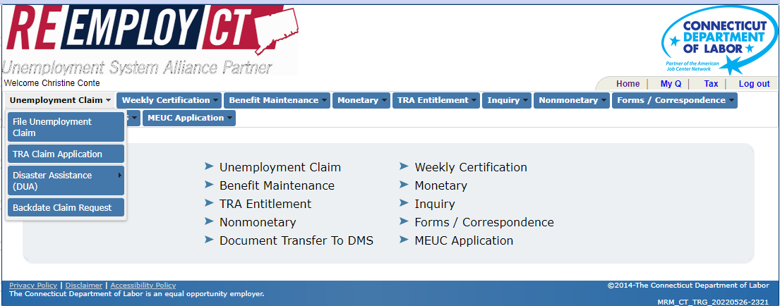
Appling for TRA Benefits
Click on Unemployment Claim>TRA Claim Application
Notes:
From the Unemployment Claim drop-down menu, click on TRA Application

Slide 17
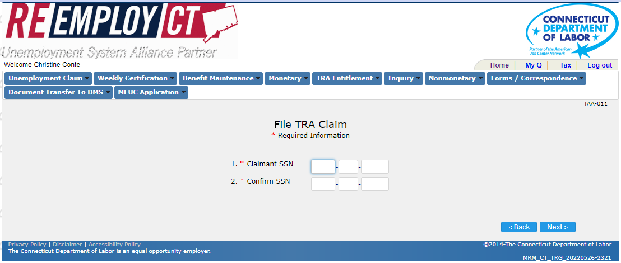
Applying for TRA Benefits
Notes:
Enter your Social Security Number and click on Next. Please contact us if you receive a message that you are not authorized to file.

Slide 18
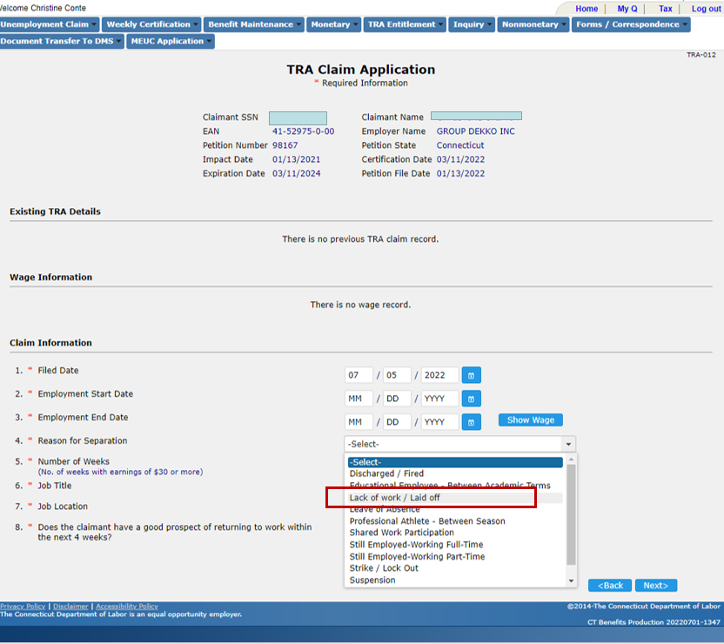
Notes:
Confirm that the information at the top of the screen is relevant to you, then enter the date you are filing, your start date and end date with the employer listed above. Be sure to choose lack of work under reason for separation.

Slide 19
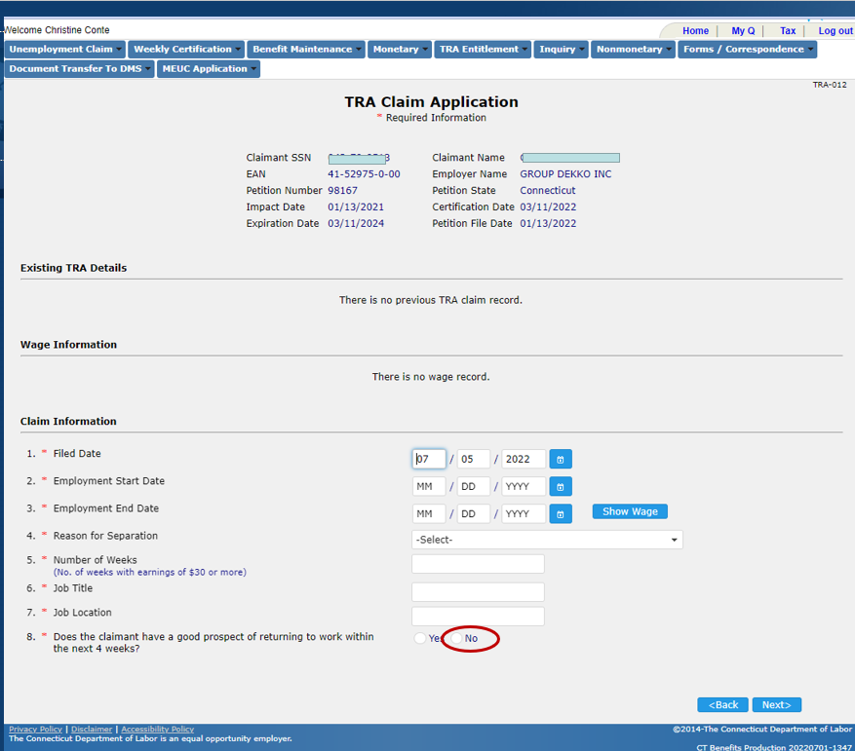
Notes:
Enter the number of weeks you worked for this employer. Then enter your job title as well as the location of the company. Then select “No” for question 8.

Slide 20
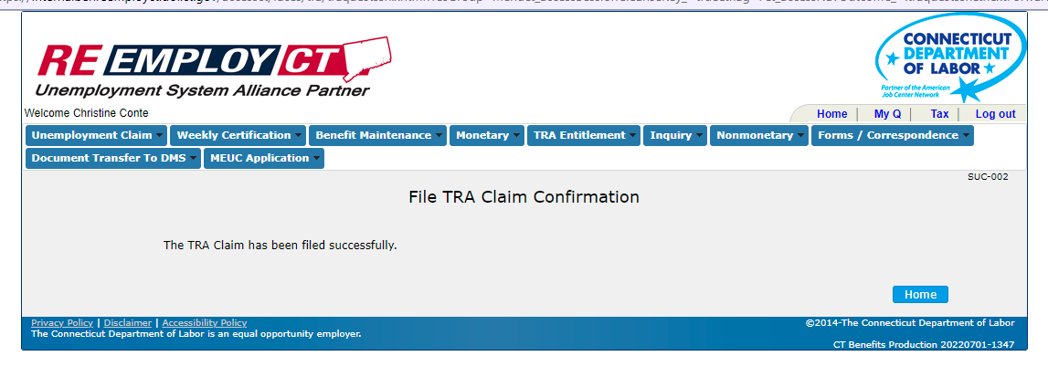
Notes:
This is the confirmation screen you will see once you enter your information.

Slide 21
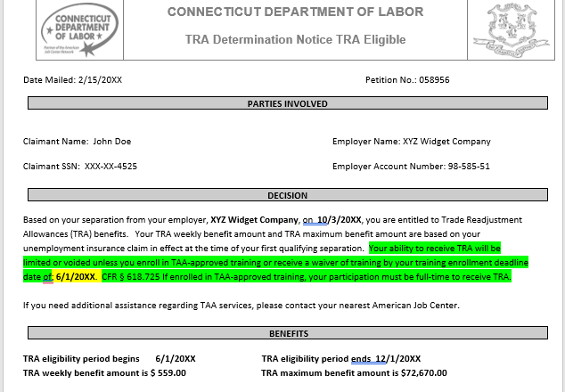
TRA Enrollment Deadline
Highlight the date, as you need to be enrolled in training prior to
this date (or on a waiver) In order to receive TRA
Notes:
Once your application is processed you will receive this letter in the mail. Please pay close attention to the dates on the letter as they are very important.
This slide shows what your TRA determination letter looks like and contains important information such as your training enrollment date deadline, the weekly amount of TRA and your Basic TRA eligibility period.
The arrow points to the area where the enrollment date is listed. This is the date you need to be enrolled in or waived from training in order to receive any TRA benefits, however, you may receive TRA benefits prior to your deadline date.
Please make sure to always have your current address on file. You can update your address in your reemployct account.

Slide 22
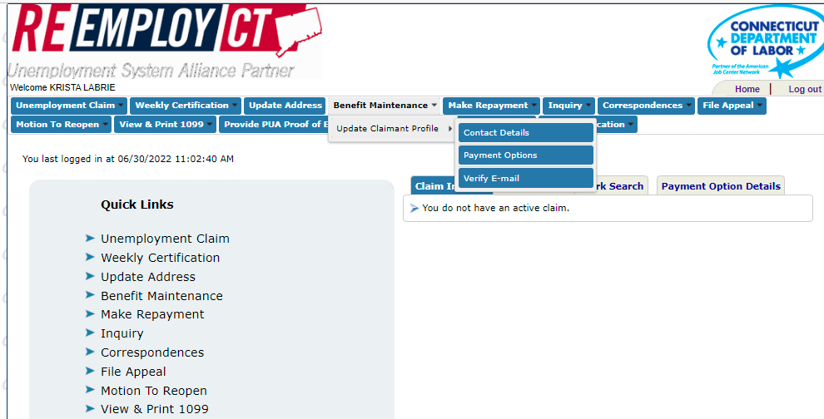
Changing Contact Information through Benefit Maintenance
Notes:
This is where you can change your address in your reemployct account. Click “Benefit Maintenance” then “Contact Details” to update your contact information.

Slide 23
Three Types of TRA
Basic TRA – up 26 weeks
Additional TRA – up to 65 weeks
Completion TRA – up to 13 weeks
**See pages 11 – 13 of the Participant’s Guide for Eligibility Requirements**
Notes:
There are three types of TRA payments. The first one is Basic TRA, this is up to 26 weeks of benefits you may receive after exhausting regular unemployment insurance benefits.
You may be able to collect Basic TRA while conducting a work search up to your enrollment date deadline without attending training or having a waiver issued.
You may also be eligible if you are participating in full time training, have completed training, or have obtained a waiver of the training requirement.
Additional TRA is up to 65 weeks of additional benefits available while you are participating in full-time training.
Completion TRA is up to 13 weeks of additional benefits payable to you when you exhaust ALL Basic and Additional TRA – you must also be enrolled and participating in training and be on target to complete the training according to the goals outlined on your training plan.

Slide 24
Waiver of Training
Eligible during Basic TRA only after enrollment deadline date, if waived from training.
Three Types of Waivers:
  Health
  Enrollment Unavailable
  Training Unavailable
Work Search efforts are required if on a waiver!
Notes:
A waiver of training allows you to receive Basic TRA after your enrollment deadline date while not participating in training.
There are Three Types of Waivers: Health: Unable to participate in training or complete training due to a health condition. Enrollment Not Available: Training will not begin within 30 days of the approval date. Training Not Available: No training is available in which you can enroll .
You are required to perform work search efforts while on a waiver. Remember: Waivers are only available during Basic TRA and In order to receive Additional or Completion TRA, you MUST be participating in TAA approved training. You do not need to look for work while you are in training.

Slide 25
Basic TRA
Job Search Requirements not in training
Make three job development/seeking efforts a week
At least one effort must include applying for a job
Maintain a record and accept suitable work
Submit efforts when you file your weekly certification online
Notes:
Job Search Requirements are the same as when you file for Unemployment benefits
Make at least three efforts to find work or increase your job seeking skills/knowledge.
Accept any offer of “suitable work”

Slide 26

Training
Eligible if there is no suitable employment available
May be approved for full-time
or part-time training
TRA payments are only available if you are enrolled in full-time training
Notes:
We are going to discuss re-training under the TAA program. It may be determined that there is no suitable work available to you and training is necessary for you to become gainfully employed.
Under the program you may enroll in full or part time training; however, if you opt to go to school part time you will not receive the TRA payments we discussed earlier.

Slide 27
Types of Training
  Classroom/On-line Training
  On-the-Job Training
  Apprenticeship Programs
  Post-Secondary Education
  Certifications
  Prerequisite and Remedial
Notes:
There is a wide variety of training options that may be suitable for you. This slide lists several of them. The most common is traditional classroom training or online training. This could involve certification programs, college degrees and general education or remedial training. There is also an option for On-the-Job Training or apprenticeship programs.

Slide 28
6 Criteria for Training
All Six Criteria must be met!
  There is NO “suitable” employment available
  You would benefit from the training
  There is a realistic expectation of employment after training
Notes:
4. There are training facilities that offer the training within a reasonable commuting distance from your home. If the program is over 41 miles from your home, we would require further research before its approval.
5. You may be required to take assessments to see if you meet the educational requirements of the program you choose.
6. You will be asked to compare three programs. We want to ensure the program is not too expensive and is appropriate. You can still be approved if it is not the least expensive program if it is justified in the training plan.

Slide 29
6 Criteria for Training
  4. The training is reasonably available
  5. You are qualified to take and finish the training
  6. Training is available at a reasonable cost
Notes:
4. There are training facilities that offer the training within a reasonable commuting distance from your home or if they are outside the commuting area we would dig deeper into the cost and feasibility
5. We do not want to set you up for failure may assess your skills. If the training program runs beyond your eligibility for Income Support (TRA) you may be asked to complete a financial support statement.
6. You will be asked to compare similar programs to look at program costs and content, we want to ensure the program is not too expensive and content is appropriate. You can still be approved if it is not least expensive program as long as it is justified.

Slide 30

Questions?
Notes:
Are there any questions before we move on?

Slide 31

The Training Plan
Notes:
You will work with your TAA Counselor to develop a plan specifically designed to meet your needs. Your plan will be sent to the TAA unit in Central Office for approval and can be modified if necessary.
Let’s look at the plan a little closer

Slide 32
What is in a Training Plan
  Labor Market Data to Support the Plan
  Documented Training Benchmarks
  Financial Support Projection
  Training Program Comparisons
  Course Outline
  Career Development Plan
Notes:
A training plan will assist you in obtaining skills necessary to gain suitable employment. There are several components and documents that need to be included to support the 6 criteria for plan approval. This slide lists several of the components of the plan
You will be expected to take an active role in the development of your plan and once started, you are expected to complete the training.

Slide 33
Training Allowances
Training must be approved BEFORE any expenses will be covered
Up to $25,300 allowed for training related costs
Allowance for mileage, food and lodging reimbursement if your training commute is more than 41 miles from your home
Notes:
Do not pay for anything yourself as we work directly with the vendor once your plan is approved. Allowable costs for training is up to $25,300 although if approved in advance, the program can go over that amount.
Mileage expenses can be reimbursed if you apply in advance. You can be paid if your commute to training is over 41 miles one way.

Slide 34

Training Allowances
There is a maximum of 130 weeks of training allowed
Entitled to one training plan per Trade Act Certification
Notes:
You are entitled to one Training Plan per Trade Act certification.
However, a single plan can consist of multiple training components. Such as a high school diploma, a college degree, or third-party certifications.

Slide 35

Incumbent Worker
An incumbent worker is still employed, but has been threatened with a separation from their company due to foreign trade
Notes:
This would pertain to you if you are still working and are given a layoff date that has not occurred yet. You can still participate in the program; however, there will be limits on what benefits you can access.

Slide 36

Incumbent Worker
TAA training is available while still employed
Must be certified as eligible to apply for TAA benefits/services
Re-employment Services available
TRA is not available while still employed
Notes:
Because you are still working you will not receive financial payments, but you can begin to research employment opportunities and training programs that interest you.
You would receive an approval letter for TAA and another one after your layoff date which may offer expanded benefits.

Slide 37
On The Job Training
Working at a new job while receiving training on NEW skills by company
Can be combined with classroom training if needed
Wages paid by employer – No TRA
This is your one and only training plan
Must apply before starting the new job
Notes:
OJT is an Earn while you learn program that is customized to meet the needs of the employer. TAA will provide the employer up to 50% of your starting wage rate.
You must apply for On the Job Training before starting the new job.
**with reimbursement up to 1,600 hours depending upon job complexity and the employee’s current skills and qualifications, however, the program cannot exceed 104 weeks total.

Slide 38

Apprenticeship Training
Requires Registration with
State Apprenticeship Office
TAA funds can be used to reimburse the employer for costs of training, up to 50% of wages
Wages paid by employer – No TRA
This is your one and only training plan
Notes:
Apprenticeship training is similar to On-the-Job training – these are jobs like plumber, electrician, cook, barber, sprinkler fitter, tool & die maker, etc…
The program will cover schooling and related instruction costs like tools and testing.
***Apprenticeships are not subject to the 104-week statutory duration of OJT training limit. The length of the paid work-based learning component must not exceed 130 weeks. However, the length of the educational or instructional training component of the apprenticeship may exceed 130 weeks and continue through the scheduled completion of that specific apprenticeship training.

Slide 39

Occupational Training
Certification programs
Associate degrees
Bachelor degrees
Master degrees
Must be able to complete within the
130-week limitation
Notes:
Occupational training would be considered training that results in a certificate or degree such as the ones listed on this slide. You may have taken courses prior to layoff and need to finish up a degree. TAA funds can help you do that.

Slide 40
Remedial Training
High School Diploma/ General Education Development Diploma (HSD) (GED)
Adult Basic Education (ABE)
English Language Learner (ELL)
Remedial training can be combined with occupational training if the total training weeks is 130 or less
Notes:
Remedial training can be part of your training plan. For example, you can take refresher courses in basic education, ESL courses or receive a GED and then go on to a Certificate or Degree program.

Slide 41
Examples of Training Paths
Client 1:
  Worked in manufacturing as a coiler operator. No formal education: Enrolls in GED program and then an Advanced Manufacturing Certificate program.
Client 2:
  Has BA in Business Administration: Enrolls in Graduate Level Masters of Business Administration Program.
Client 3:
  Has Masters Degree in Computer Programming: Enrolls in Advanced-Level Certification Courses for: Java , SQL and Python
Client 4:
  Worked as a Customer Service Representative in Insurance Claims, Has High School Diploma: Enrolls in Associate's Degree Program for Paralegal.
Notes:
Read slides

Slide 42

Refresh!
Notes:
Let’s take a minute to refresh our memory on some of the Trade Basics we spoke about today

Slide 43
TAA
  Trade Adjustment Assistance
TRA
  Trade Readjustment Allowance ($)
Who may be eligible?
  Job loss due to foreign trade
What are some of the benefits?
Income support, classroom training, reemployment services, on the job training.

Slide 44
What is the maximum number of training/TRA payment weeks?
  130 weeks
  Can I collect Additional TRA if I am in part-time Training?
    No
  Before training is approved, I will develop a Plan with my TAA Representative.
  Yes
  Before I start classes under the program, I must first receive my TAA approval notice.
  Yes

Slide 45

Stay on Track with your Goal!
Notes:
The Trade program has many great benefits that come with rules and responsibilities.
You need to keep organized, focused and goal oriented.

Slide 46

Responsibilities
Follow Program Rules
Maintain in Contact with your TAA Counselor, ask questions
Submit required program documentation
Don’t risk losing your benefits
Notes:
You will be provided with documentation detailing your responsibilities. (Form TAA-157)
You will need to provide grades, progress reports, transcripts and diplomas upon request.
When in doubt, ask! Don’t make any changes before speaking with your TAA Counselor
Failing to comply means you may lose your benefits and possibly be liable to repay money expended on your behalf.

Slide 47

RTAA
Reemployment Trade Adjustment Assistance
Provides a wage supplement when you are earning less than what you were making at your Trade impacted employer
Must be 50 years of age or older
Earn less than $50,000 in the new job
Maximum of $10,000 paid to you over a two-year period
Notes:
RTAA bridges the GAP between prior Trade impacted job and your NEW job.
To receive RTAA you will need to: be fully employed or employed part-time (20+) hours per week and attending TAA full-time training. Your eligibility period begins when your unemployment benefits have exhausted or when your new job begins, whichever is sooner.

Slide 48
RTAA
Reemployment Trade Adjustment Assistance
  Cannot receive TRA while receiving RTAA
  If you collected TRA beforehand, those benefits will be subtracted from the $10,000 cap (eligibility period reduced)
  Once RTAA is received, you cannot collect any unclaimed TRA
Notes:
Read slide

Slide 49
Job Search Allowance
Application for job search allowance must be submitted before job search begins
No suitable work within your commuting area
Covers 90% of the costs for travel & subsistence
Maximum of $1,250.00 - save receipts
Notes:
Job Search Allowance covers some of the expenses while looking for work. You must submit an application in advance to receive this benefit. For searches outside of your commuting area (41 or more miles one way), you will only get paid for anything over 41 miles, so if the commute is 45 miles each way you will get paid for the 8-mile difference (round trip). There must be a finding of no suitable employment available in your commuting area. It Covers 90% of the costs for travel and subsistence up to a maximum of $1,250.00, save all receipts.

Slide 50

Relocation Allowance
No suitable employment available in your commuting area
Must have a bona fide job offer of long-term suitable employment
Lump sum of $1,250.00
Covers up to 90% of the expenses that are reasonable and necessary
Notes:
Relocation Allowance reimburses you for approved expenses when you must move to a new area to earn sustaining wages. You must have a job offer of long-term suitable employment in writing and the offer requires relocation
You must submit an application for this benefit. The application must be submitted before the relocation process begins and you need to save all receipts.

Slide 51
Health Coverage Tax Credit (HCTC)
If available, usually up for reauthorization yearly (December 31)
Covers 72.5% of you and your family’s healthcare insurance premiums if participating in a qualified health care plan as defined by the IRS
CTDOL provides TRA eligibility information to the IRS, we do not determine who is eligible for the credit
You will need to fill out forms to enroll and request monthly payments, forms can be found on the IRS site at: WWW.IRS.GOV/HCTC
Notes:
HCTC expired on 12/31/2021 – currently awaiting reauthorization. When approved you will receive a notice in the mail if eligible.
*******
Must be eligible for TRA & ATAA recipients
Operated & funded by the Internal Revenue Service, we only provide information on your Trade eligibility to the IRS.
Forms and information can be found on the IRS site at: WWW.IRS.GOV/HCTC
If you do not request advance monthly payments directly to your plan administrator and instead pay 100% of your health insurance premium, you can claim your tax credit when you file your refund.
Again, we do not administer HCTC and you must go to the IRS website for information and forms. Please visit their website for common Q& A’s.

Slide 52

Next Steps
Register with CTHires www.cthires.com
Notes:
In order to take advantage of all the services available to you through our American Job Centers, including TAA, you must first create an account in the CTHires database, located at: www.cthires.com
Feel free to reach out to us if you have any problems registering. The site is user friendly from a tablet or smartphone.
When registering first: Click on Sign in/Register

Slide 53
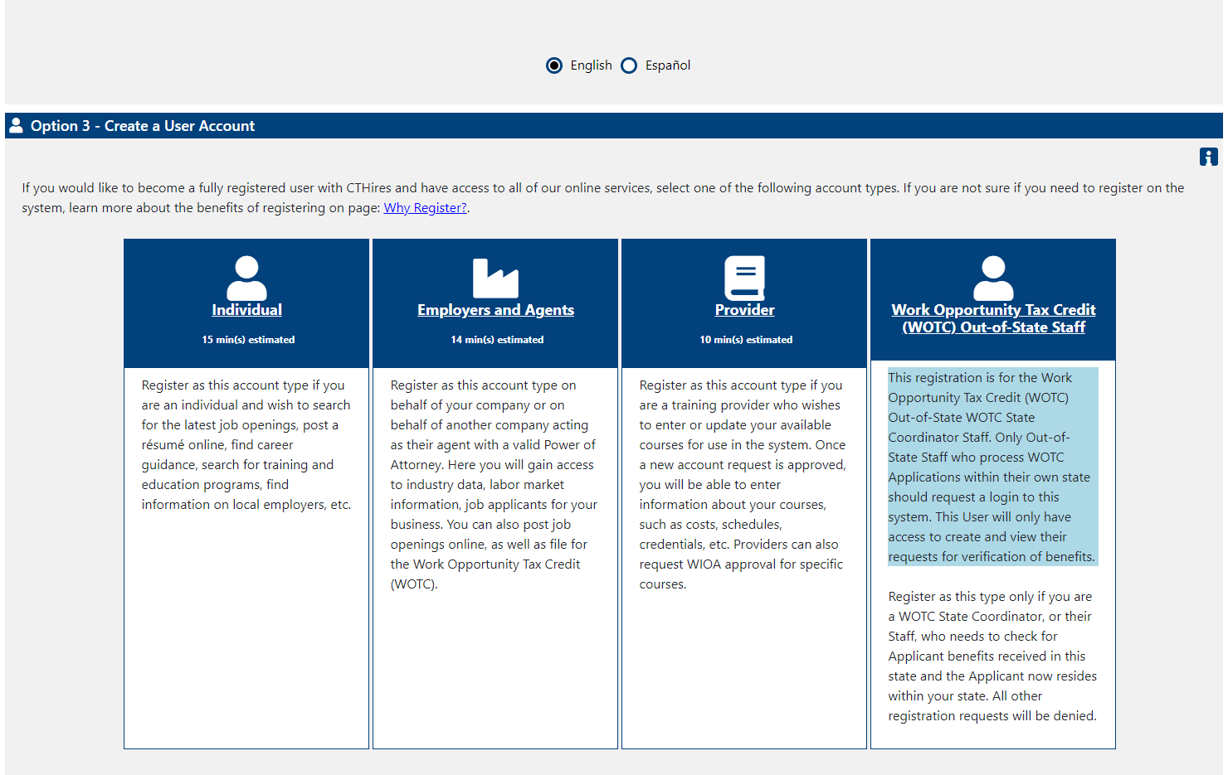
Individual Registration
Notes:
The next step would be to click on Individual,

Slide 54
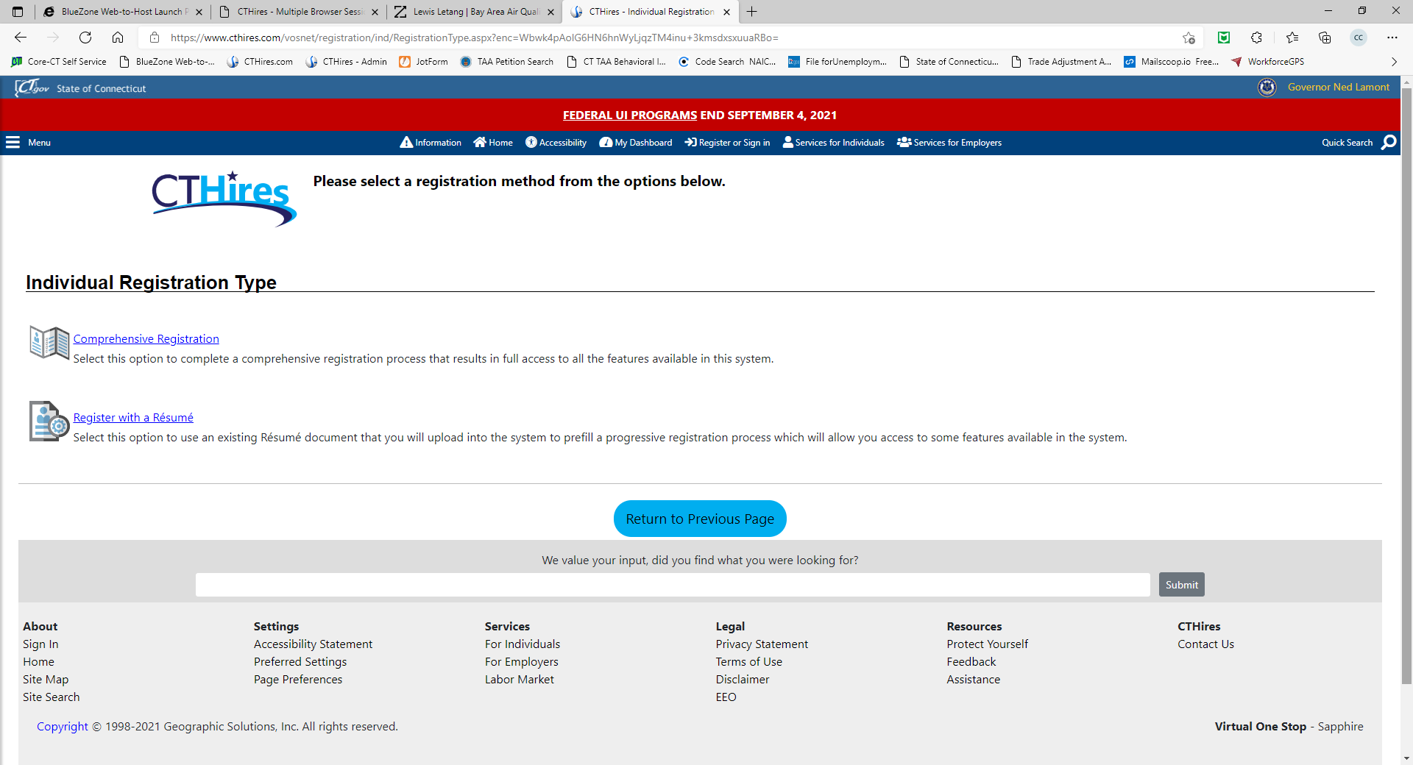
Choose
Comprehensive Registration
Notes:
select a Comprehensive Registration

Slide 55
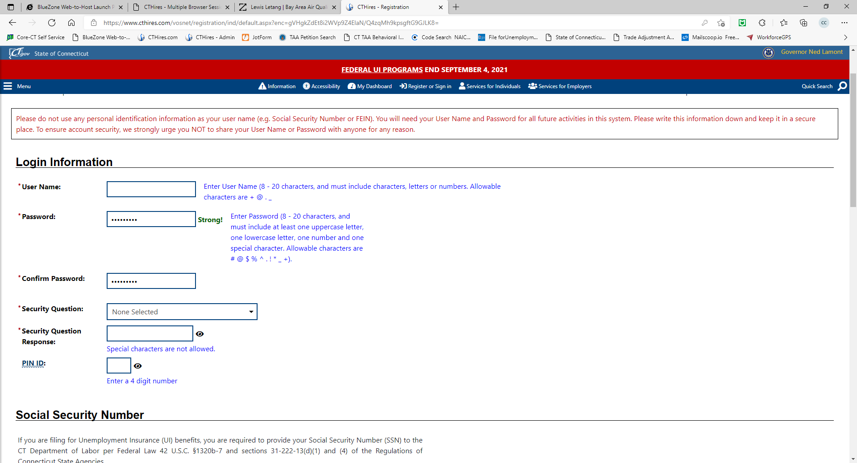
User Name & Password
Notes:
Create a username and a password

Slide 56
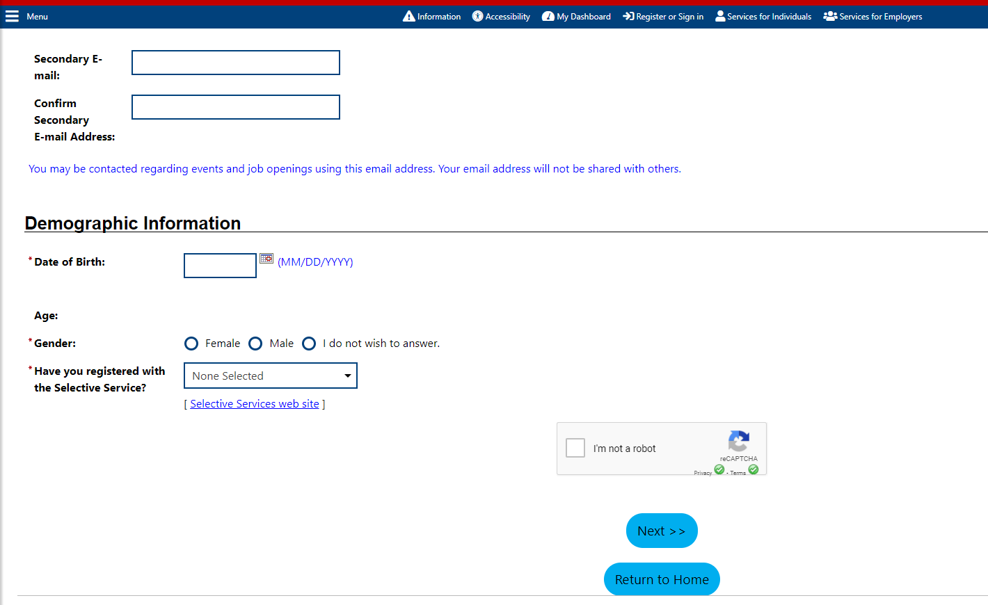
Required Fields
Notes:
All required fields are indicated by a red asterisk. Once you complete a page click on next to proceed to the next page.

Slide 57
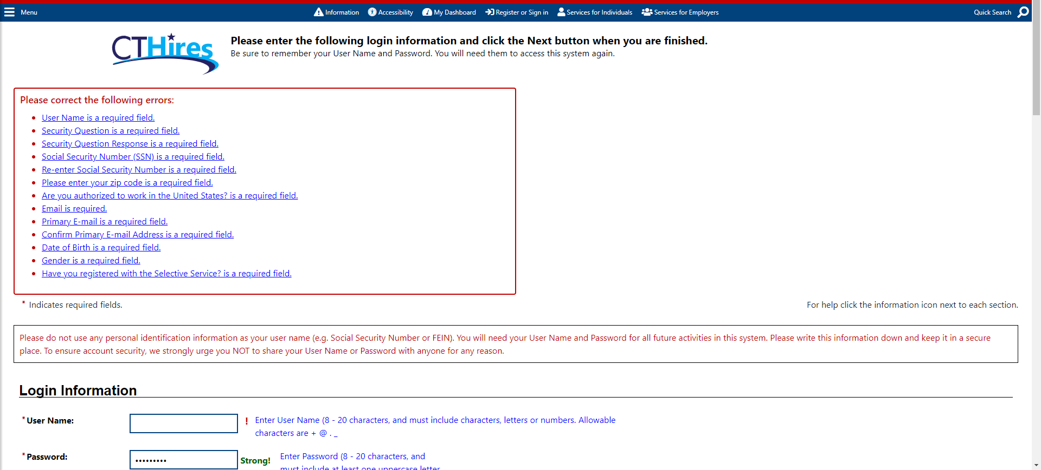
Errors
Notes:
If errors are found on your page, you will be notified of the errors in a red box at the top of the page and you will need to go back and correct the entry and then click on next to proceed.

Slide 58
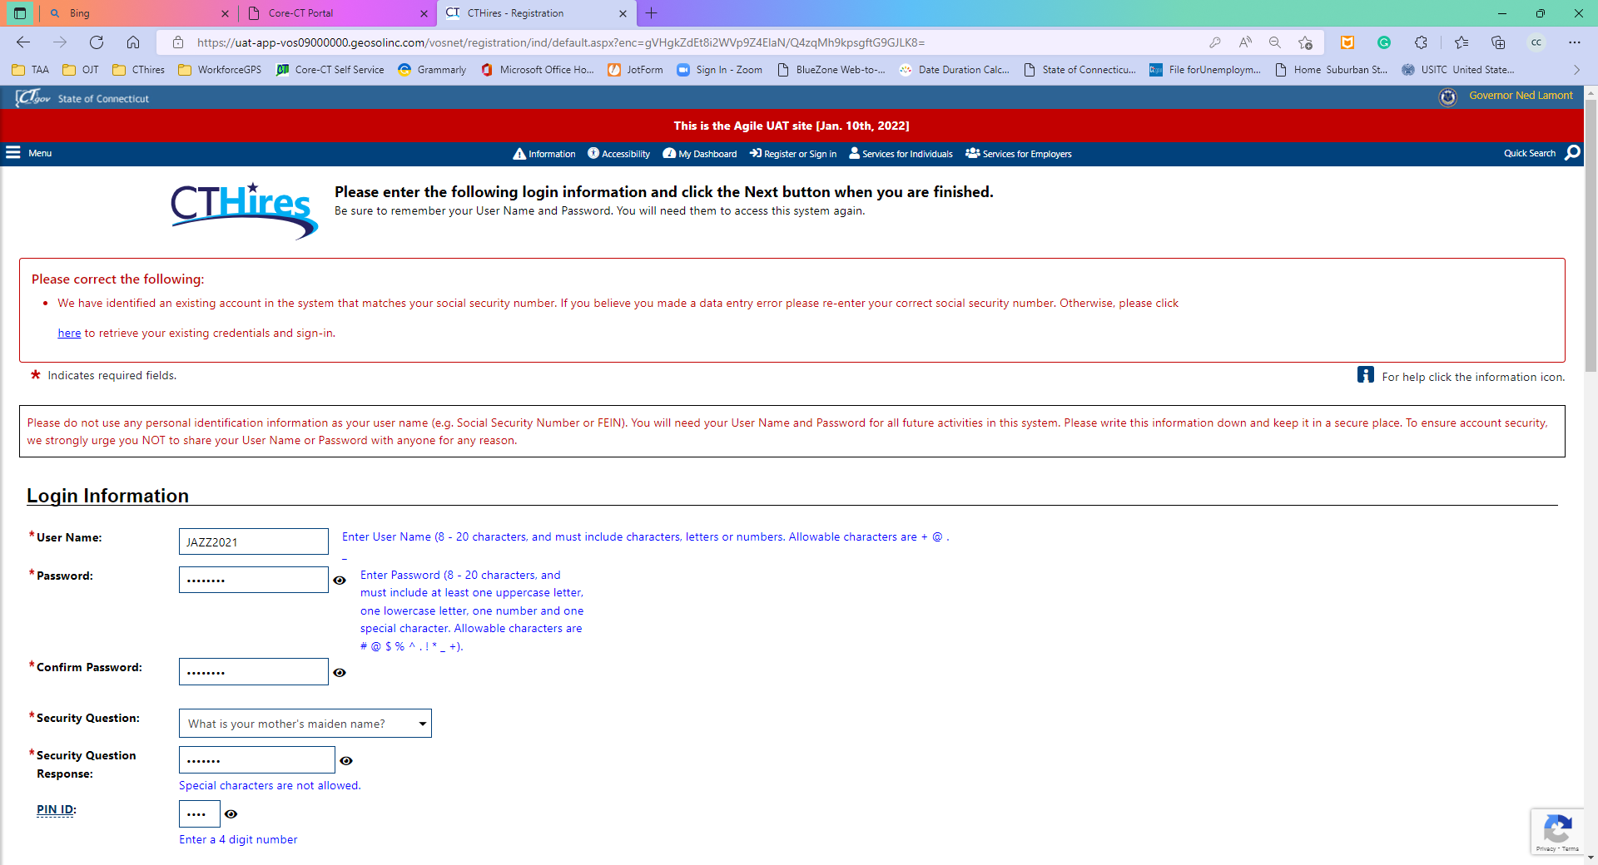
Already have an Account
Notes:
When you file for unemployment benefits the system creates a shell account for you. Once you enter the required information, you may receive a message letting you know you already have an account Click on the link in the first red box to retrieve the information. It is important to do this to avoid duplicate accounts being created.

Slide 59
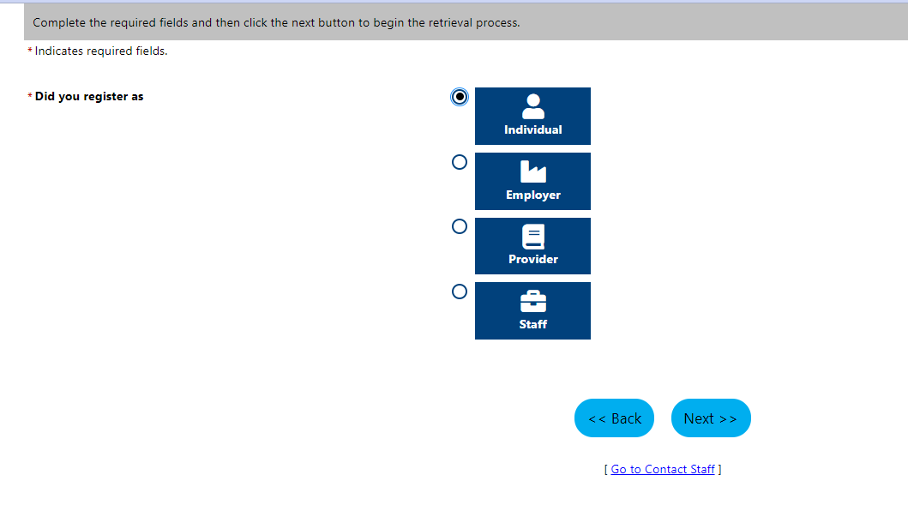
Notes:
Click that you registered as an individual

Slide 60
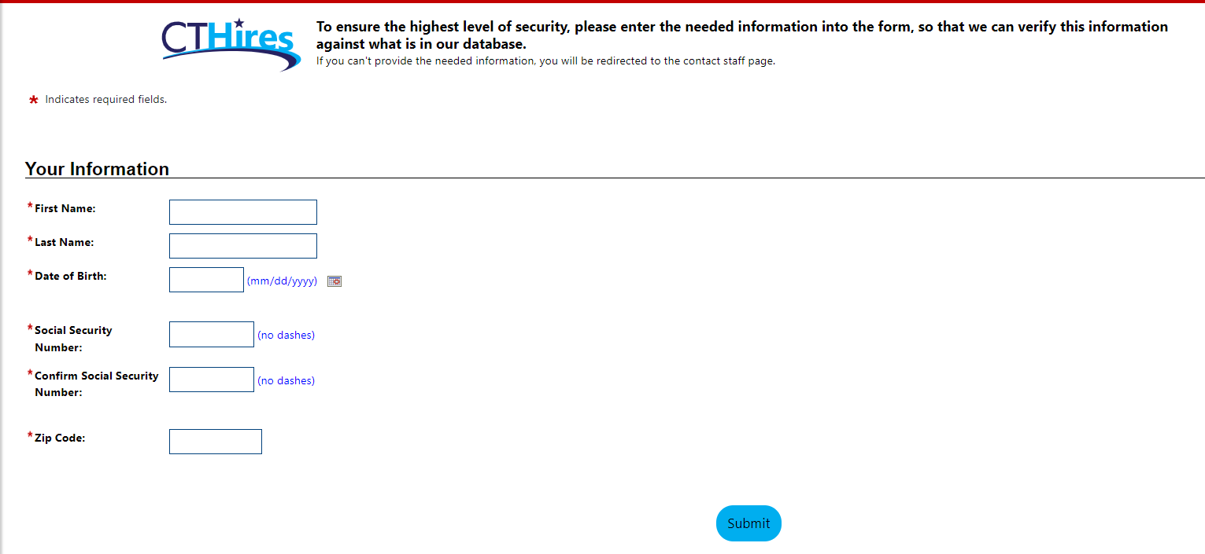
Retrieving your Information
Notes:
Enter your personal information in the boxes listed and click submit

Slide 61
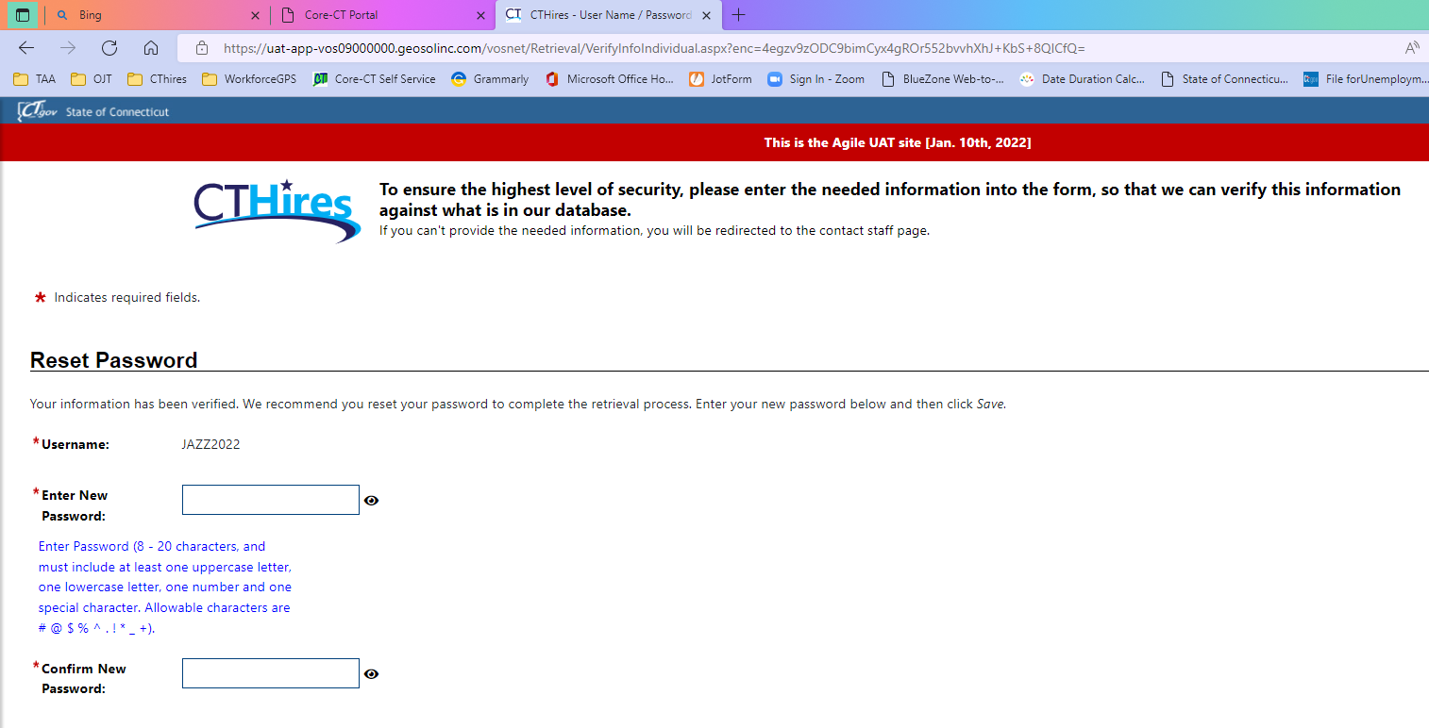
Notes:
Make note of your username and new password.

Slide 62

Sign-in
Notes:
Click Sign-in

Slide 63
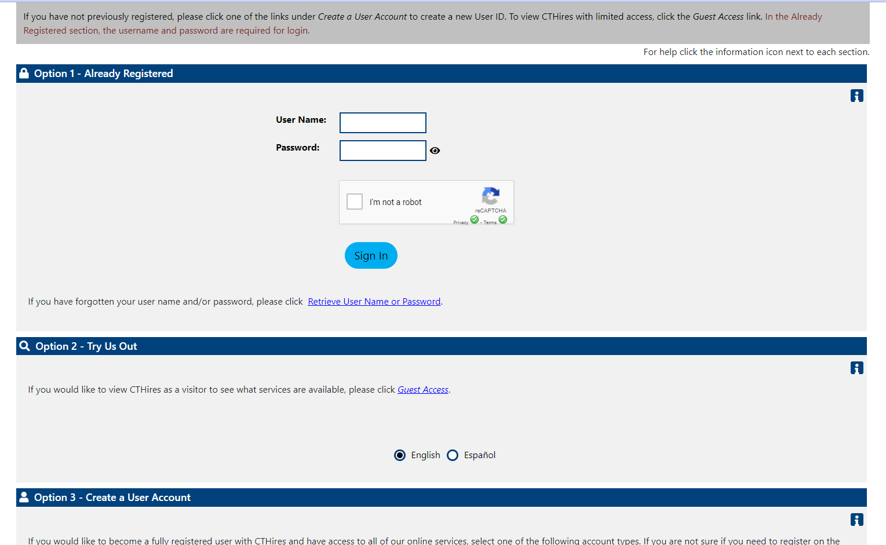
Notes:
Enter your username and password

Slide 64
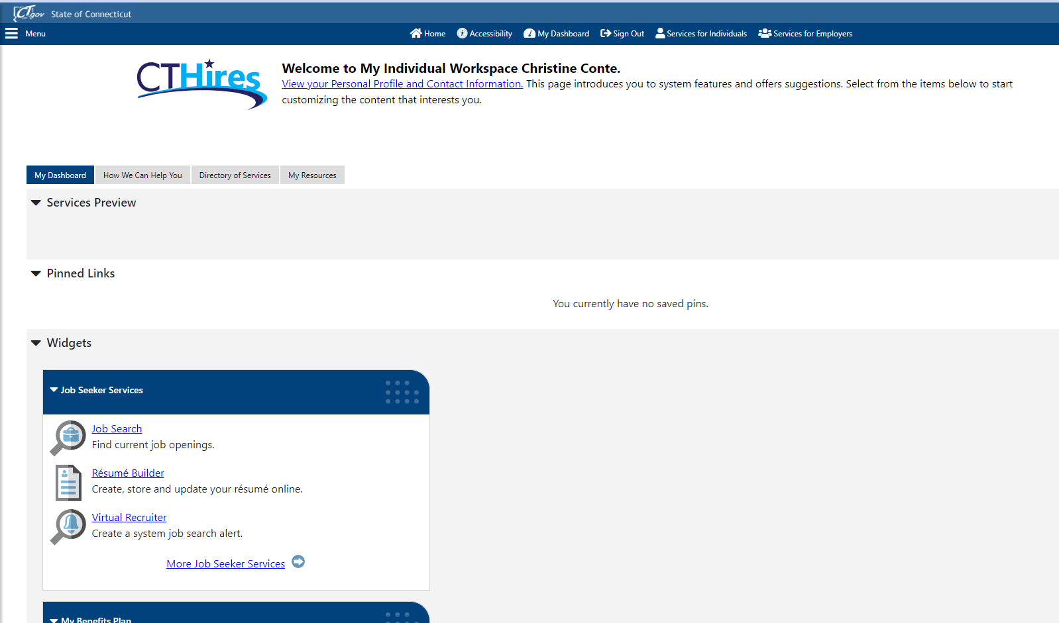
Personal Profile
Notes:
Click on Personal Profile to update your CTHires information

Slide 65

Appointments
You will be contacted by a TAA Counselor to schedule your first appointment.
You will also be co-enrolled with the Workforce Innovation and Opportunity Act (WIOA), Dislocated Worker program.
Appointments are held virtually
or in person at your local American
Job Center
Notes:
After we process your application, you will be contacted by a TAA Counselor to schedule your first appointment. If you are not contacted, please let us know.
Some of the benefits have deadlines so it is important to apply as soon as possible.
At your first appointment, you will be enrolled in TAA & WIOA, complete forms, and receive more detailed information on the program.

Slide 66
WIOA Enrollment Documentation
- Samples -
Birth Certificate
Alien Registration Card
Driver’s License / ID Card
Social Security Card
Selective Service Registration
Pay Stub
Educational Diploma
Notes:
There may be additional documentation required. The packet you receive in the mail will give more details on the type of information collected and includes a self-attestation form that can be used in lieu of the actual documents.

Slide 67
Refresh your Memory!
Once you submit your application and receive your determination packet. Review the documents and complete the forms.
https://www.ctdol.state.ct.us/TradeAct
Click on REVERSION
Notes:
Before your first appointment make sure to complete the forms and review the materials. Jot down any questions you may want to ask your TAA Counselor. The packet you have or will receive in the mail once you are eligible for the program contains a form you can use to jot down any questions you may have.

Slide 68

Questions?
Notes:
Does anyone have any questions that were not previously addressed?

Slide 69

TAA Unit - Contact Information
dol.taaunit@ct.gov
860-263-2070
Notes:
This slide contains our contact information, feel free to reach out to us with any question.
Our detailed power point presentation can be found on our CTDOL Website for viewing later. We also have a YouTube video available which provides a snapshot of the TAA program. You will receive an email from us with direct links to these items.
Thank you for attending the TAA Orientation today. We look forward to working with you to help you achieve your future goals.

