Slide 1

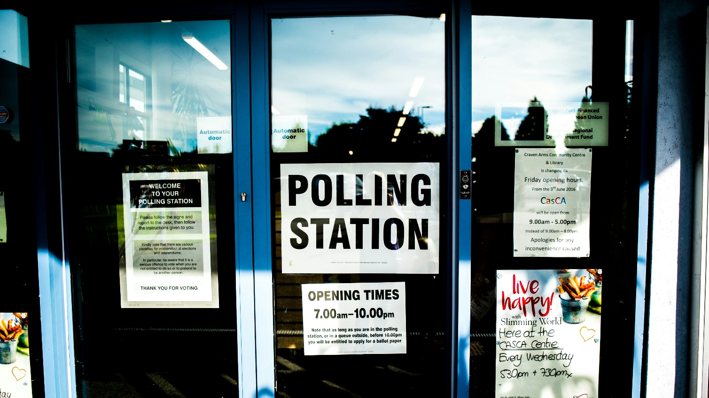




Election Security Working Group
Notes:
Welcome to Election Season! This presentation is brought to you by the Election Security Working Group.

Slide 2
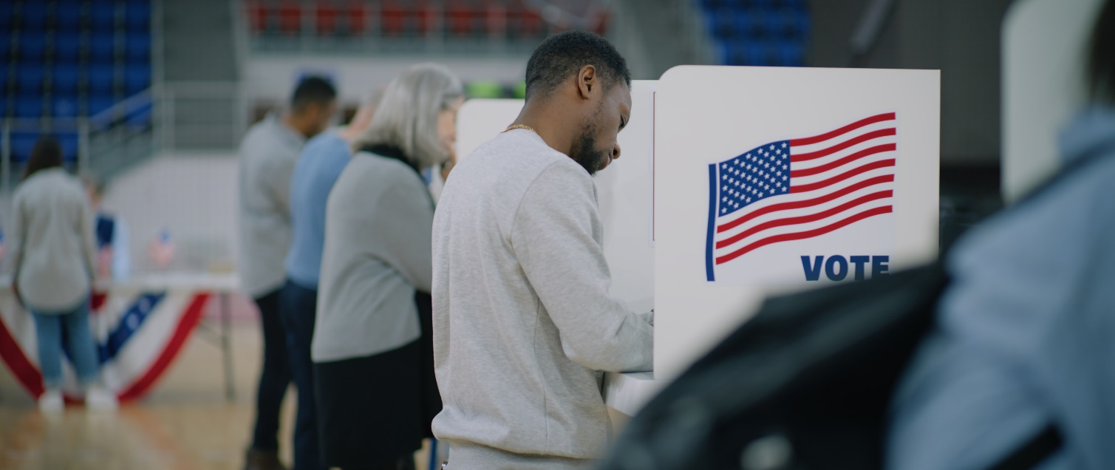
Law Enforcement and Voting in Connecticut
Notes:
Election activities can present unique scenarios that will ultimately involve the assistance of a law enforcement officer. This presentation is meant to inform you of some of those scenarios you may be asked to respond to, as well as give you an understanding of the role of an officer at or around Early Voting and the polling places.

Slide 3
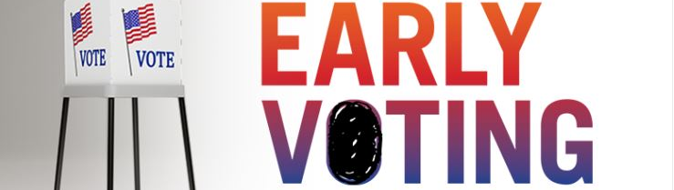
FOURTEEN DAYS OF EARLY VOTING:
MONDAY, OCT. 21 – SUNDAY, NOV. 3.
HOURS: 10:00 AM to 6:00 PM, EXCEPT OCT. 29 AND OCT. 31, WHEN HOURS ARE 8:00 AM to 8:00 PM.
Notes:
The State of Connecticut will hold Early Voting from Monday, October 21 through Sunday, November 3rd. Early Voting hours are between 10:00 am and 6:00 pm, EXCEPT on October 29th and Halloween, where voting hours are between 8:00 am and 8:00 pm.
Election Day is Tuesday, November 5th, when voting will occur between the hours of 6:00 am and 8:00 pm.

Slide 4

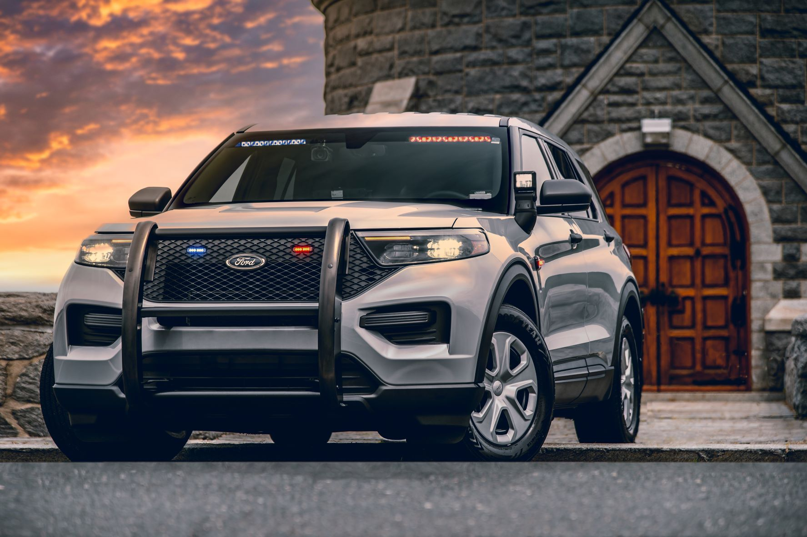
Nothing in this presentation should be considered a substitute for your training, standard operating procedures, direction from your commanders, or the exercise of your professional judgment.
Notes:
The Secretary of the State, Office of the Attorney General, State Elections Enforcement Commission, DESPP, Division of Criminal Justice, and the FBI are resources for you as you navigate interactions with the public that are often unique to the occurrence of national and local elections.

Slide 5
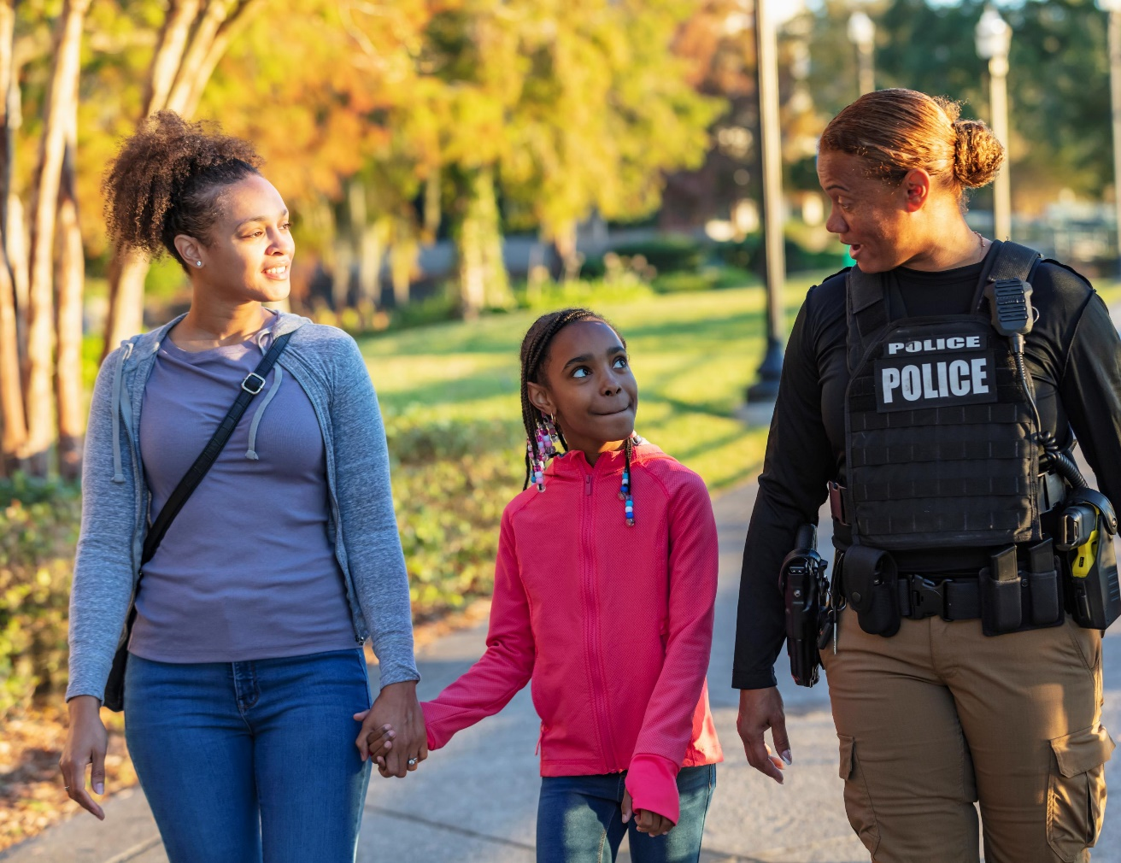
An Officer’s Role
Peaceful and Orderly Administration of the Election is Paramount
Help Ensure an Orderly Election, Uninterrupted by Disorderly Conduct
Not a Time to Express Personal or Political Opinions
Notes:
During Early Voting and on Election Day, a polling place and the 75-foot area around it are not a fully public space, even if the rest of the year that location might be considered a space open to the public. During this time, election officials have greater authority to control behavior of people in that space and can remove people if the election official determines it is proper to do so pursuant to state law.
This principle is counter-intuitive to your law enforcement training and experience, that says the officer has lawful authority over lay citizens.
Officers do not, however, lose their authority or ability to effect an arrest in matters simply because they concern an election.
Simply act according to the principle that an overt show of force, or the expression of an officer’s personal or political opinion have no place in election matters. In most situations, de-escalation should be the priority.

Slide 6
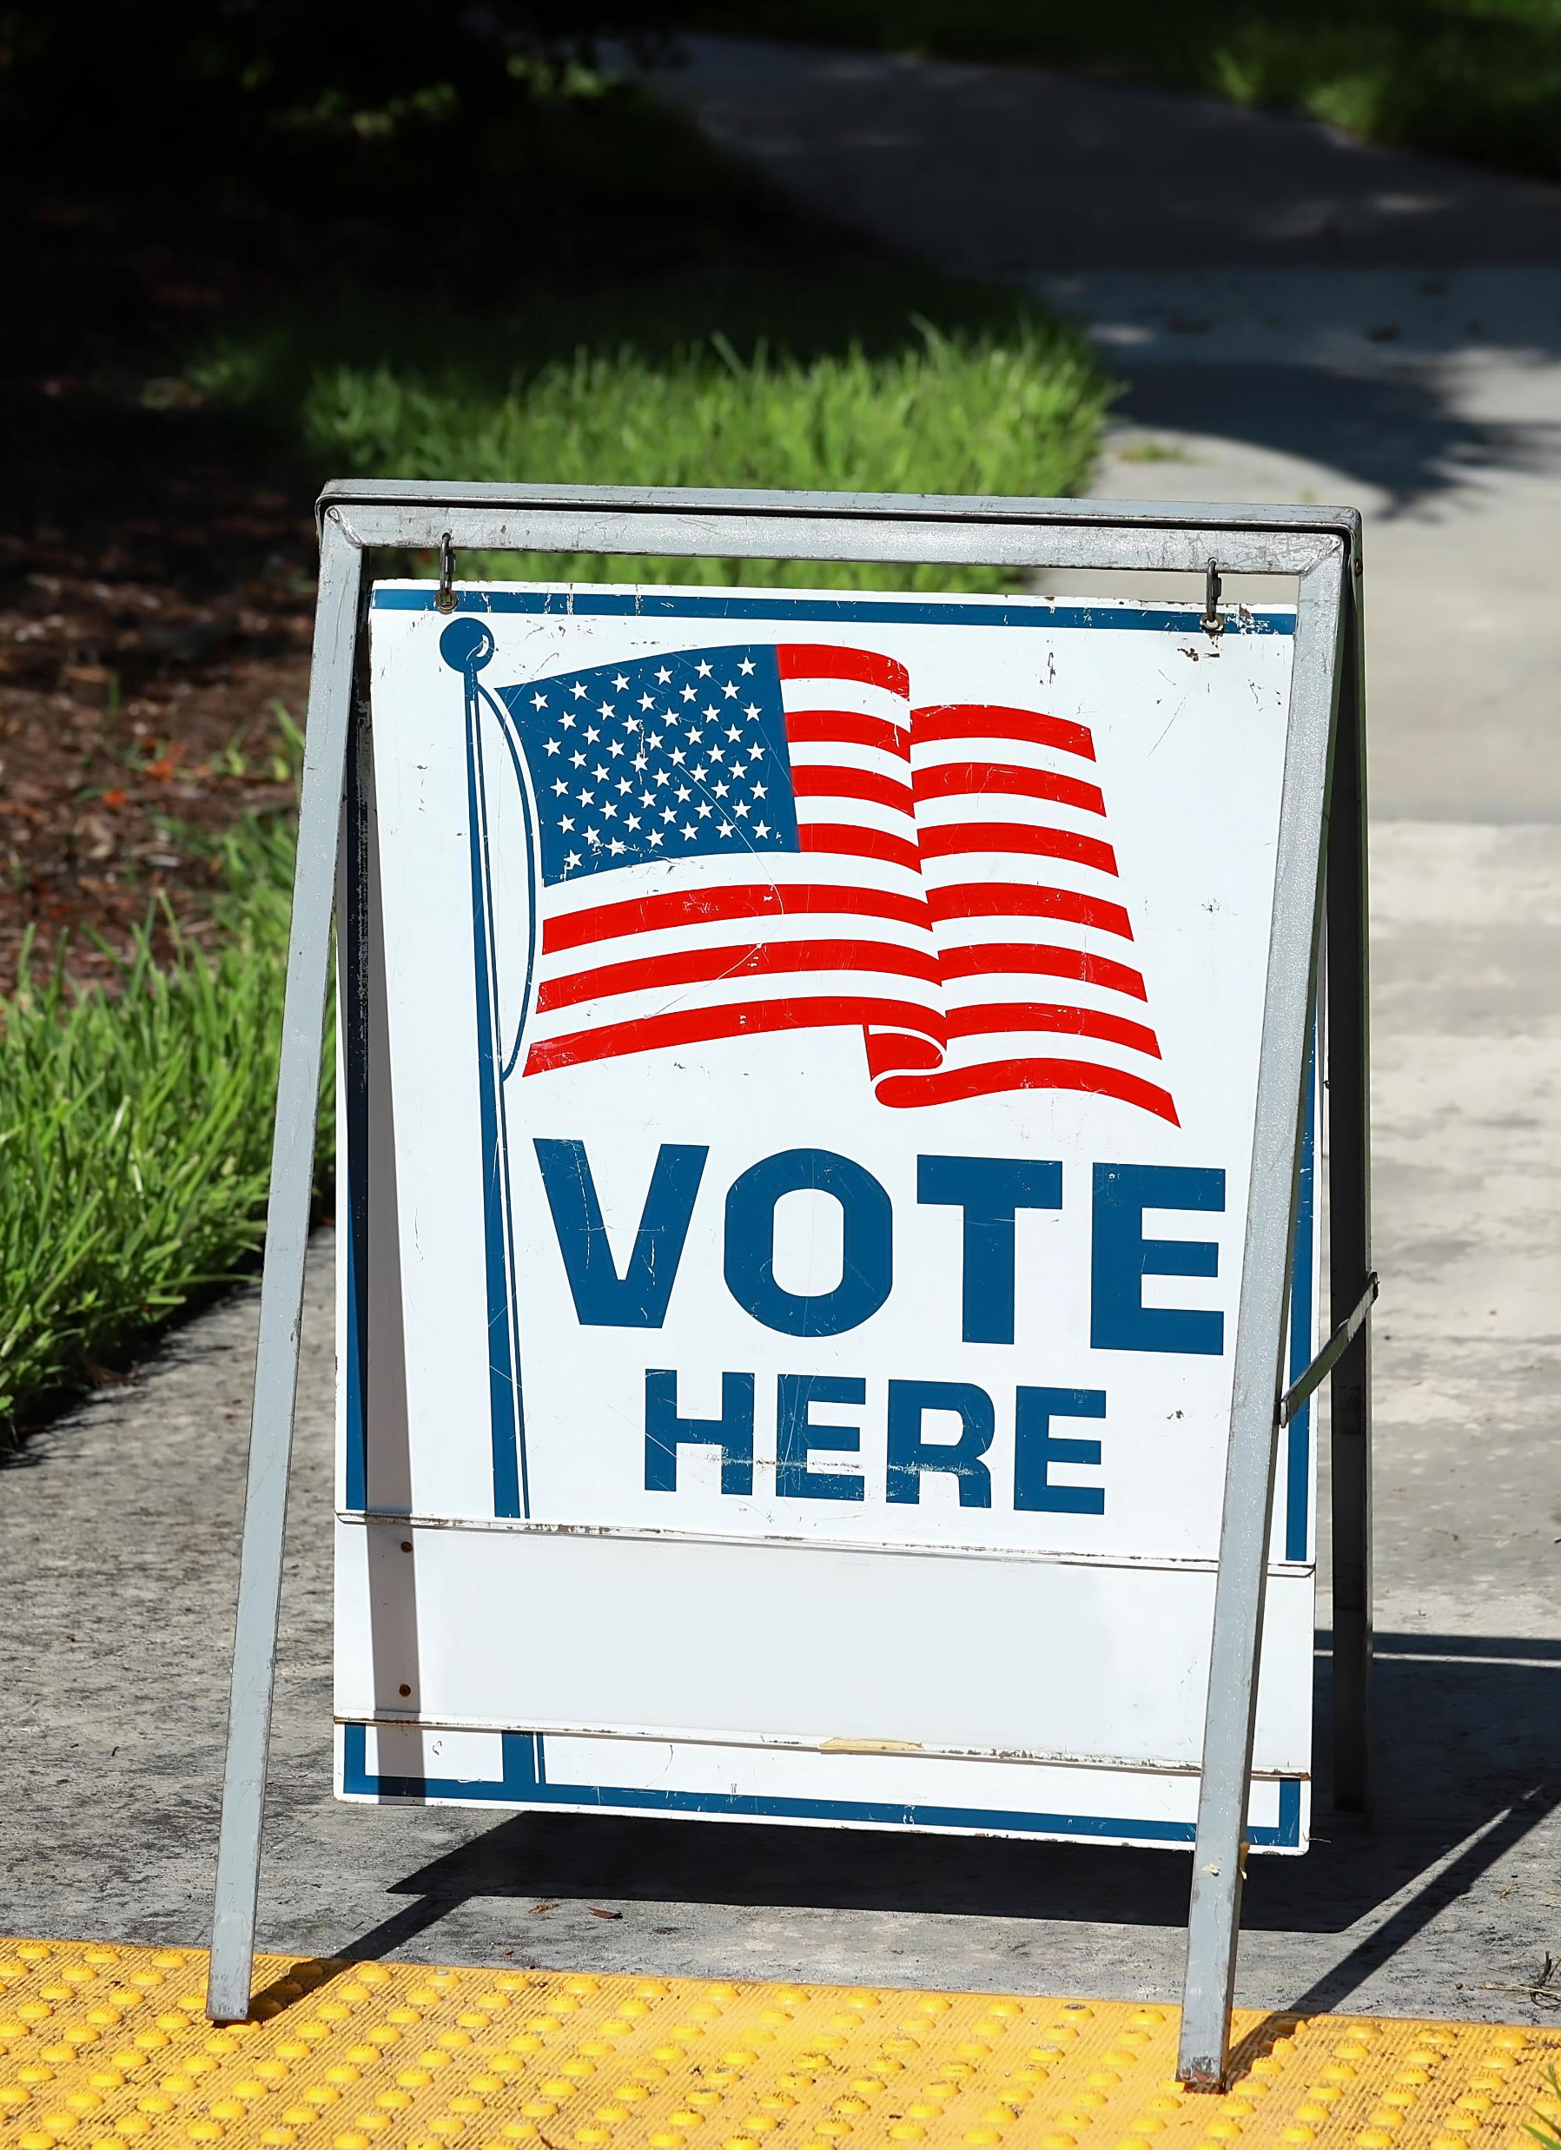
A moderator is an election official appointed by the registrar of voters who is in charge of each polling location. Generally speaking, the moderator is responsible for ensuring the orderly process of voting.
Notes:
The moderator is given statutory authority to employ an officer to remove an individual who does not submit to the moderator’s authority over the polling place. If the moderator orders you to remove a person from the polling place, CT General Statute Section 9-230 dictates you must do that.
If you remove anyone from the polling place for any reason, be aware that C.G.S. §9-230 commands that no offender be deprived of his right to vote any longer than the offender refuses to conform to order. It is counterintuitive to return an unruly individual to the place they disturbed. If the person has already voted, they do not need to be returned to the polling place. If the person has not voted, they may be removed for such time is necessary to process their arrest and may be returned when they have demonstrated they can conform to order. If you’ve determined they cannot, you must document that in your report.
It is helpful to remember that a person must leave the polling place once their vote has been cast. If a person cast their ballot, the requirement that a person be returned to the polling place does not apply.

Slide 7
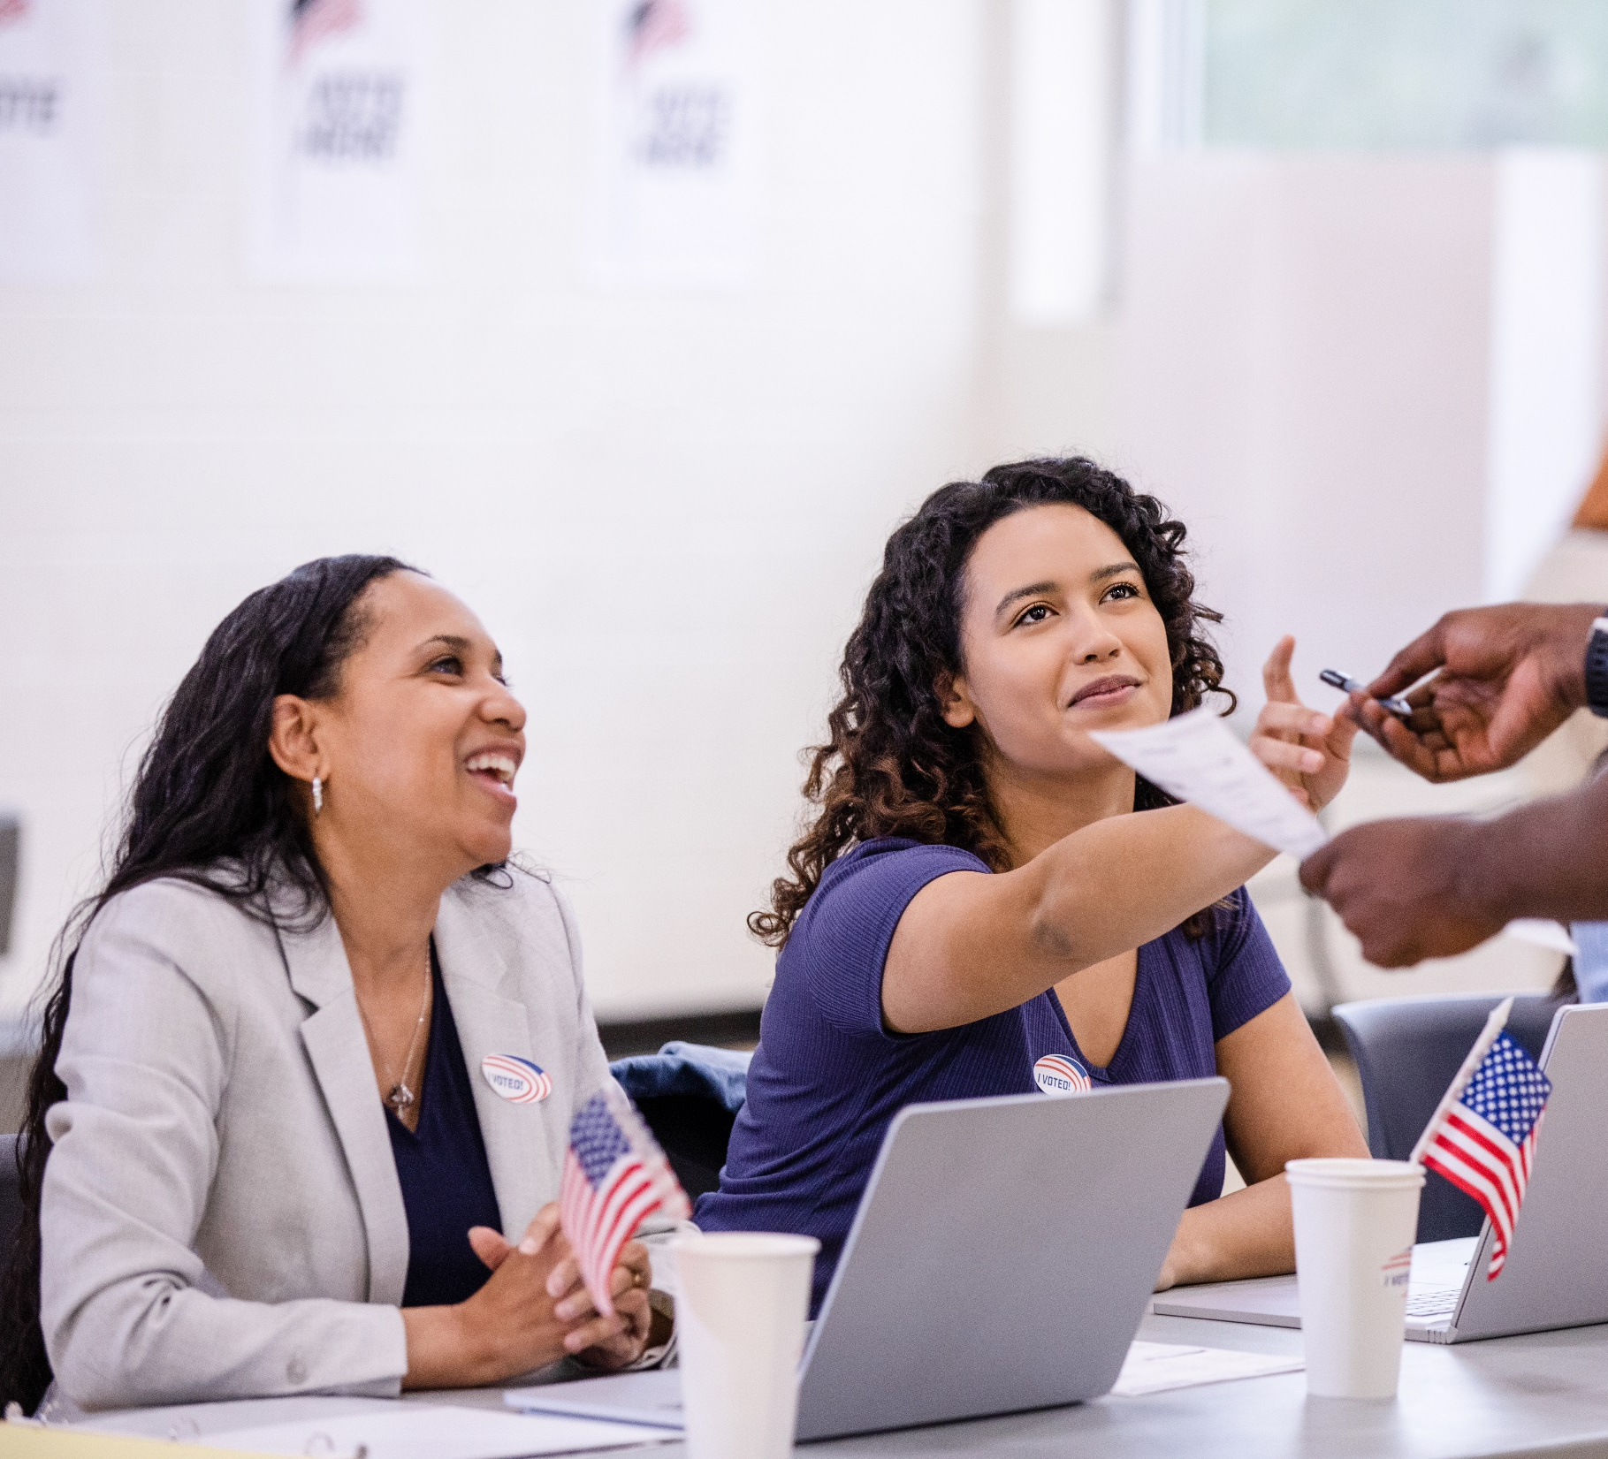
If you are called to a polling place, always introduce yourself to the moderator.
Notes:
There are two situations where an officer may be called to a polling place – a request from the registrar of voters, or in response to moderator or citizen complaints.
The registrar of voters may request a police officer be present where they may anticipate disorder. If you find yourself at the polls for this purpose, touch base with the moderator.
The moderator will likely have a preferred location for you to be on-hand. Also, be sure to ask the moderator to show you where the 75-foot boundary is.

Slide 8
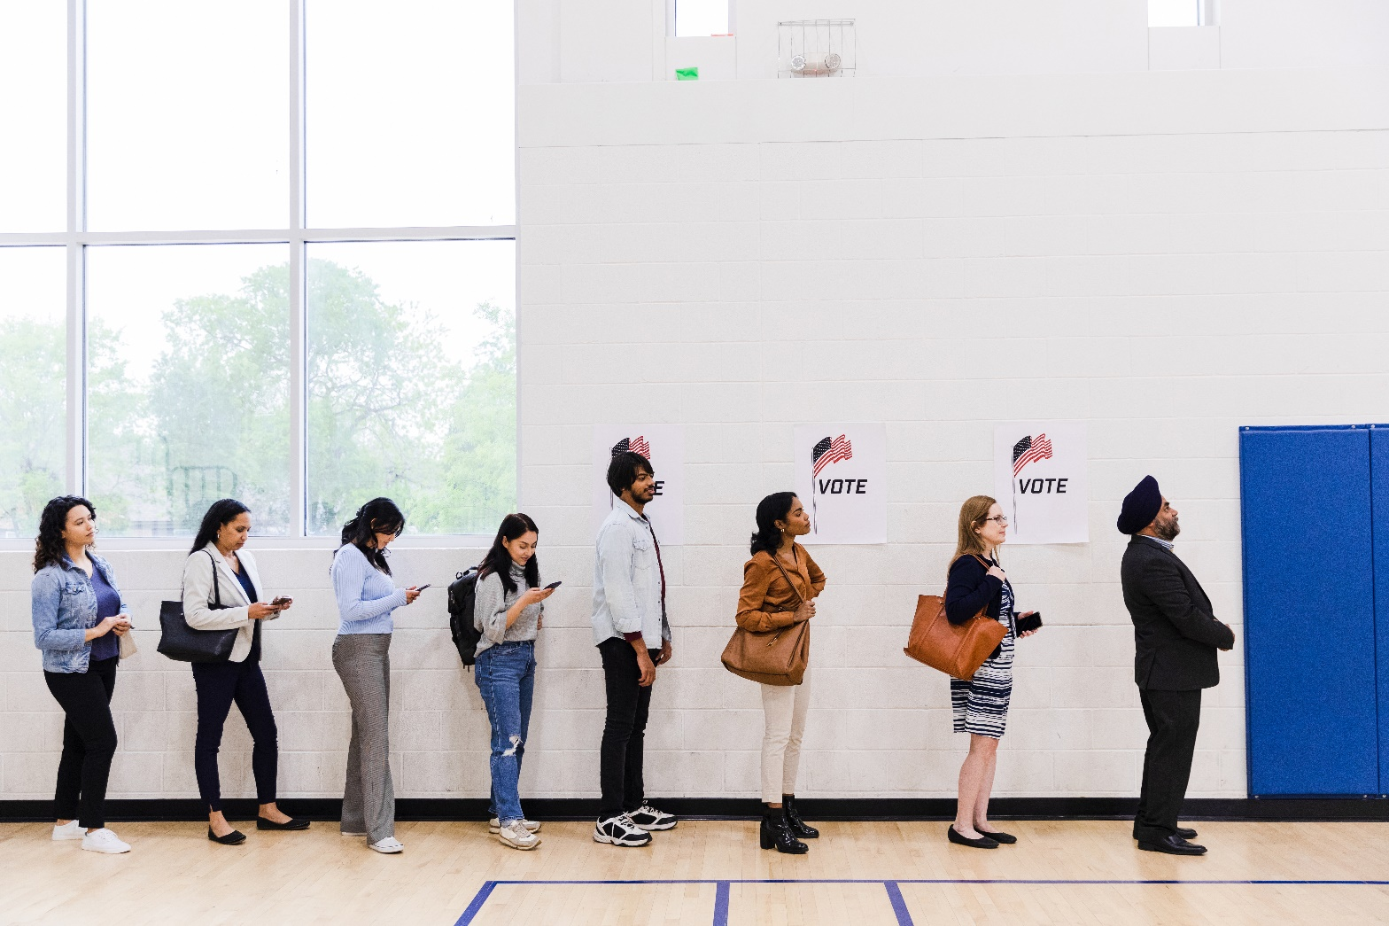
Moderator & Citizen Complaints
Moderator
Officer on-hand (ROV)
Disorderly person refuses to leave polling place
Complainant or Witness
Citizen
Complainant
Witness
Notes:
If you are at the polls in response to a moderator or citizen complaint, make contact with the moderator. The moderator also documents the events of election day at their polling place. Their notations may be helpful to you if documentation of your encounter with the public is necessary.
Bottom Line: Whether you find yourself at a polling location at the request of a registrar of voters, or in response to a citizen complaint, introduce yourself to the moderator.

Slide 9
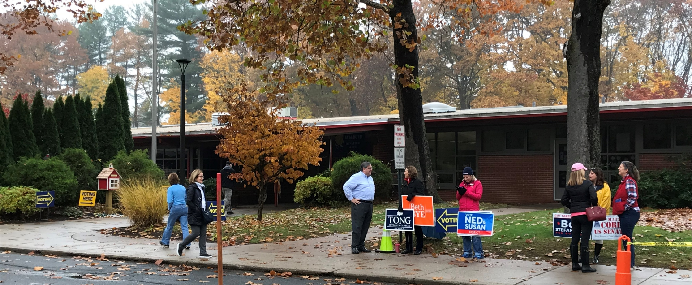
No Campaigning Inside 75 Foot Zone
Notes:
You may be aware from your personal experience visiting a polling location that no person shall solicit, loiter, or peddle or offer any advertising matter, ballot or circular to another person inside of the building or within a 75-foot radius of the outside entrance to the building…otherwise referred to as “The 75 Foot Rule”.
A familiar example is the typical lawn sign. Lawn signs are NOT permitted within the 75-foot zone. An officer may encounter other types of campaign activities that are not always so straightforward.
You may not be familiar with the scenario where permissible activities at the edge of the 75-foot zone develop into a disturbance on election day. Common forms of election-related speech up to the edge of the 75-foot zone are permitted – a person can speak, hold or place a sign, pass out leaflets or wave candidate flags up to the edge of the 75-foot zone, as long as it does not interfere with the orderly process of voting. If there is a disturbance at the edge of the zone, however, the moderator should be contacted if safely and practically possible. Disturbances in an area outside the 75-foot zone should be addressed like any other disturbance.

Slide 10
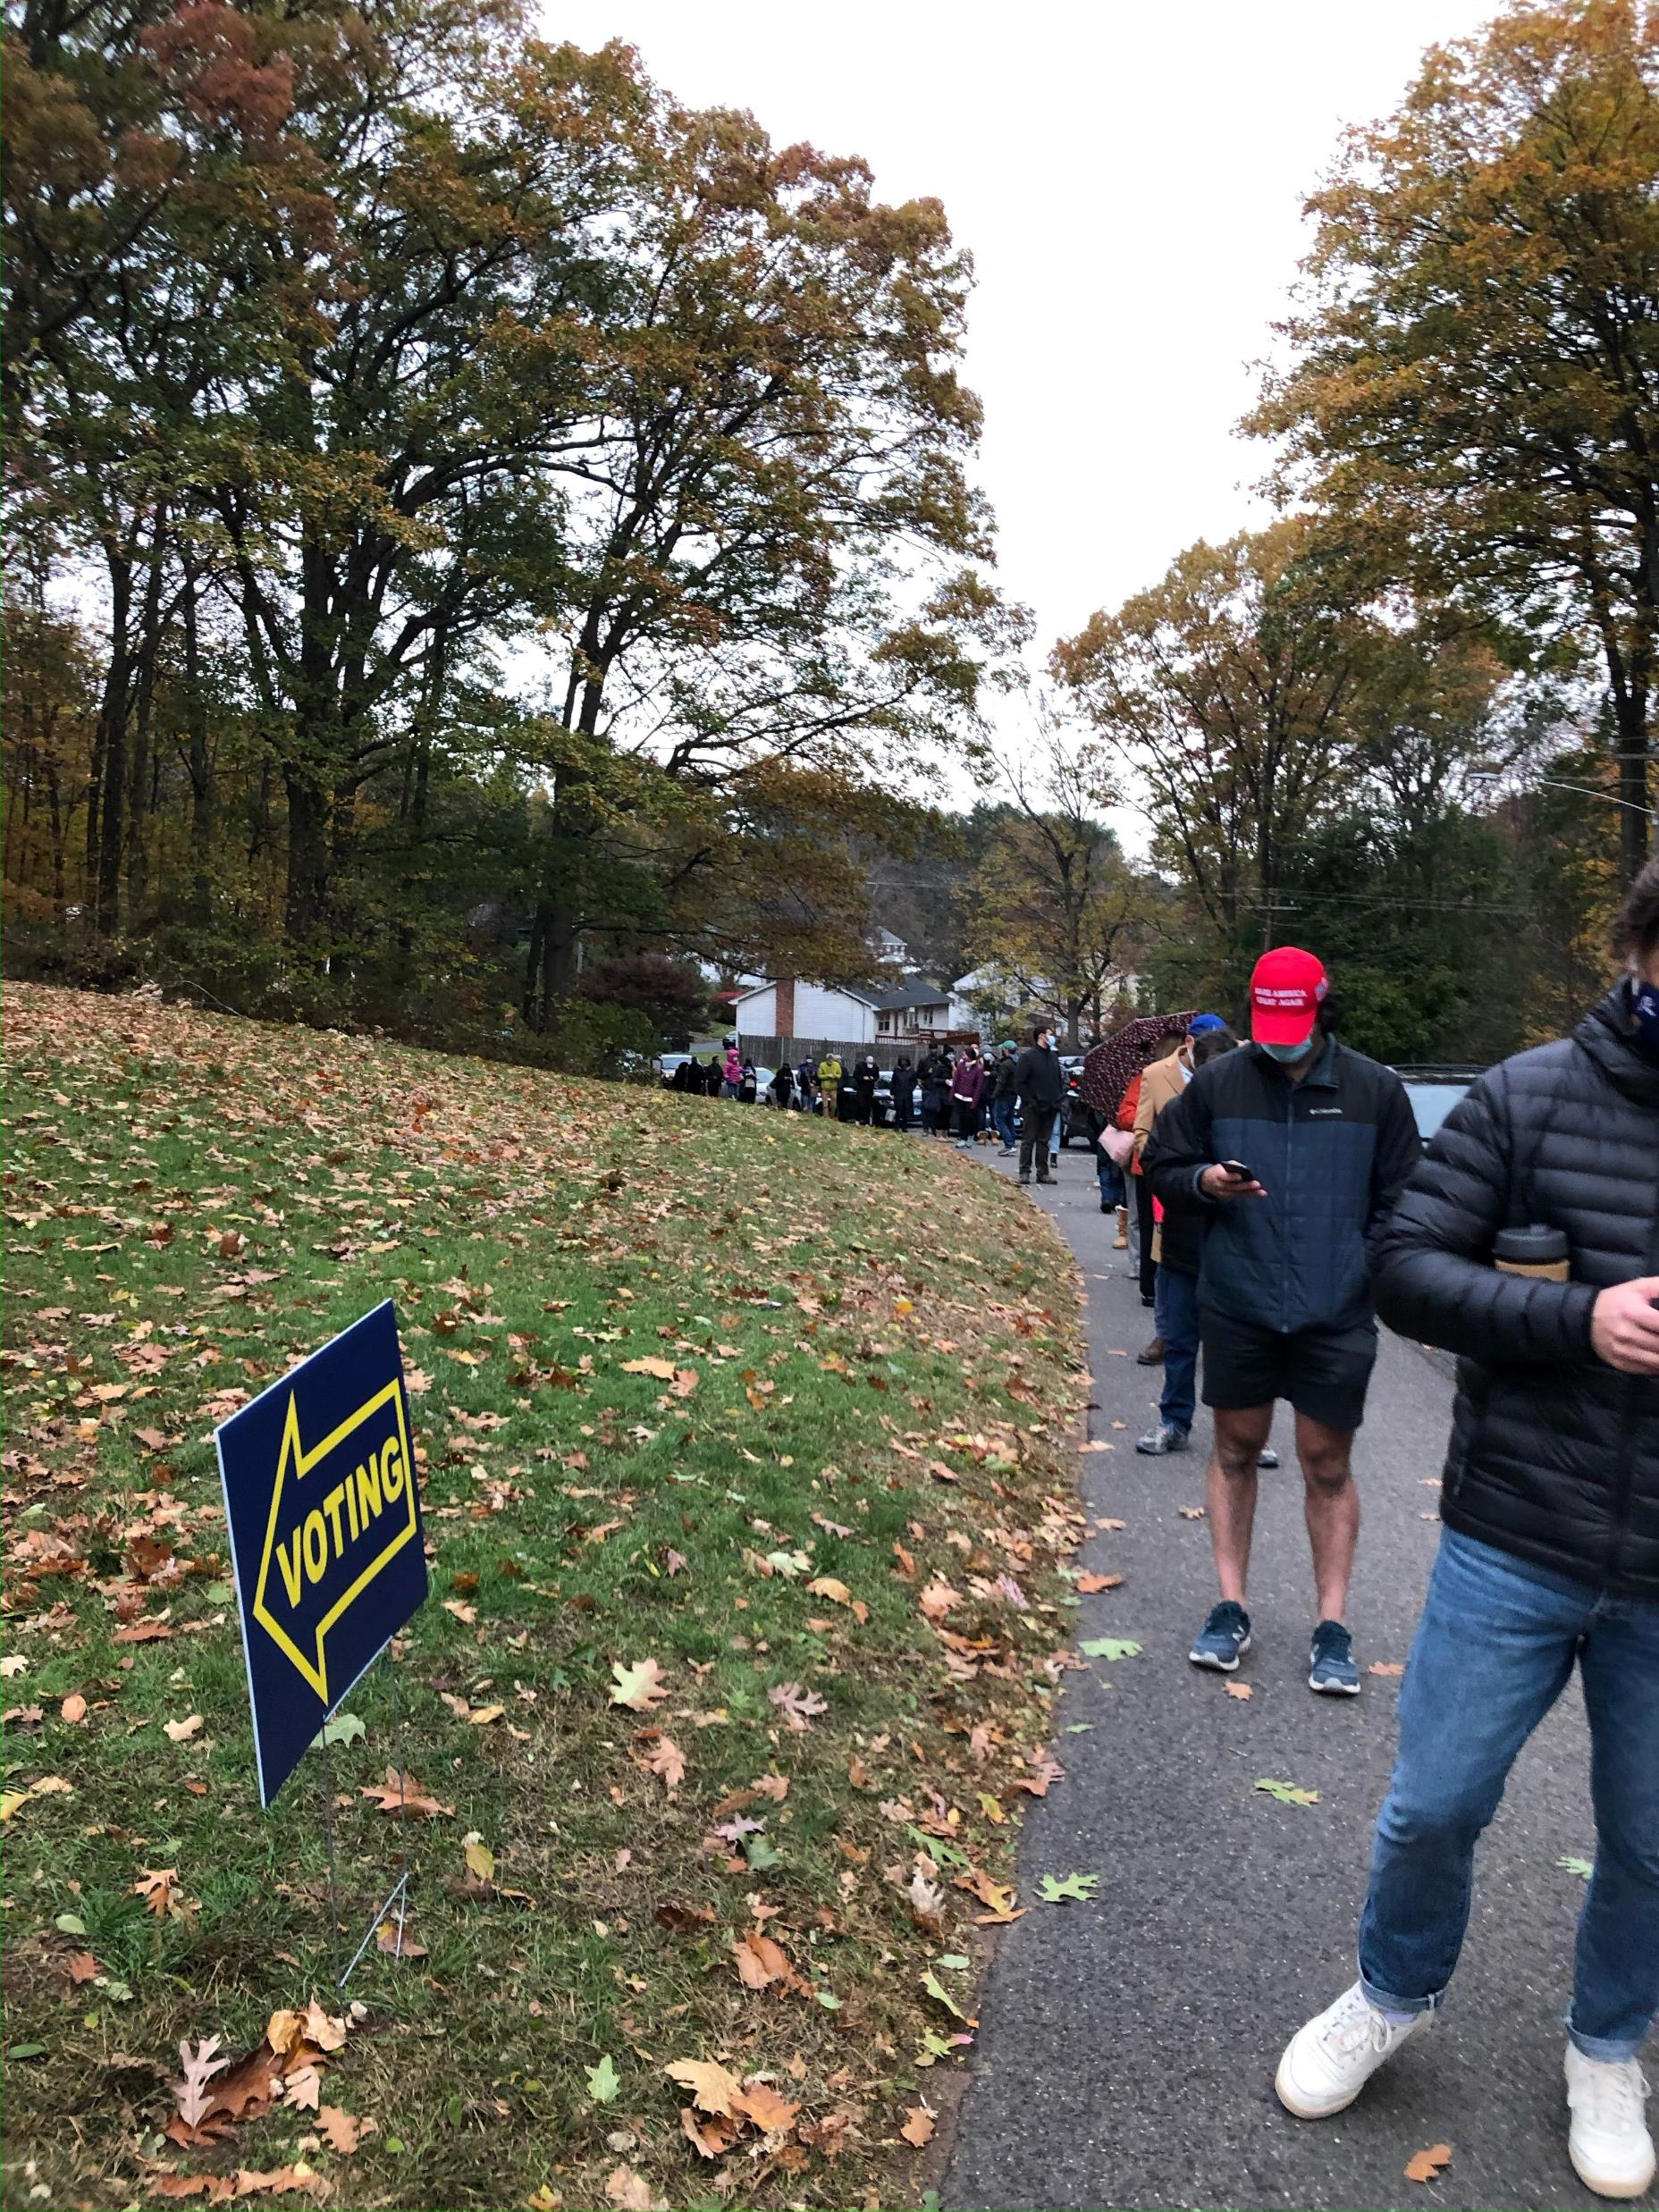
It is not your affirmative duty to “police” the attire of the visitors of the polling place or people expressing their political opinions within the 75’ zone.
Notes:
Another not-so-simple example has to do with clothing or items carried on the person of a voter. While a polling place and the 75-foot zone around it are supposed to be mainly a “politics free” space, people are not barred from entering those areas simply because their clothing and other items on their person could be interpreted as having a political message. The line for voter’s clothing and paraphernalia is whether the items message expressly advocates for the election or defeat of a specific candidate or issue on the ballot. “Express advocacy” includes the name of a candidate on the ballot. It does not include the motto or symbols of a political campaign or social movements.
Even if a person enters the early voting or polling place wearing items that encourages voters to vote a certain way and conveys support for or against a specific candidate or issue on the ballot (known as “electioneering”), they will not be barred from voting. They will have an opportunity to come into compliance. The voter is permitted to stay in the polling place to complete their vote if the person removes or covers the offending article.
Be aware, it is not your affirmative duty to “police” the attire of the visitors of the polling place or people expressing their political opinions within the 75-foot zone. This is first the business of the moderator, who can seek law enforcement assistance if there is a person who needs to conform their conduct to the rules.

Slide 11
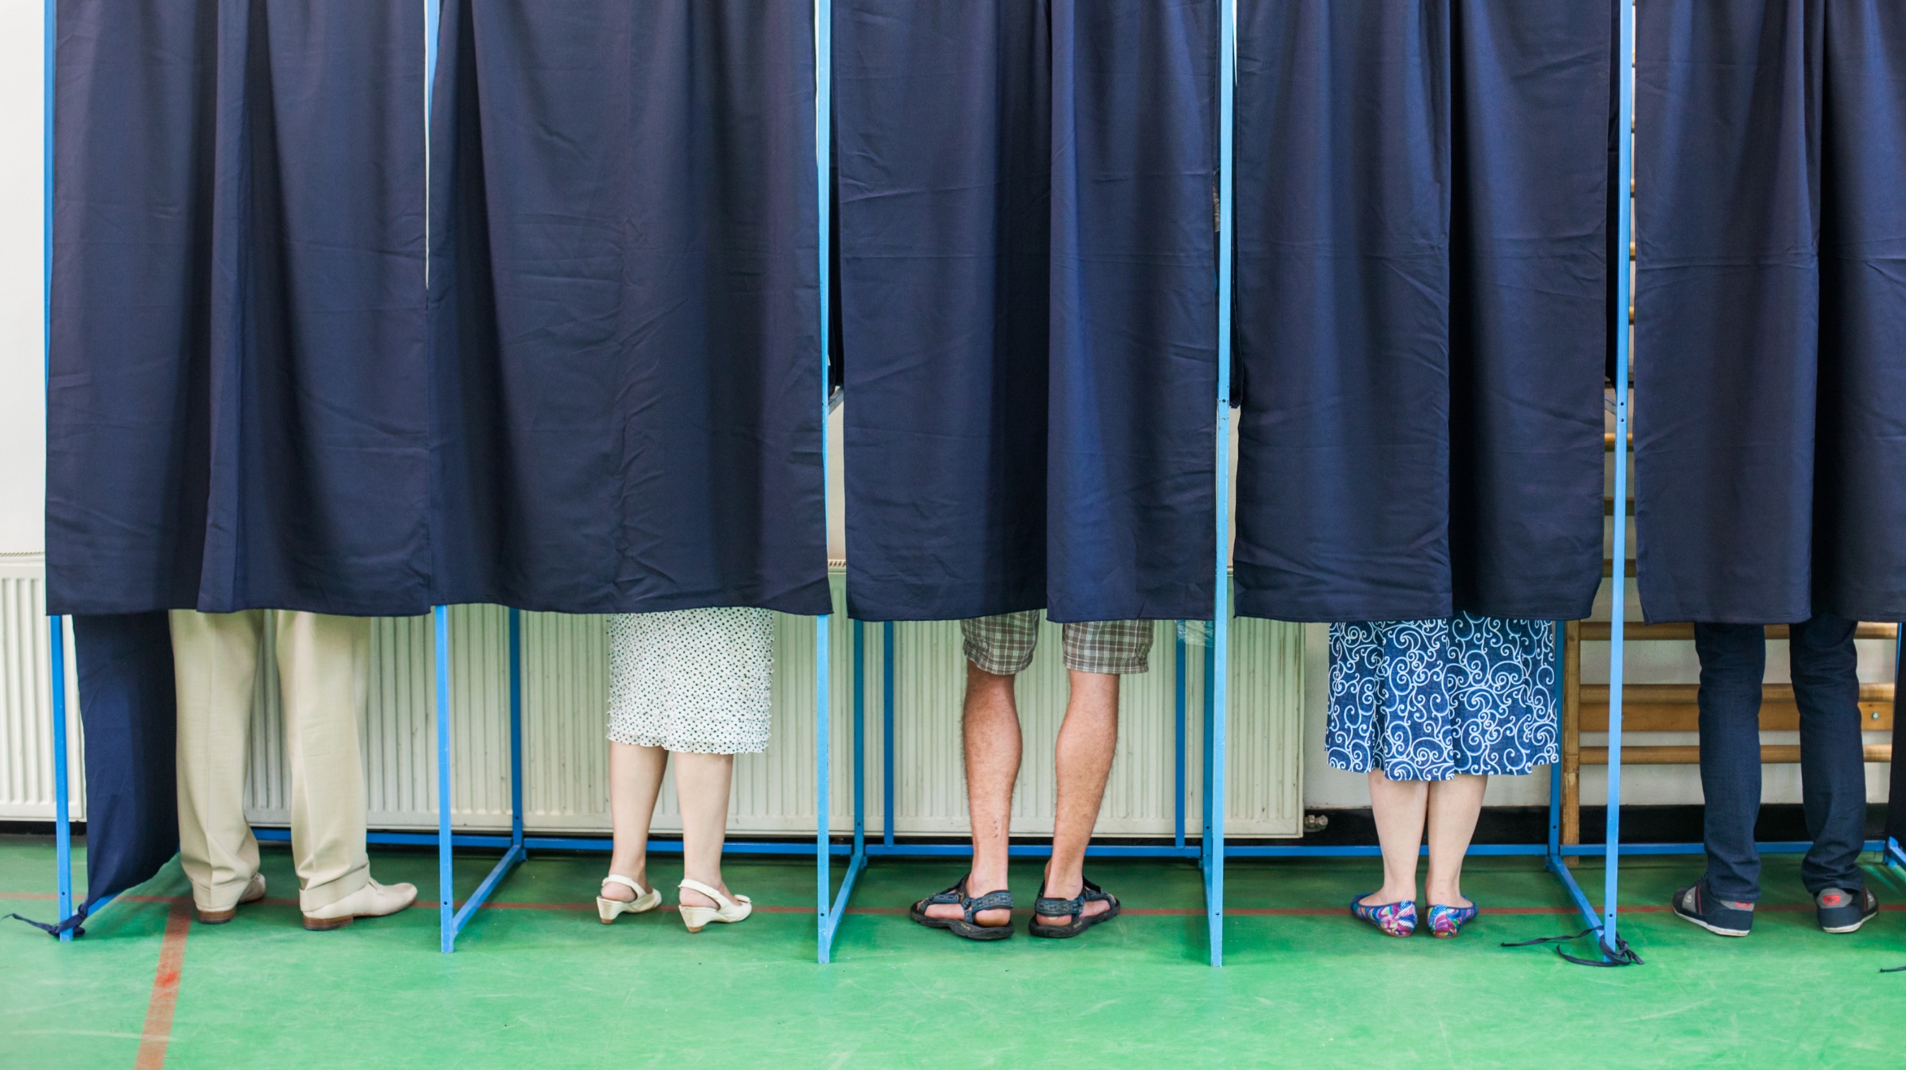
Voters have the right to fill out their ballot in private.
Notes:
It is also a well-known rule that voters have a right to vote privately. The mechanics of enforcement are not always straight-forward.
The secrecy of the ballot is preserved by restricting access to the area around the voter. Law enforcement should not enter the area of the polling place where voting takes place, particularly if they are wearing body cameras, unless there is an emergency that requires it.
The news media are permitted in the polling place with permission of the moderator. If the moderator determines their presence interferes with the orderly process of voting, the members of the media can be removed. No person who is a member of the news media can interfere in the right of a voter to a secret vote without influence.
Voters who wish to disclose the content of their own ballots before they are cast, like in the case of “ballot selfies,” are not prohibited from doing so. However, the practice is not encouraged by the Secretary of the State and a voter who does engage in this conduct cannot do so in a manner the jeopardizes the secrecy of another’s voter’s ballot.

Slide 12
State and Municipal Employees and Political Activities
Public Employees Retain their 1st Amendment Rights except:
Employed (yes) v. While on Duty (NO)
Using Municipal Assets (NO)
Using Official Authority/Influence = Interfere or Affect Election Result (NO)
* The HATCH ACT limits certain political activities of employees who work in programs financed by the federal government … local law enforcement DO receive federal funding
Notes:
Remember, your assignment or call to the polls during early voting and Election Day DOES NOT involve expressing your personal political opinions.
Public employees DO retain their First Amendment rights while so employed. Public employees can vote as they choose and express their opinions on political subjects and candidates. Public employees are free to participate in political management and campaigns, can be a member of a political party or hold office, and campaign for a candidate. Public employees can be a member of an organization or club and participate in a long list of other First Amendment activities
What you do while employed is different than what is permitted while on duty.
A public employee may NOT engage in such activity while on duty or within any period of time during which such employee is expected to perform services for which they receive compensation.
A public employee SHALL NOT utilize municipal funds, supplies, vehicles or facilities to secure support for, or oppose any candidate, party, or issue in a political partisan election.
Moreover, a public employee may not use their official authority or influence to interfere with or affect the result of an election. This is prohibited by state and federal law.
A federal law known as the “Hatch Act” regulates political activities for state employees whose duties and responsibilities are performed in connection with federal financed activities. The Hatch Act also prohibits an employee from using their official authority to influence or interfere with or affect an election.

Slide 13
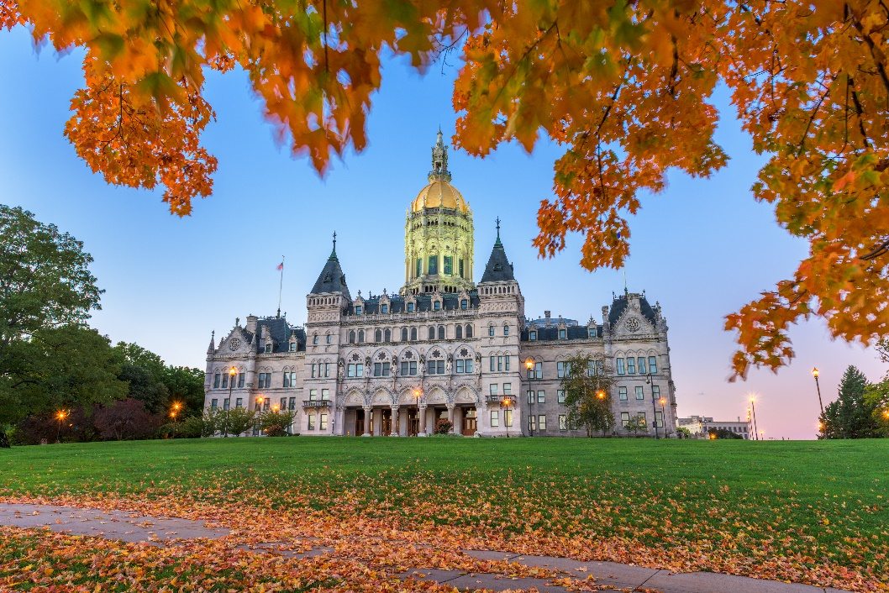
Connecticut General Statutes
Carrying a Pistol or Revolver CGS 29-35
  With a permit 29-35(a)(1)
  Concealed (a)(2)
  Permit Stop & Show (b)
Carrying a F/A in a Prohibited Place CGS 29-28(e) / 29-37(a)
Possession of a Weapon on School Grounds CGS 53a-217b
Breach of Peace & Disorderly Conduct
Threatening CGS 53a-61aa, 53a-62
Criminal Mischief CGS 53a-115 thru 117a
Criminal Trespass 53a-107 thru 110a
Signage – Permits & Local Ordinances
Notes:
Though the polling place may shed some of its classification of “public space” during Early Voting and on Election Day, the criminal laws within the Connecticut General Statutes are not diminished by the election season. Some statutes that are relevant to common complaints at or outside the polling place include, but are not limited to, the requirement that a person have a permit to carry a pistol or revolver upon their person, and that one must carry such permit while carrying said pistol or revolver. The requirement that the pistol or revolver be concealed and not knowingly and purposefully displayed remains enforceable. The requirement that a person show an officer their permit while carrying if the officer sees the firearm and has reasonable suspicion of a crime -- in order to verify the validity of the permit or identification of the person – also retains its intended effect.
The laws prohibiting the carrying of a firearm in prohibited places are also not diminished. A permitted person cannot carry a firearm into a place where the owner or person in control of the premises prohibits firearms, simply because they have a permit. Weapons are prohibited from being carried on school grounds. A person cannot carry a firearm into a polling place that is a school during early voting or election day, even if the person is otherwise carrying their pistol or revolver in the manner required by law. A valid permit does not override prohibitions under law on any day of the year.
The governmental interest in orderly and influence-free voting is very strong at the polling place. Breach of peace, disorderly conduct, and threatening behavior are not permitted.
It will be helpful to familiarize yourself with local rules related to posting of fliers in places other than the area near a polling place either on election day or the time leading up to it. State laws like criminal mischief and trespass may also be applicable.

Slide 14

FBI Role in Election Crimes
18 USC 592 prohibits the sending or stationing of federal "armed men" at polling stations or tabulation centers.
Except exigent circumstances to prevent injury to life – Acts of Terrorism, Shooting, Bombing, and Acts of Impending Violence
Federal election violations: Voter/ballot fraud, voter suppression/intimidation, vote buying schemes, campaign finance violations, threats to election workers or polling locations and cyber intrusions.
Notes:
Our federal partners are also involved in the investigation of matters concerning elections.
Federal election violations include but are not limited to: voter/ballot fraud, voter suppression or intimidation, vote buying schemes, campaign finance violations, threats to election workers or polling locations and cyber intrusions.
Section 592 of Chapter 18 of the United States Code has been interpreted to mean that federal agents cannot overtly respond to polling stations or tabulation centers to investigate crimes during an election. However, you should still report an incident to the FBI where warranted because the FBI IS permitted to take non-overt investigative steps.
Only in response to exigent circumstances, such as acts of terrorism, shooting, bombing or acts of impending violence, when such response is intended to prevent injury to life, will any FBI Special Agent conduct any investigative activity at or near a polling location or tabulation center during an election. This is because, during such an event, the polling location has ceased to operate as a polling location.

Slide 15

Responding to Election Day Threats
Joint Hazardous Materials Assessment Teams will be available on Election Day to provide rapid credibility assessments of any potential threat to a polling location. The goal is to keep polling locations open. The JHAT teams are made up of local, regional, state and federal haz mat team members. If you have any questions, please contact demhs.fieldsupport@ct.gov.
Notes:
On Election Day, Joint Hazard Mitigation Assessment Teams will be ready to respond to help keep polling places open by reducing the time it takes to determine if a threat is credible. Supporting partners include local, regional, state, and federal hazardous materials and bomb teams. These resources are NOT meant to replace your local municipal response.

Slide 16
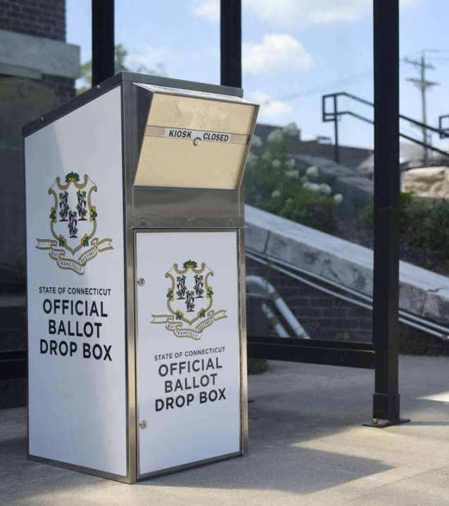
Resources
CTIC – Call 860-706-5500 or e-mail ctic@ct.gov.
DCJ – Call your Inspector in your Judicial District.
FBI – Call FBI New Haven 24/7 @ 203-777-6311.
OAG – Call Maura Murphy, Special Litigation Section Chief @ 860-808-5020.
SEEC – Call Staff Attorney William Smith or Legal Investigator Ronald Perry @ 860-256-2940.
SOTS – Call the general line @ 860-509-6100 or the Hotline during EV or on Election Day @ 1-866-733-2463
Notes:
If you have any questions related to the information that has been presented to you today or need assistance on election related matters do not hesitate to reach out to the members of the Election Security Working Group.

