Slide 1

Presented By:
Amy M. Blazawski, MSW, LCSW, CESP
Self Determination Director, NR
Supporting a Self- Determined Life!
Notes:
Thank you Deputy Commissioner Velardo, and thank you everyone on this beautiful morning for joining us. At DDS CT we have 3 regional Self Determination Directors, and today you’ll be hearing from each of us regarding the concepts Self-Direction, and how to get started. We currently support approx. 2,000 individuals and their person-centered planning teams to direct their own supports and services, and we are continuing to grow as we support and develop new and innovative ways to make Self direction a first option through offering an opportunity to build a complete and holistic person centered support package.
We will explore some basics and answer questions following the presentation, however, pls post them in the chat if possible! So, let’s get started!

Slide 2


There is a difference between
Self-Determination and Self-Direction!

Slide 3
What is Self Determination?
Self-Determination is a value that is expressed when individuals learn about basic rights; use this knowledge to broaden their experiences; and use these new experiences to make informed choices about new ways of living and being.
Self-Determination means taking greater responsibility and control of one’s life.
Notes:
Blaze

Slide 4
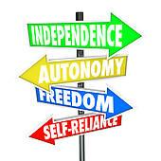
Self-Determination
Freedom to decide how to live their lives.
Support they need to live full self determined lives.
Authority over their resources and supports.
Responsibility for their decisions and actions.
People living self determined lives have:
Self Determination is based upon a foundation that encourages and supports: Respect ,Dignity, & Dreaming…Whatever It Takes!
Notes:
Blaze

Slide 5

Self-Determination
Everyone has the right to direct their own future
Everyone should have control over how they live their lives, where, and with whom
Everyone should have authority over the resources that support them.
Notes:
Blaze

Slide 6
Principles of
Self-Determination
CHOICE
DIGNITY AND RESPECT
RELATIONSHIPS
CONTROL
DREAMING
CONTRIBUTION AND COMMUNITY
FISCAL CONSERVATISM
ROLES AND RESPONSIBILITIES
WHATEVER IT TAKES
Notes:
Blaze

Slide 7

Self-Determined Life Outcomes
Self-awareness
Self-advocacy
Self-confidence
Self-evaluation
Self goals and actions – informed decision making
Self-management
Self-adjustment to improve one’s success
Notes:
Self-awareness – begins with the ability to identify and understand one’s needs, interests, strengths, limitations, and values
Self-advocacy – refers to the ability to express one’s needs, wants, and rights in an assertive manner
Self-confidence – the belief that on expects to obtain his or her goals
Self goals and actions Decision making is the complex skill of setting goals and actions, identifying information to make decisions, and choosing the best option to implement one’s plan
Self-management – independent performance is one’s ability to start and complete tasks through self-management strategies
Self-evaluation – includes the ability to self-assess one’s performance and determine when a goal or task has been satisfactorily completed
Self-adjustment – adjustment is the process of revising goals and plans to a improve one’s performance or success

Slide 8
What is Self Direction?
Self Direction is a service delivery model that individuals can use to become more self-determined and to have greater control and authority in their lives. The self-direction model affords the individual the ability to hire and manage employees to provide specific services, goods or equipment.
Self Direction is a path one can choose to become more self-determined.
Notes:
BLAZE

Slide 9

Self-Direction: Think About It. . .
This is service delivery for individuals and/or designated representatives who wish to exercise more choice, control, and authority over their supports.
Self-direction gives waiver participants and families greater control over the services they receive, how they receive them, and who provides them.
Notes:
BLAZE

Slide 10

Self-Direction - Think About . . .
People who self-direct must be willing to take on the responsibility of managing their services
  You will be in control of your budget which is a fixed dollar amount for the purchase of services and supports available under the waiver
  You select and arrange for the services and supports in your individual plan
  You are accountable for using your budget to more effectively meet your needs and more efficiently use public dollars
  You are the employer of record
  You can hire, train, and fire employees.
Notes:
BLAZE

Slide 11
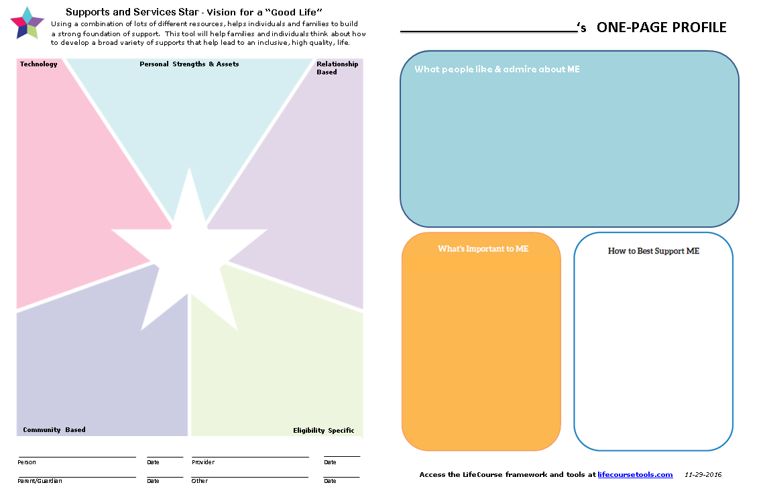
Materials to Use for Identifying Supports as well as what supports already exist…
Building a Person-Centered Plan!
Notes:
Blaze

Slide 12
PART 2:
Self-Direction Basics!
Denise Paladino, SD Director (South)
Dory Michael-Martusis SD Director (West)
Amy M. Blazawski, SD Director (North)
Notes:
ELISA-BLAZE

Slide 13
Supporting a Self Determined Life!
Self Directing Supports & Services
Employer of Record / Sponsoring Person Responsibilities
Notes:
Dory

Slide 14
Where to start…
Individuals who choose to self-direct their services must also understand the important roles of the Employer of Record and Sponsoring Person, and how to best fulfill employer responsibilities.
Notes:
Denise

Slide 15
Sponsoring Person
A Sponsoring Person may be needed to understand, sign, and carry out the responsibilities identified in the Self-Direction Agreement.
Notes:
Dory; The sponsoring person cannot be a paid employee of the person they sponsor. They serve as a “helper” in the process of Self Directing services & supports.
Reminder If not assistance is needed the person will function as the employer of record

Slide 16
Employer of Record (EOR)
The Employer of Record (EOR) is responsible to have a tax ID number officially assigned. (The FI will assist with this.) The EOR is many times also considered to be the Sponsoring Person.
Notes:
Dory : The EOR may not be a paid employee of the person they sponsor.

Slide 17
What is the Employer of Record / Sponsoring Person Responsible for?
Reviews and signs the Agreement for Self Direction and assists in the hiring process.
Reviews and signs the Employee/Employer Agreement Form.
Signs employee timesheets and ensures that they are accurate and reflect the waiver services as described in the Individual Plan.
Notes:
Denise

Slide 18

Public Partnerships
EOR Training Series:
New EOR’s are required to complete the series at their own pace, with guidance from PPL Staff.
Review roles and responsibilities of the EOR through a detailed explanation of the Self-Directed Support Agreement (SDSA).
Enhanced training for all existing EOR’s who may need a “refresher” for Self-Directed services.
Notes:
Denise

Slide 19
Choose a Fiscal Intermediary
Review Agreement w/ the Employer of Record
Obtain an Allocation
Develop & Manage Budget
Agreement for
Self Directed Services
Steps to Self Direct
Notes:
Blaze
Reference the slide to see the progressive steps

Slide 20
Agreement For Self Directed Supports
The Self-Directed Support Agreement is the tool that DDS uses to ensure that individuals who choose to self-direct their services fully understand their employer responsibilities.
This agreement identifies what supports the person may need to effectively implement Self Directed Supports.
If adequate supports are not identified in the Self-Directed Support Agreement, DDS will not authorize self directed supports.
Notes:
Dory

Slide 21
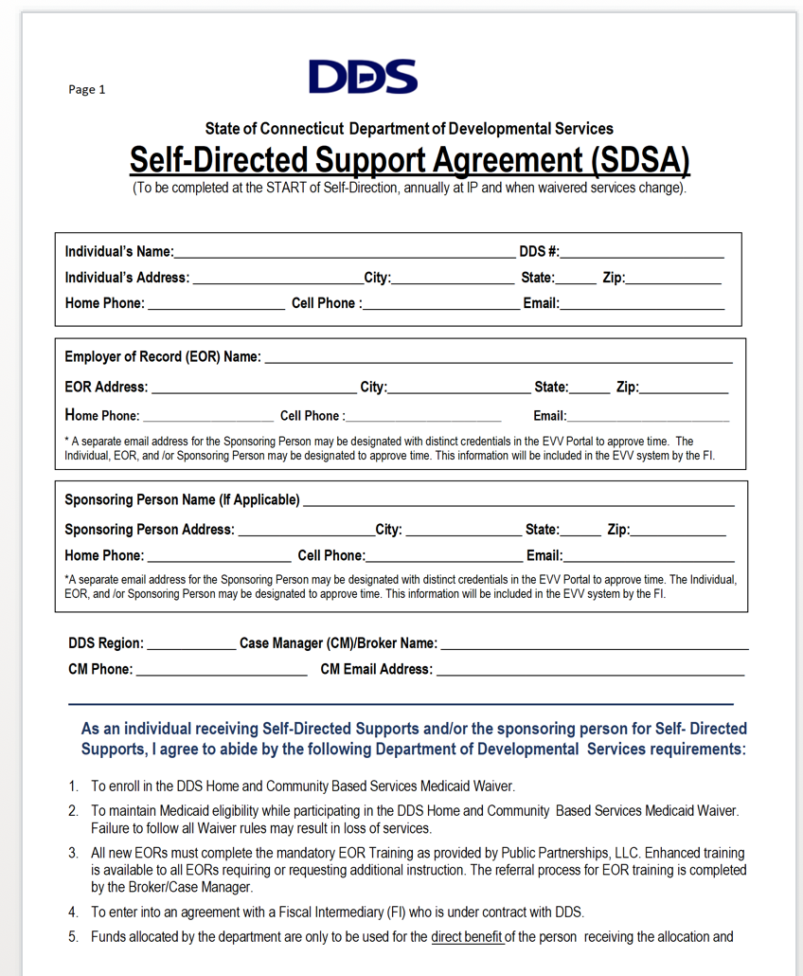
What does the Agreement For Self- Directed Supports look like?
Notes:
Dory: This is the checklist for self directed support agreement
The CM/Broker will review with consumer

Slide 22

Role of the Fiscal Intermediary
Individuals who chose to self direct their services must select a Fiscal Intermediary (FI) to help them manage their employer responsibilities and manage their budget.
FI’s help individuals with the following tasks associated with the Budget:
Complete state and federal employer forms, pay staff, purchase Worker’s Compensation, ensure tax compliance, and prepare end of year reports.
They also perform background checks on new employees, ensure employees complete required CDS and identified trainings, pay vendor bills, and assist individuals to stay within their budget.
Notes:
Blaze

Slide 23
Fiscal Intermediary (FI)
ROLE OF THE FI (Cont.)
BUDGET MANAGEMENT
Documentation of funds and expenditures through monthly and quarterly reports.
Payment processing in accordance to individualized plans.
Notification to Case Manager when budgets are exceeded or need to be adjusted.
Monthly and quarterly reports to you, as well as your DDS representative.
Privacy through HIPPA compliance.
EMPLOYER ASSISTANCE
Training and assistance with paperwork to all new and existing employers in their own home.
Background and DDS registry checks as required.
Responsible for all documentation & records related to tax withholdings and Dept. of Labor law compliance.
Assistance with obtaining Workman’s Compensation Insurance and payment of premiums.
Process Employee time and issue paychecks.
Electronic Visit Verification
Notes:
Blaze

Slide 24
Finding Employees
Choosing Employees
Keeping Employees
Offering the Job
Steps to Hiring & Managing Staff
Managing Staff
Notes:
Denise

Slide 25
Finding Employees
One of the most challenging aspects of being an employer is finding good employees!
Develop an employee job description with needed qualifications.
Sponsoring Persons /EOR’s/ Brokers can also help individuals learn effective marketing techniques and teach them how to use natural support systems to recruit employees.
Notes:
Denise

Slide 26
Recruitment Techniques
Word of Mouth
Local Flyers (Colleges, places of worship, libraries, etc…)
Paid Advertisements
Internet Employment Services (“Rewarding Work”, “Care.com” or other employment services such as “Monster.com”).
DDS contracts with:
REWARDINGWORK.ORG
ACCESS CODE: CTddsconnect
Notes:
Denise

Slide 27
Contacts:
Denise Paladino, SD Director (South)
denise.paladino@ct.gov
Dory Michael-Martusis SD Director (West)
dory.michael-martusis@ct.gov
Amy M. Blazawski, SD Director (North)
amy.blazawski@ct.gov
Notes:
Dory

