Slide 1





A Trusted Tool to
Connect with Caregivers
Including Respite
Care Providers

Slide 2

About Rewarding Work
OUR MISSION
To assist people with disabilities and their families, making it possible to live at home or in the community of their choice, by connecting them with care - when and where they need it.
• Established in 2004
• First web-based matching service directory of its kind
- Supports Self Direction & Respite Care
- Free to individuals and families receiving services through CT DDS
• Affiliate of TILL, Inc. since 2018

Slide 3




Connecting to Care
Supports Self Direction
• Companion
• Respite Worker
• PCA
• Individual Home Support
• Individual Day Support
• Behavior Specialist
• Job Coach
• Skills Trainer
Filter and Search
Your Area
Targeted recruitment
efforts
Job Board and Applicant Directory
Automatic
notifications
A Resource You Can Trust
Customer Support
M-F 9-5 EST

Slide 4



A Modern and Intuitive Resource
Website
  • Mobile friendly and
  ADA compliant
  • Translate to any language
  • Helpful resources
Tool
  • Personalized dashboards
  • Powerful search engine
  • Easy to use job board
  • Secure database
  • Up to date applicant pool
  and job postings
Features
  • Automated notifications
  • New & updated
  applicant indicators
  • Video tutorials
“I want to thank you for your great website. I have to say we’ve tried about half a dozen agencies and they didn’t provide any better candidates than your website did (and of course we’d have ended up paying a lot more)."
FAMILY CAREGIVER

Slide 5
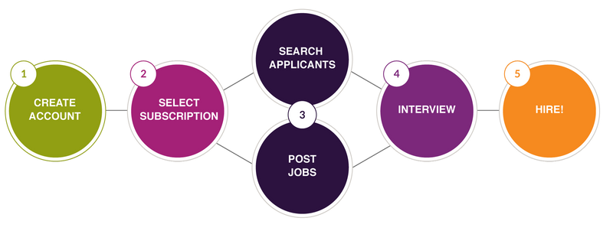
How it Works For Employers
Video Link
Video Link
Video Link
As an employer using Rewarding Work, your information remains confidential at all times and is not visible to applicants.

Slide 6



Subscription
DDS Access Code
• Individuals and families receiving CT DDS Services
• Access code is valid for a free 12-month renewable subscription: ctddsconnect
• Access to the directory & 5 job postings per month
Individual
• 1-month, 3-month, 6-month, 12-month options
• Access to the directory & 5 job postings per month
Agency
• 3-month, 6-month, 12-month options
• Up to 5 employee accounts
• Access to the directory & 10 job postings per month
Click Here to learn more about our subscription options

Slide 7

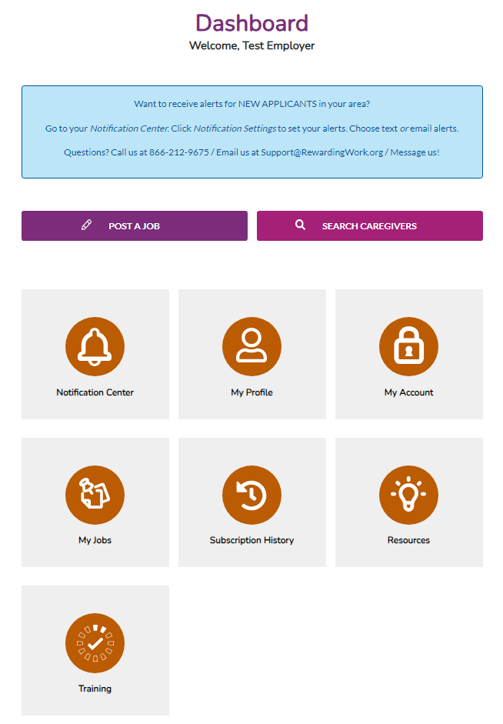
Employer Dashboard
Notification Center
• Set up text or email alerts
My Profile
• User info (internal only)
My Account
• Email and password
My Jobs
• Create, edit and republish
Subscription History
• Subscribe and renew
Resources & Training

Slide 8
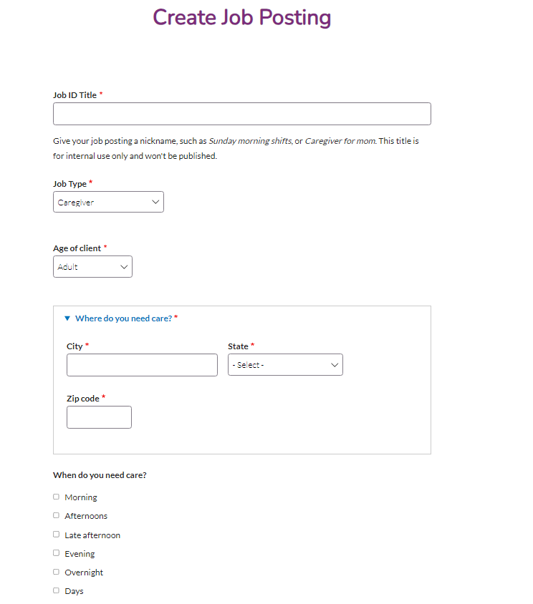
Job Posting
Job Postings are Live for 30 Days
• You can edit and also repost
Job ID Title
• For your use only
Hourly Pay Rate
• Helps attract candidates
Description
• The more detail you offer the better chances you’ll make a match!
The best way to attract interested and available candidates is to post your job on the job board.

Slide 9
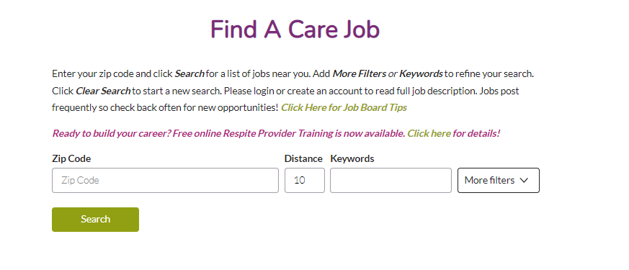
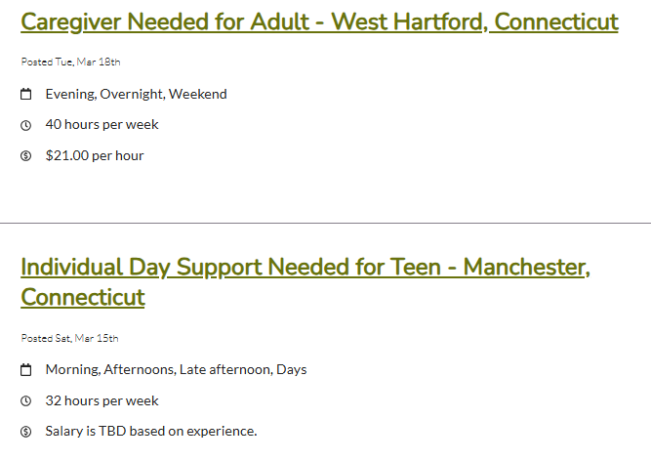
Job Board
Once published, your job will appear on the job board. When applicants apply, you’ll receive an email with a link to their profile. It’s up to you if you want to contact them.

Slide 10
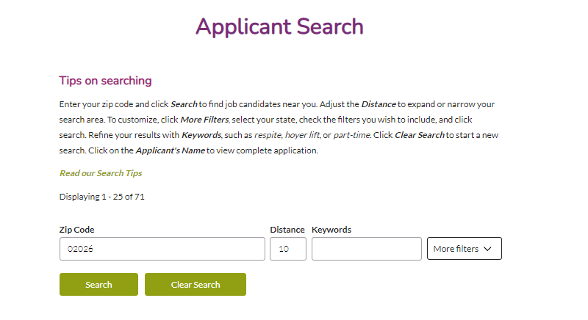
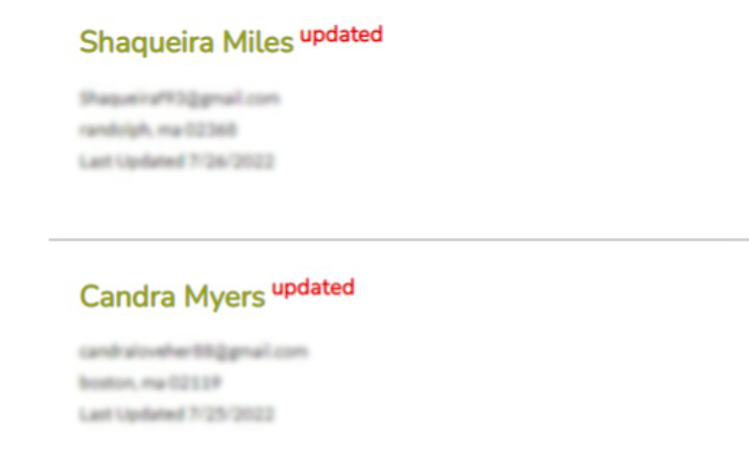
Search for Caregivers
Search for applicants in your area by entering your zip code, completing a keyword search or filtering for additional criteria.
The Applicant Search feature is secure and only accessible to subscribed employers.

Slide 11
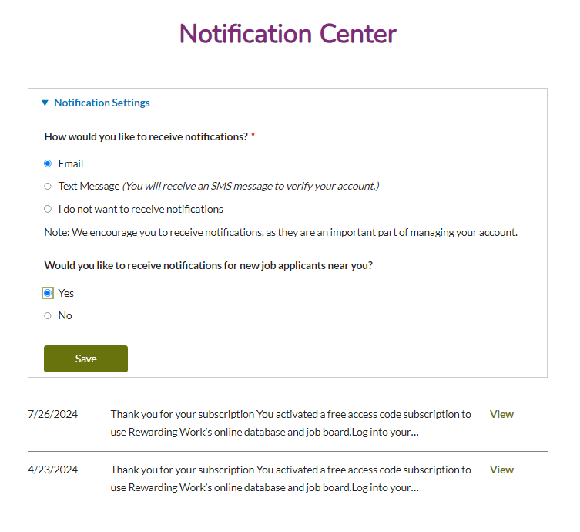
Tip! Set up alerts
Setting up notifications for new applicants in your area can help your search.
From your Dashboard, click Notification Center.
Then select and save Notification Settings.

Slide 12
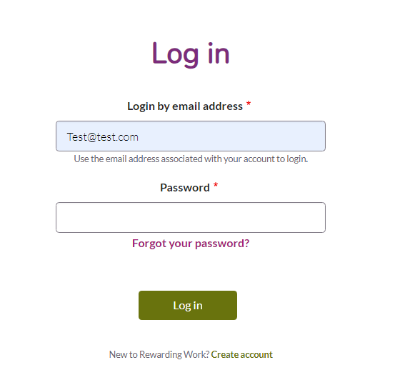
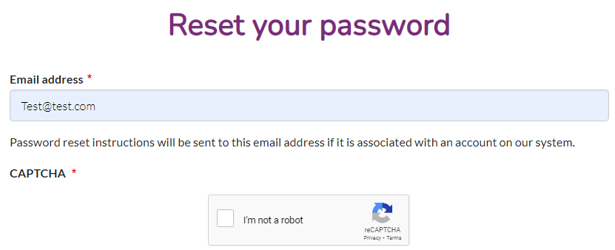
Forgot your password?
Click the link on the login screen to reset your password.
Then password reset instructions will be sent to your account email.

Slide 13







Always Here To Support You
Customer Support
Mon-Fri 9am-5pm EST
Phone: (866) 212-9675
Email: support@rewardingwork.org
www.RewardingWork.org
Follow us on Social
Thank You!

