Slide 1
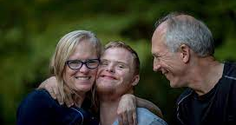

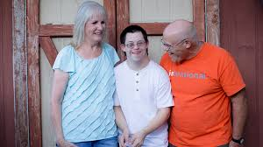
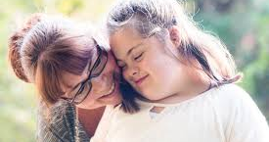


What is a
Community Companion Home? (CCH)
What is a
Community Companion
Home (CCH)?

Slide 2
Community Companion Home (CCH)
DDS licenses people to provide care and services in their home to adults or children with intellectual disabilities.
A CCH is licensed by DDS to make sure that the health, safety, and social needs of the individual are met.
A matching process is used to ensure a successful placement.
CCH home can be supported by a team comprised of a Case Manager, Compliance Coordinator, Nurse, and a Behaviorist to ensure a successful placement.

Slide 3
Why the CCH Model?
The CCH model is very successful in other states. In Vermont & New Hampshire is it the primary Residential Care Model.
Our average length of placement is close to 10 years with the longest successful placement currently at 36 years.

Slide 4
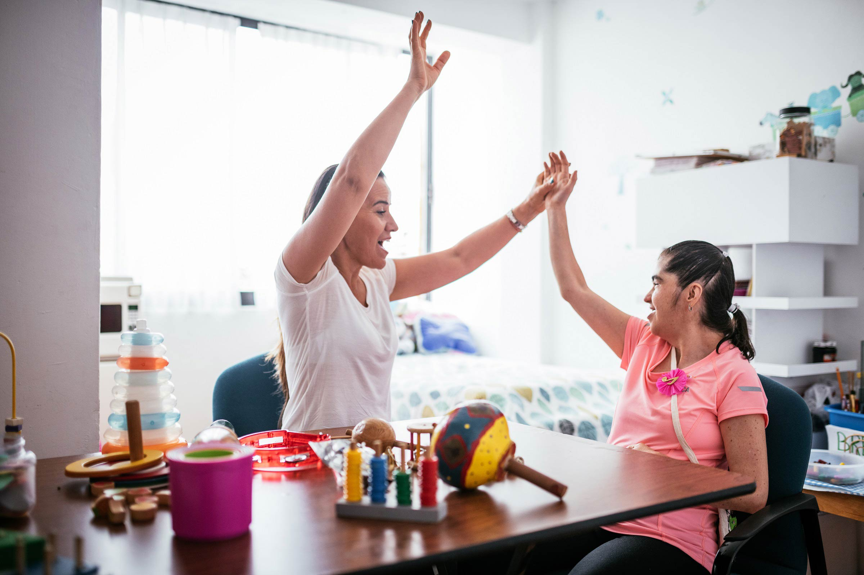
How do I become a
CCH Home?

Slide 5
What are the core elements of a CCH?
Initial CCH application process.
Applicant needs to provide proof that they are in good health.
Applicant provides three written references from people who are not related.
Background checks are completed on all occupants of the home over the age of 18.
Home Study interviews with the applicant and family.
The applicant’s home is put though a comprehensive Health and Fire Safety checklist.
Quality Reviewers from DDS Central Office will visit the home for an inspection to ensure that the environment is safe and that the CCH applicant has been properly trained.

Slide 6

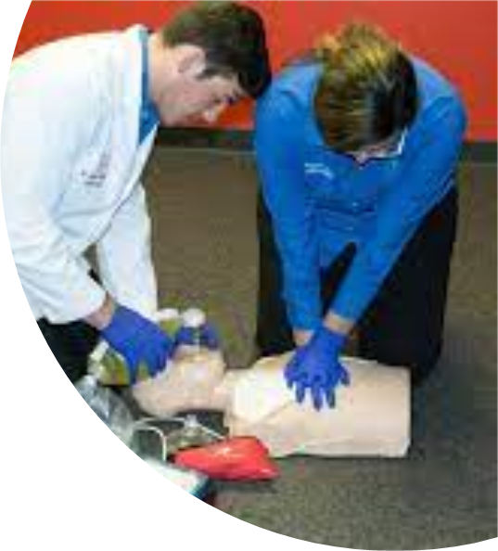

Training to become a
CCH Licensee

Slide 7
Training Information
Overview of disabilities, abuse & neglect prevention and reporting, program development, interacting with families, language and communication needs.
Essential safety training is required in: CPR, First Aid, infection control, medical & emergency procedures, positive behavioral supports and DDS policies and procedures.
There is also specialized, individual training sessions for topics that relate specifically to the person’s needs.

Slide 8


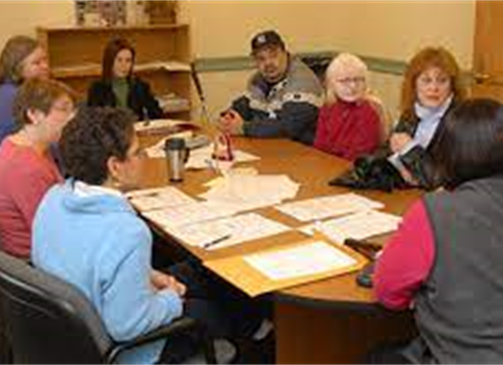
Responsibilities of a
CCH Licensee

Slide 9

Matching Process
An individual is matched based on similar interests and backgrounds.
Visits are conducted between the individual and the CCH.
The final placement decision is made between the individual, the CCH Licensee, and the individuals natural family.

Slide 10
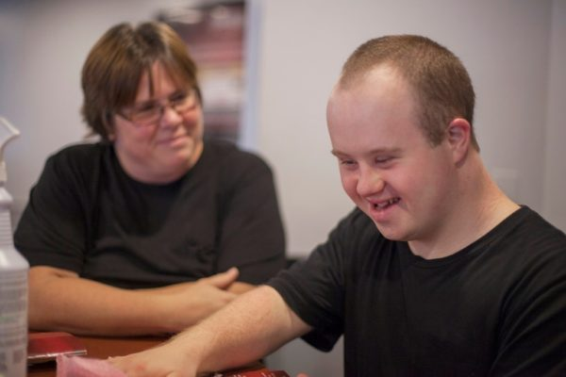
What is the role of the individual's family?
The individual's family is encouraged to play an active and ongoing role in the person’s life.
Family members attend meetings and assist in the development and review of the Individualized Plan
Family members can offer respite support to the CCH.

Slide 11
What are the roles of the Case Manager and Clinical Supports?
The DDS Case Manager will visit an individual a minimum of once every 3 months to see how the individual and the family are doing and to create and review the Individual Plan (IP).
DDS or Private agency staff member visits the CCH home monthly to assist and provide feedback to the Licensee.
Each home has nursing coordination and behavioral health services as needed to provide supports to the CCH.

