Slide 1

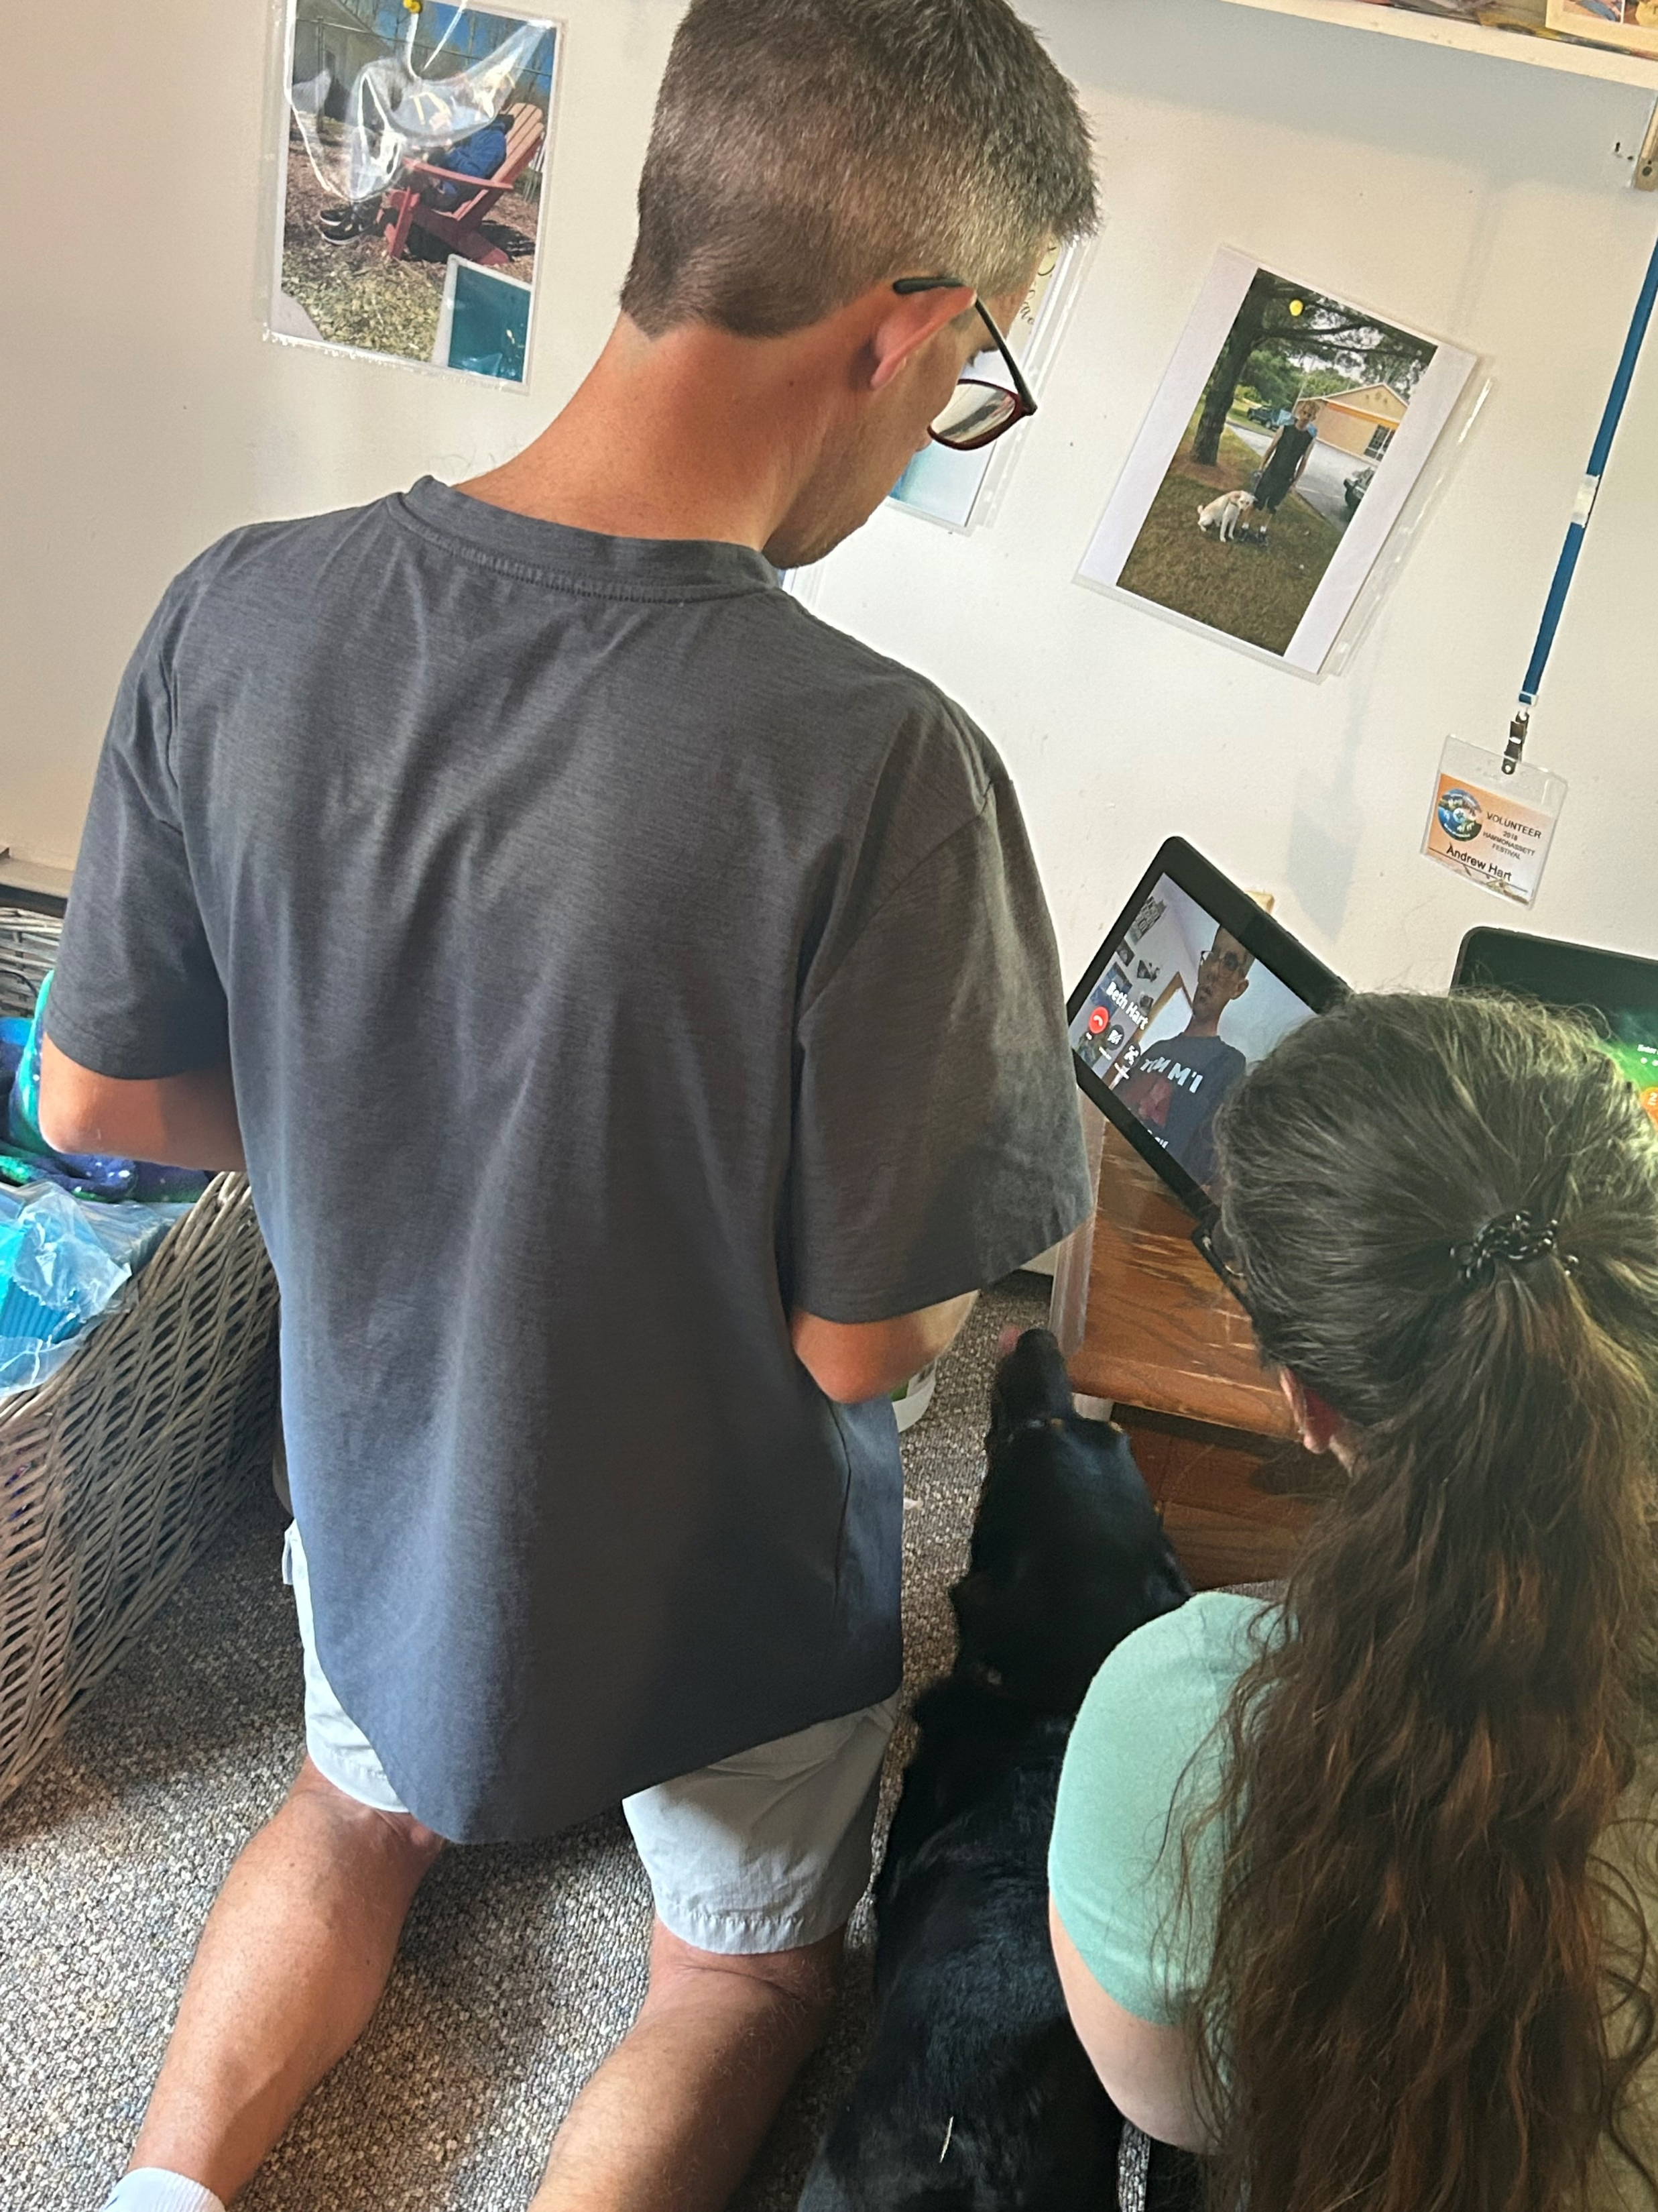
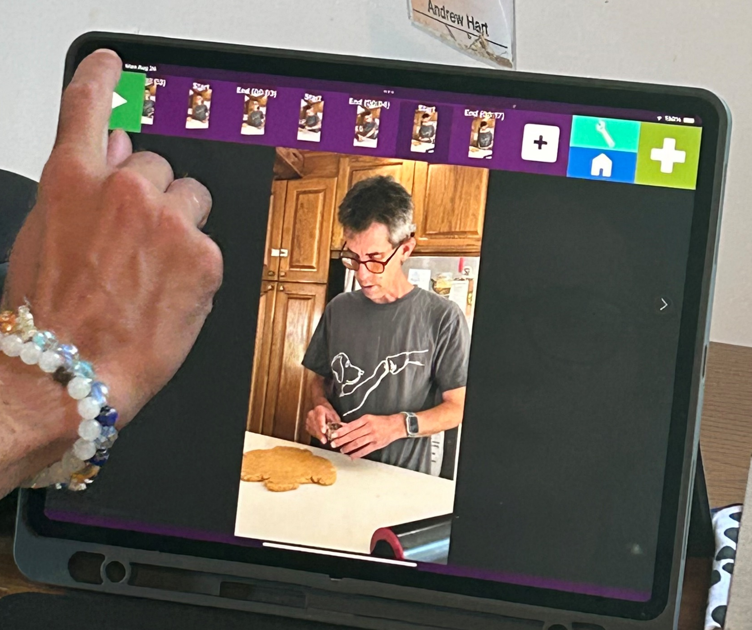
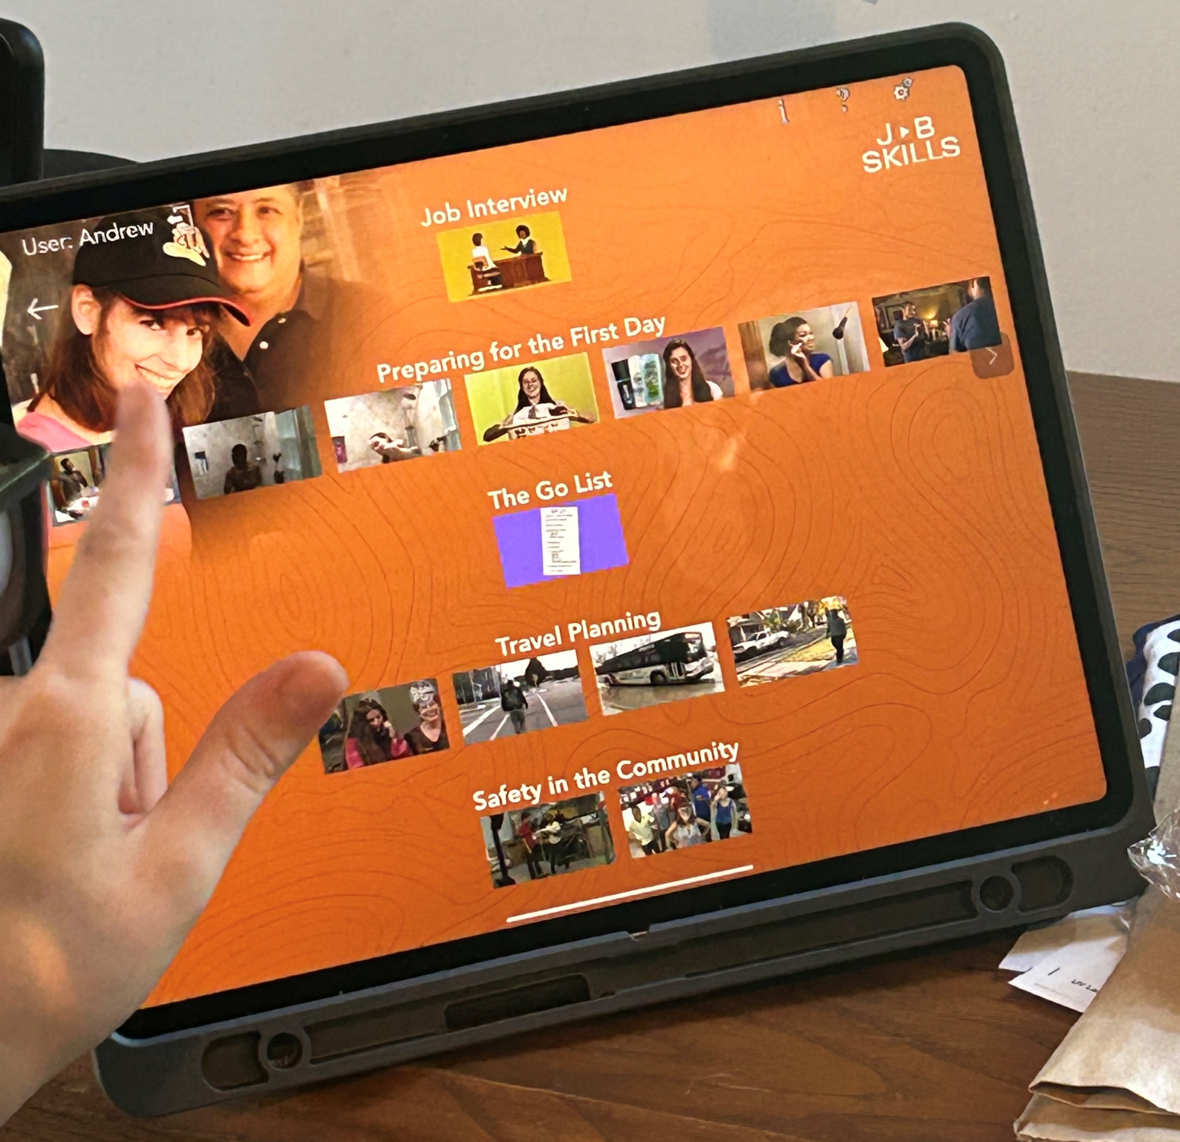

Andrew
Echo Show 10
iPad
Attainment GoVisual
Attainment Job Coaching On Demand
Apple Watch
Kristen Gilfeather
Assistive Technology Manager
NEAT.DDS@oakhillct.org

