Slide 1
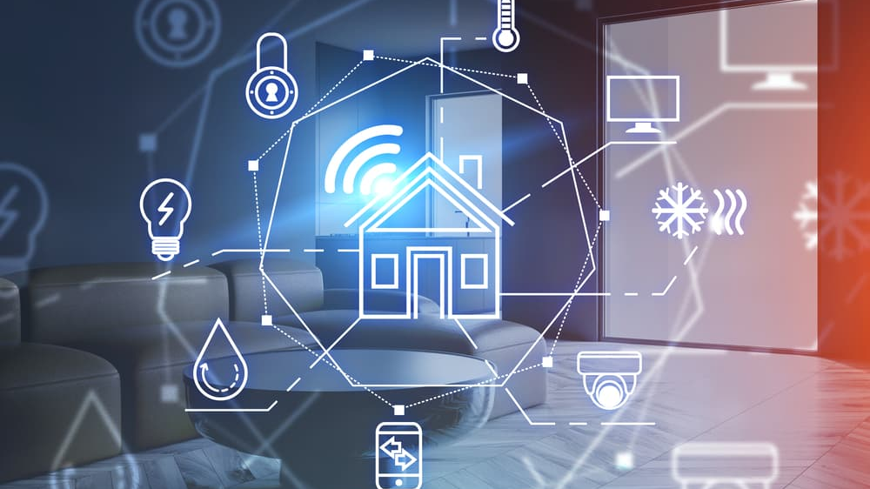
Empowering Families:
An Overview and Practical Guide to Assistive Technology at Home

Slide 2
Integrating home automation systems into your daily routine can enhance convenience, security, and energy efficiency. Here are some ways to get started:
Smart Alarm Clock: Use a smart speaker to wake you up at a specific time with your favorite music.
Smart Lights: Program lights to gradually brighten in the morning to simulate a sunrise.
Smart Blinds: Automate blinds to open when your alarm goes off.
Smart Coffee Maker: Schedule your coffee machine to start brewing as your alarm goes off.
Morning Routine

Slide 3
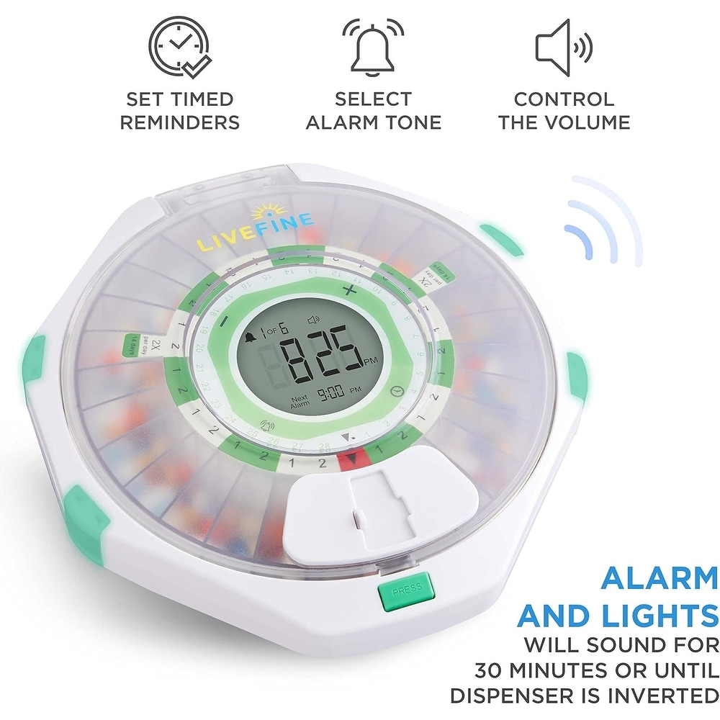
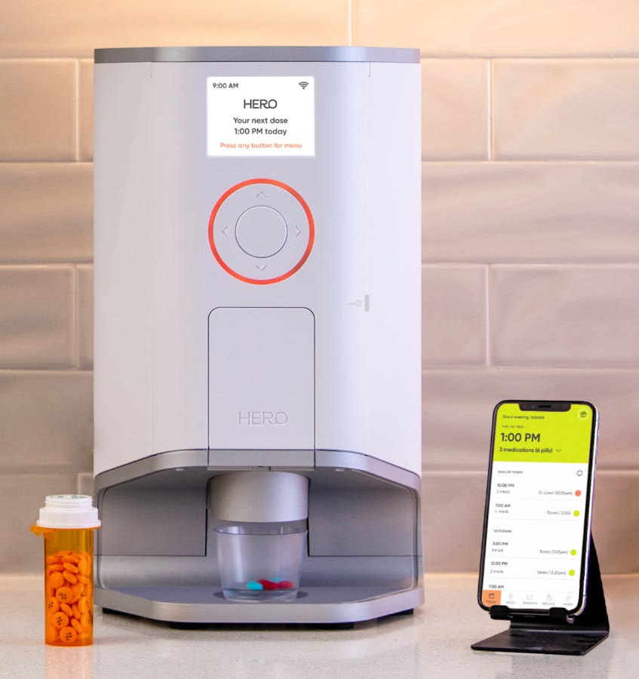
Medication Disbursement

Slide 4

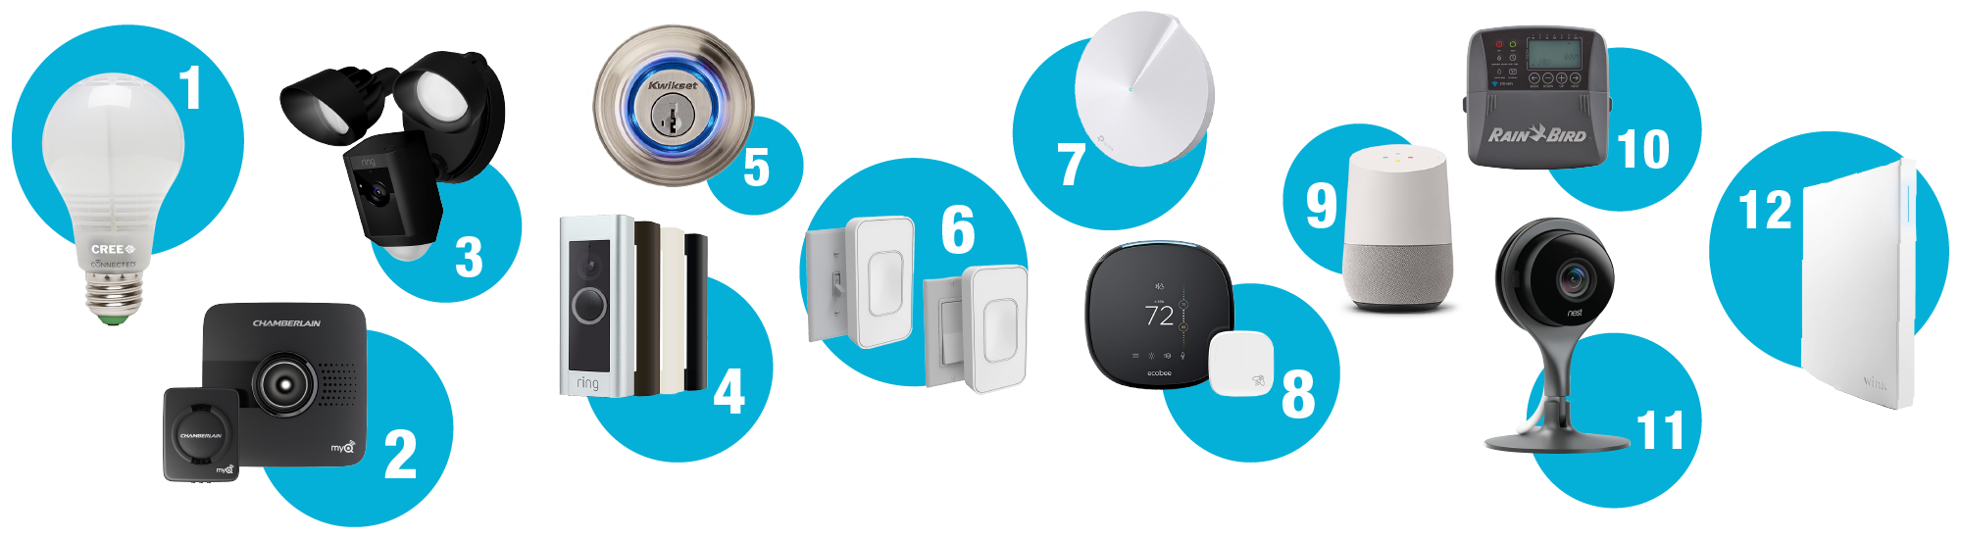

Coming Home
Smart Locks: Use geofencing to automatically unlock the door as you arrive home.
Smart Thermostat: Set your thermostat to adjust to a comfortable temperature when you're almost home.
Smart Lighting: Program lights to turn on as you enter different rooms.
Voice Commands: Use a smart speaker to update you on news, weather, and emails as you unwind.

Slide 5
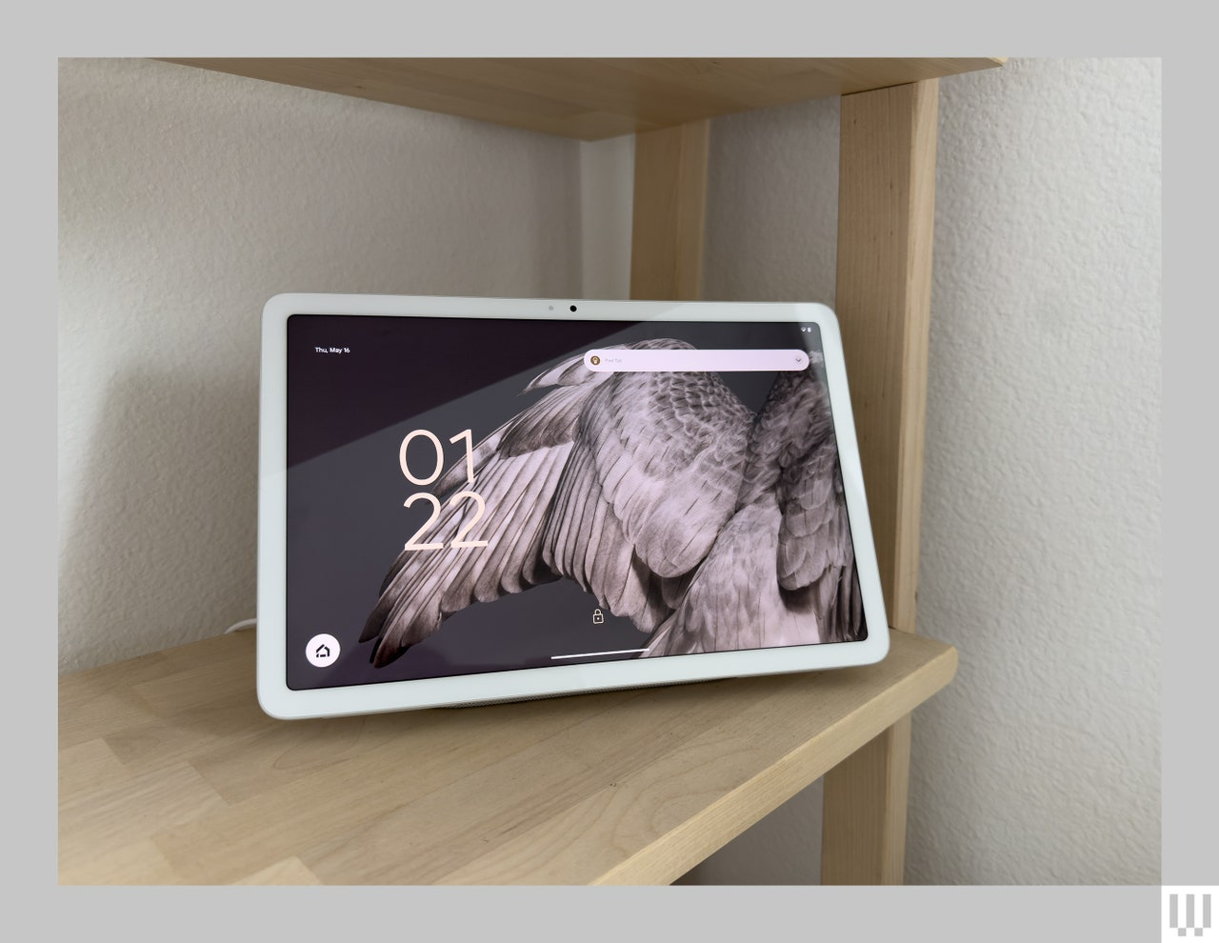
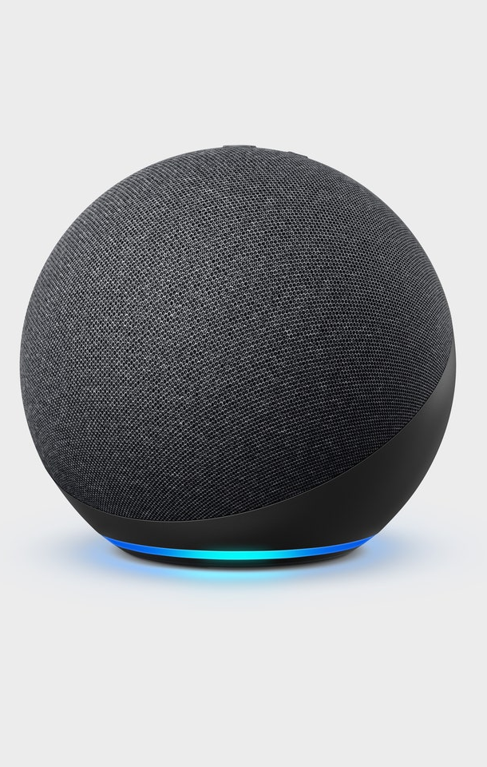
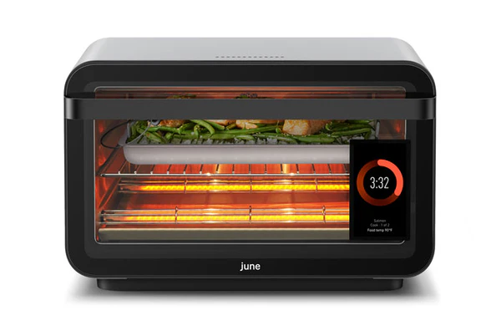
Cooking and Eating
Smart Appliances: Use a smart oven or air fryer that you can control with your phone.
Voice-activated Assistants: Set timers, find recipes, and control other kitchen gadgets hands-free.

Slide 6
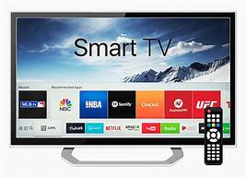
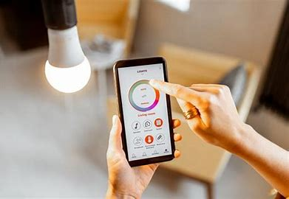
Relaxation and Entertainment
Smart Speakers: Play music, podcasts, or audiobooks using voice commands.
Smart TV:
Control your TV, streaming devices, or gaming consoles with your voice.
Smart Lighting: Set the mood with different lighting scenes for reading, movie watching, or relaxing.

Slide 7

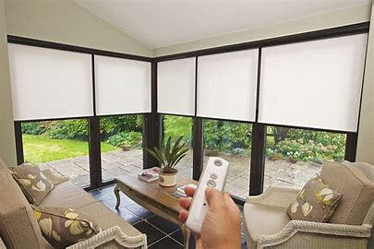
Bedtime
Smart Thermostat: Schedule the temperature to gradually drop to improve sleep quality.
Smart Lights: Program lights to dim or turn off at a specific time.
Smart Blinds: Automate blinds to close as you head to bed.
Security Systems: Ensure all doors are locked and activate outdoor security cameras and lights.

Slide 8
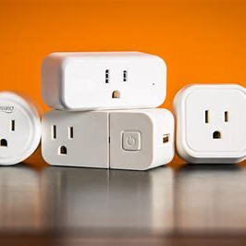
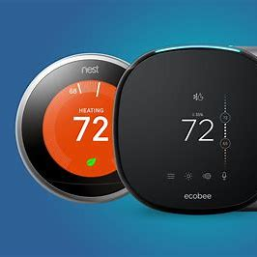
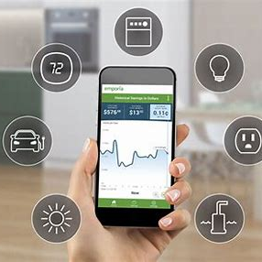
Energy Efficiency
Smart Plugs: Turn off electronics and appliances remotely to save energy.
Smart Thermostat: Monitor and adjust heating and cooling based on your schedule.
Energy Monitoring: Track energy usage and receive tips for efficiency.

Slide 9
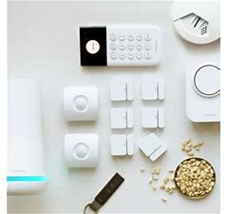
Home Safety and Security
Security Cameras: Overseeing your home remotely via your smartphone.
Smart Doorbells: See and talk to visitors no matter where you are.
Smoke and Carbon Monoxide Detectors: Get notifications on your phone if there's an emergency.

Slide 10
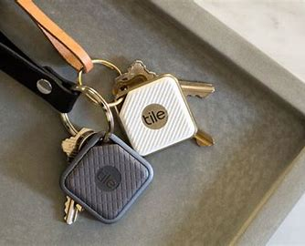
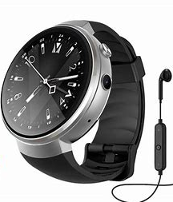

Person Safety with the Help of Location Finders
GPS-enabled devices can help you locate your loved one, and they may need to locate you in an emergency.
Smart Watches
Cell Phones
Tiles/buttons
Shoe inserts
Geofencing: Sets up virtual boundaries

Slide 11
Tips for Getting Started
Start Small: Begin with one or two devices and gradually expand your system.
Compatibility: Make sure new devices are compatible with your existing smart home ecosystem.
Automate Routines: Use routines and scenes to group multiple actions together for even more convenience.
Voice Commands: Get familiar with voice commands for hands-free control.

Slide 12
Thank you
Patricia Orozco
Director of Assistive Technology
DDS.AssistiveTechnology@ct.gov

