Slide 1



A Guide to Assistive
Technology
Newington Storrs Windsor Putnam
“Each person deserves a day away in which no problems are confronted, no solutions searched for.”
― Maya Angelou
DDS North Region Respite Coordinator
Sean Charvis

Slide 2


What is Assistive
Technology (AT)?
Assistive technology (AT) is any item, piece of equipment, software program, or product system that is used to increase, maintain, or improve the functional capabilities of persons with disabilities.
AT can be low-tech: communication boards made of cardboard or fuzzy felt.
AT can be high-tech: special-purpose computers.
AT can be hardware: prosthetics, mounting systems, and positioning devices.
AT can be computer hardware: special switches, keyboards, and pointing devices.
AT can be computer software: screen readers and communication programs.
AT can be inclusive or specialized learning materials and curriculum aids.
AT can be specialized curricular software.
AT can be much more—electronic devices, wheelchairs, walkers, braces, educational software, power lifts, pencil holders, eye-gaze and head trackers, and much more.
Assistive technology helps people who have difficulty speaking, typing, writing, remembering, pointing, seeing, hearing, learning, walking, and many other things. Different disabilities require different assistive technologies.

Slide 3

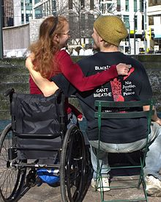
Why is AT being implemented in family respite centers (FRC) throughout the state?
12
DDS has been in the process of converting all of the family respite centers throughout the state into smart facilities, so that they can be examples to families who may be interested in using AT. This will show families inexpensive ways to monitor and care for their loved ones while affording them an increased independence.
This Photo by Unknown Author is licensed under CC BY-SA

Slide 4




Devices used when creating a smart home or facility
Wi-Fi is defined as an abbreviation for wireless fidelity, meaning you can access or connect to a network using radio waves, without needing to use wires.
Bluetooth is defined as a wireless technology for sending and receiving digital voice and data over cell phone headsets as well as wireless keyboards, mice and game controllers. An example of a Bluetooth device is a cell phone headset or a wireless mouse.
.
Setting up a smart home takes quite a bit of planning, fortunately, there are so many how-to guides and YouTube videos available on the internet that this can be accomplished by most tenants and homeowners.
The Ring company offers many Wi-Fi connected security devices with two way audio. Some examples are the Ring Doorbell and Ring Security System.
Manage your calendar, follow along with recipes, catch up on news, safe guard your home and more with Amazon’s Alexa. Amazon has created numerous devices that can be used on the go, or at home that work with Alexa.

Slide 5
Your Respite Center has been outfitted with several Assistive Technology (AT) devices. Information regarding Amazon devices and their use follows:
1

Slide 6


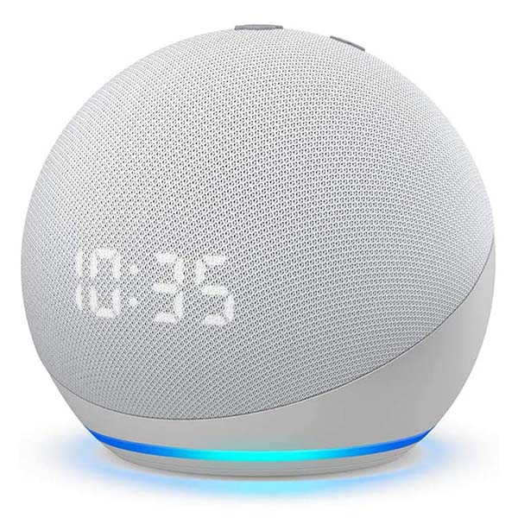
Here’s what’s playing at your local respite center
The Echo Glow
Nintendo Switch Console and Games
The Echo Dot w/Clock

Slide 7

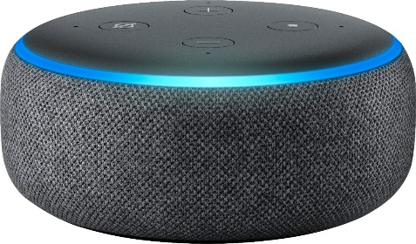
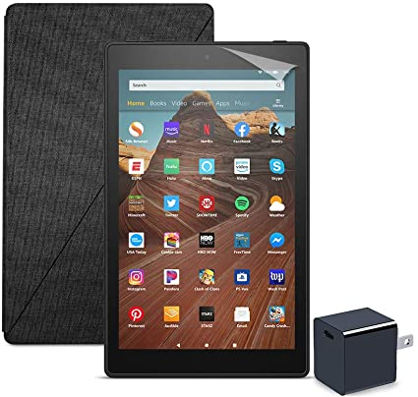
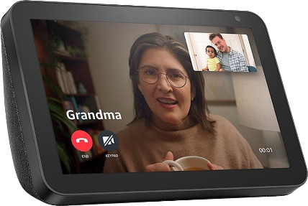
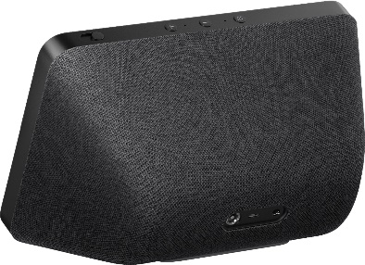
Amazon Alexa (https://alexa.amazon.com)
Alexa is an artificial intelligence (AI) assistant that understands voice commands. Amazon Alexa devices are smart devices you can interact with and control using your voice. An extensive (though not exhaustive) printed listing of Alexa commands accompanies this guide (Appendix C). Alexa devices outfitted at your location include:
Amazon Fire Tablet
Echo Dot
Amazon Echo Show
Smart Plug
The Fire Tablet is a touchscreen tablet running the Android OS (operating system). With it, you can – among other things – interact with Alexa and control connected smart devices with your voice via the Alexa app, access and control Ring products via the Ring app, and make and receive video calls.
The Echo Show is a smart device with a screen and stereo speakers. You can use the Show to interact with Alexa to ask questions, play games, listen to music/ radio stations/ podcasts/ audiobooks, view the weather/ calendars/ recipes, watch news/ TV shows/ movies/movie trailers, set alarms, control connected smart devices, make and receive video calls and more. There are buttons atop the unit for Volume Up, Volume Down, Camera Shutter On/ Off and Microphone-Camera Connect/ Disconnect.
Fire Tablet
Amazon Echo Dot
Amazon Smart Plugs
The Echo Dot is a smart device you can use to interact with Alexa to ask questions, play games, play music/ radio stations/ podcasts/ audiobooks, check the weather, read the news, set alarms, control connected smart devices and more. There are four physical buttons atop the unit for Power, Volume Up, Volume Down, and Microphone Connect/ Disconnect.
Echo Show
Amazon Smart Plugs are smart devices that do not have Alexa built in, but work together with Alexa to enable you to remotely control (turn on/ off)/ schedule connected lights, fans, and appliances using your voice or via the Alexa app.

Slide 8
Your Respite Center has been outfitted with several Assistive Technology (AT) devices. Information regarding devices and their use follows:
Ring
2

Slide 9
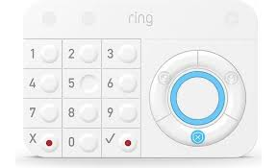
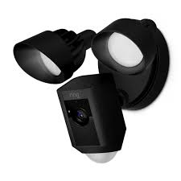
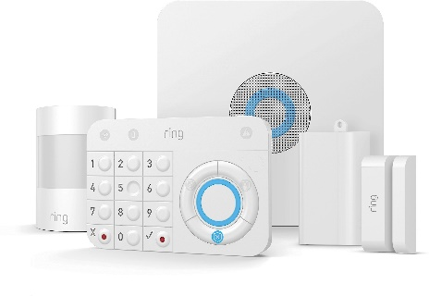
Ring (https://ring.com)
Your location’s Ring security system includes several components. The purpose of these is to help safeguard the expensive assistive technologies at your location. Item locations are indicated on your location’s Assistive Technology Device Inventory form.
Ring Alarm Base Station
Ring Alarm Keypad
Ring Floodlight Camera (or Spotlight Camera)
The Base Station is the hub (brains) of the Ring Security network. It includes a siren and a backup battery that powers the system for up to 24 hours in the event of a power outage. There is no user interaction for this device.
The Floodlight (or Spotlight, depending on your location) Camera is a motion activated high definition camera that includes a built in siren, microphone to listen to the exterior area, speaker to have a two way conversation with persons outside the home, and lights that can be manually controlled or automatically triggered by motion. The camera can be controlled via the Ring app. Live or recorded video can be viewed via the Ring app or an Amazon Alexa device with screen and sends alerts of motion detected. Alexa commands include “Alexa, show [camera name],” Alexa, hide [camera name],” or “Alexa, stop.” Alexa notifications and routines can be configured incorporating this device.
Ring Alarm Base Station
Ring Alarm Keypad
The Keypad arms and disarms your Ring Security System. You can arm or disarm the system by entering the key code into the Keypad, through the Ring app, or via Alexa (i.e. “Alexa, arm Ring”, “Alexa, is Ring armed?”, “Alexa, disarm Ring” (Alexa will ask for the key code).
Ring Floodlight Camera
(or Spotlight Camera)

Slide 10

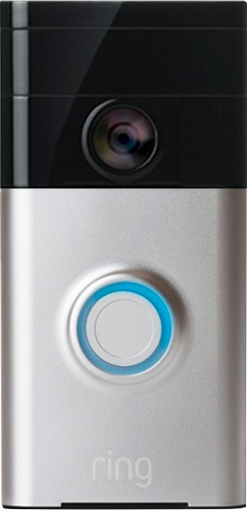
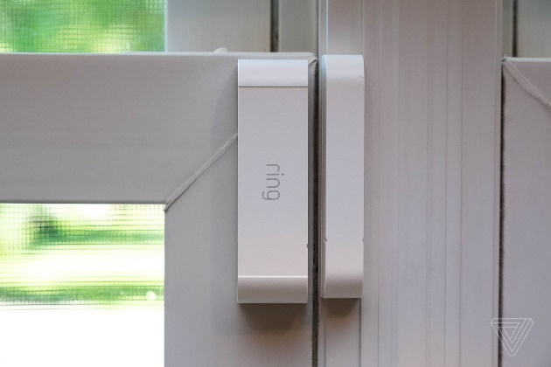
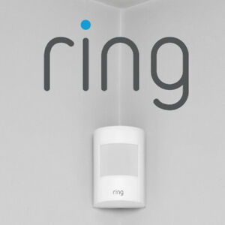
Ring (https://ring.com)
Your location’s Ring security system includes several components. The purpose of these is to help safeguard the expensive assistive technologies at your location. Item locations are indicated on your location’s Assistive Technology Device Inventory form.
Ring Alarm Motion Sensor
Ring Alarm Contact Sensor
Ring Doorbell Camera
The Doorbell Camera is a motion-activated high definition camera that includes a doorbell, microphone to listen to the exterior area, and speaker to have a two-way conversation with persons outside the home. The camera can be controlled via the Ring app. Live or recorded video can be viewed via the Ring app or an Amazon Alexa device with a screen and sends alerts of motion detected. Alexa commands include “Alexa, show [camera name],” Alexa, hide [camera name],” or “Alexa, stop.” Alexa notifications and routines can be configured incorporating this device.
The Motion Sensor notifies the Base Station when it detects motion inside your location. It contains no cameras. It will trigger the alarm when armed. There is no user interaction for this device, but Alexa notifications and routines can be configured incorporating this device.
Door
Window
Ring Doorbell Camera
Ring Alarm Contact Sensor
The Contact Sensor notifies the Base Station when windows or doors it is mounted to open or closed. It will trigger the Alarm when armed. There is no user interaction for this device, but Alexa notifications and routines can be configured incorporating this device.
RING SENSOR

Slide 11

JUNE Smart Oven
Convection Oven : Twin convection fans double the airflow for faster, more even cooking.
Air Fryer
Grill
Roaster
Slow Cooker
Dehydrator
Toaster
Reheat
Pizza Oven
Proofer : Bread makers and pastry chefs, we just want to get a rise out of you. Get it?
Broiler
Warming Drawer

