Slide 1

Employment & Day Services (EDS) Unit
Pathways to Competitive Integrated employment
Presented by the Employment & Day Services Team: Brian Gresko (SR), Darrell Spears (NR), Kate DeStefano (WR), and Trever Rogers (CO)

Slide 2

Meet Your EDS Team
Trever Rogers
Education Services Specialist
460 Capitol Avenue, Hartford, CT 06106
Tel: (860) 406-3404 | trever.rogers@ct.gov
Brian Gresko
Transition Advisor
15 Thorpe Avenue, Wallingford, CT 06492
Tel: (203) 294-5181 | brian.gresko@ct.gov
Darrell Spears Jr.
Education Services Specialist
255 Pitkin Street, East Hartford, CT 06108
Tel: (203) 263-2535 | darrell.spears@ct.gov
Catherine 'Kate' DeStefano
Education Services Specialist
300 Armory Drive, Stratford, CT 06614
Tel: (203)816-5184 | catherine.destefano@ct.gov
Central Office
North Region
South Region
West Region
Amber Carter
Director of Employment & Day Services
460 Capitol Avenue, Hartford, CT 06106
Tel: (860) 418-6006 | amber.carter@ct.gov
Notes:
DDS has long been committed to employment for individuals with intellectual disabilities. In 2011 DDS enacted an Employment First initiative, which remains in place to this date. DDS soon realized the need for personnel dedicated entirely to employment. Hence, the Employment and Day Services (EDS) division was created in 2018 to oversee the employment and day options provided by the Connecticut Department of Developmental Services and further its commitment to Employment First and creating pathways to competitive integrated employment. The division works with individuals, families, providers, community partners, and businesses to prepare individuals for competitive employment and match them with jobs that meet their interests, skills, and abilities. EDS currently offers a variety of day and employment services to individuals across the state of Connecticut. Our unit has a representative assigned to each of the DDS regions as well as central office. Additionally, the employment & day services division oversees many projects and grants that directly impact employment
We also serve as liaisons to statewide and national groups including the Association of People Supporting Employment First (APSE), the State Employment Leadership Network (SELN), The CT Person’s with Disabilities Committee, DDS ARPA Committees, Project Search National, and many others. We will expand on our work with some of these groups later in the presentation.
We are a resource for all of you, so please feel free to reach out to us with any questions you may have regarding employment.

Slide 3

Employment Supports
Employment First Agency Since 2011
Self-Employment
An outcome achieved with supports and services that help the participant:
  identify potential career opportunities
  identify supports that are necessary, including training and supervision for self-employment and entrepreneurial outcomes.
Group Supported Employment (GSE)
Supported employment in a competitive employment environment in which a group of participants are working under the supervision of a permanent employment specialist (job coach).
Customized Employment (CE)
A highly structured method of finding competitive integrated employment that is, focusing on the strengths, skills, and abilities of the individual and the unmet needs of employers.
Individual Supported Employment (ISE)
An employment specialist (job coach) helps find competitive employment through a job discovery process, provides training and support, and then gradually reduces time and assistance at the worksite.
Notes:
Thank you, Amber.
We have a fantastic presentation planned for today. The format is designed to provide some background information about DDS employment and pre-employment services and then move into personal stories of individuals who have successfully transitioned to employment. So let’s get started.
Today, we will take a closer look at these employment supports; self-employment. We will be highlighting microenterprises through the lens of Futures, a DDS Qualified Provider.
Next, we will transition to Group Supported Employment and a segment with Edwin who is currently utilizing this service. We will move into Customized Employment, followed by Individual Supported Employment. Bri and Brent are here today to discuss their employment experiences. Next Slide please.

Slide 4


Pre-Employment Services
Project SEARCH
Nine-month internship training program, available to school transition age students and young adults eligible for DDS services, who need more intensive employment skills training.
The program takes place in various community settings where total inclusion in the workplace facilitates the teaching and learning process as well as the acquisition of employability and marketable work skills.
The primary goal of Project SEARCH is to secure meaningful competitive employment.
Employment Transition Services (ETS)
Community-based, occupational service that is time limited up to 3 years.
Activities should occur in integrated settings and may include:
  unpaid career exploration
  financial management
  networking
  building skills leading to employment
  health and fitness activities that lead to better employment outcomes
  ETS focuses on activities that lead to competitive employment including career discovery, career exploration, skill development, and self-advocacy.
EDS_Pathways_Brochure
Notes:
We will finish the presentation with Project SEARCH, a pre-employment 9-month internship program. The goal of Project SEARCH is competitive integrated employment. Sandy Finnimore, Project SEARCH Manager for Favarh and Brett, a former Project Search intern will be discussing the Project Search program at UCONN Health. Employment Transition Services is another pre-employment service focused on gaining employment skills to prepare for a job. For more information about Employment Services, you can check out the EDS Pathways Brochure linked here.
Before we get into each service, I would like to provide a bit of helpful information as you move forward in your employment journey (for whatever stage you are currently in). Next slide please.

Slide 5


Portability
You have control over your supports and the money used to pay for the services you receive.
You can use your funds to purchase services from any qualified provider you choose, or you may use those funds to hire your own staff.
The portability process may be used when:
You are not satisfied with the services you receive from your current public or private provider.
You need to change who provides your services for some other reason.
Portability Fact Sheet
Qualified Providers
Notes:
I often get asked this question: What if my provider is not a good match, can I change providers. Yes, you have control over your supports and the funds used to purchase services. Next slide please.

Slide 6

Transportation
Service offered to enable you to get to your place of employment or your community-based day supports
This may include:
  agency provided transportation
  public transportation
    pre-purchased bus tickets, paratransit bus passes, train tickets
  private transportation
Payment per mile is made for a maximum of one round trip daily.
Wheelchair accessible transportation is paid at a higher rate only if you require the use of a wheelchair accessible vehicle.
Notes:
Transportation options are available to enable you to get to your place of employment.
Transportation is one of the leading barriers to an individual securing and maintaining a job There are several ways that individuals may find transportation, but accessibility to reliable and cost-minded transportation remains a challenge for many. The employment and day services division is heading a sub-committee with stakeholders from within the agency, providers, sister agencies and transportation systems to address this issue.

Slide 7

Bureau of Rehabilitation Services (BRS)
The Department of Aging and Disability Services (ADS) is the state Vocational Rehabilitation Agency
Let’s break it down:
BRS is under ADS (ADS used to be called DORS – Dept of Rehabilitation Services).
Their sister agency, BESB, is also under ADS.
BRS assists individuals with significant disabilities to obtain, maintain and advance in competitive integrated employment (CIE).
Department of Aging & Disability Services (ADS)
Bureau of Rehabilitation Services (BRS)
Bureau of Education and Services for the Blind (BESB)
Department of Aging and Disability Services (ct.gov)
Notes:
Previously referred to as the Department of Rehabilitation Services (DORS), the State Department of Aging and Disability Services (ADS) houses the state’s Vocational rehabilitation program the Bureau of Rehabilitation Services (BRS) and their sister agency, the Bureau of Education and Services for the Blind (BESB).
This is an important slide due to the collaboration between DDS and BRS as it pertains to employment outcomes and Customized Employment. When we get to Customized Employment, you will hear more about BRS, so a little background:
The Department of Aging and Disability Services (ADS) is the state vocational rehabilitation agency.
Both BRS and BESB are under ADS. BRS assists individuals with employment and BESB does the same for individuals with visual impairments. BRS also has Benefits Counselors who can help you to understand potential impact to benefits once you become employed. For more information about BRS, please visit their website linked here.

Slide 8
Transition-Age Students
18-22
Transition-age students can access the support of a DDS Transition Advisor.
Transition Advisors:
    Work in collaboration with BRS to increase employment outcomes
    Inform individuals and families about employment and day options
    Assist students with the transition from school to the adult world
Department of Developmental Services Secondary Transition
Notes:
Transition Advisors can assist with the transition from school to adult life. There are 3 Transition Advisors per region (North, South, and West). For Transition Advisor contact information, please visit the website linked here. Next slide please.

Slide 9
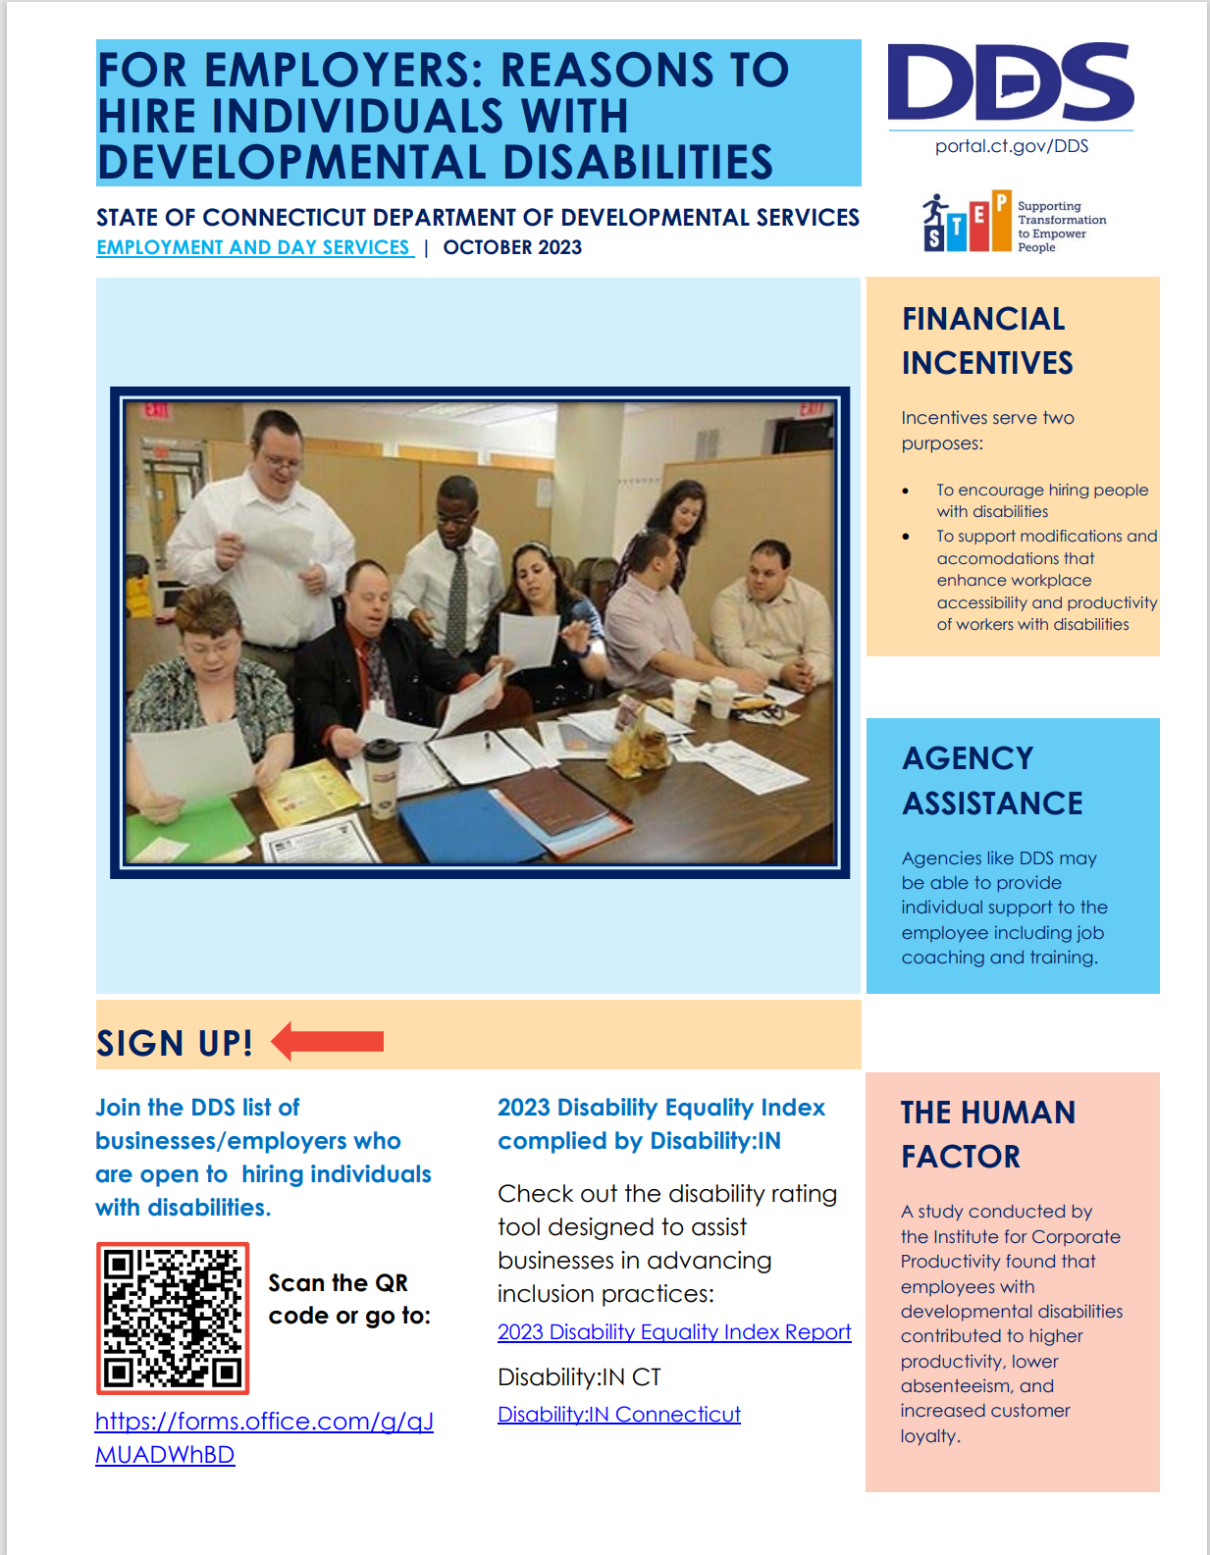
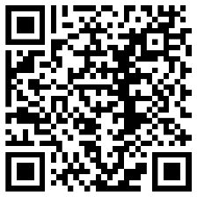
For Employers/Businesses
Join the DDS list of businesses/employers who are open to hiring individuals with disabilities.
Scan the QR code or go to: https://forms.office.com/g/qJMUADWhBD
Incentives for Employers
Notes:
If you know of employers or businesses that would like to join the DDS list, we have included a link and QR to sign up. We also have an Incentives document for Employers on the website. Now I will turn it over to Brian Gresko for a brief overview of self-employment options followed by a conversation with Brian, Darrell, and Darlene Borre from Futures. Next slide please.

Slide 10
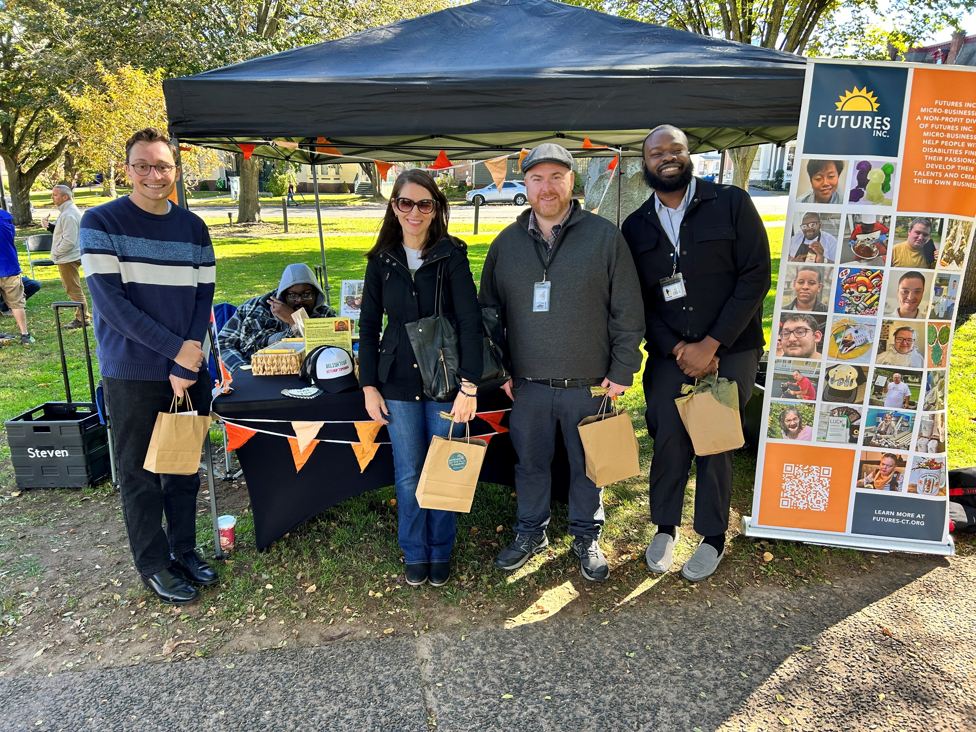
Self- employment options
Conversation with Darlene BorrÉ
EDS Team at the Middletown Farmer’s Market

Slide 11

Self-Employment, Small Business Enterprise, and Innovative Employment Opportunity
Self-Employment & Small Business Enterprise
Innovative Employment Opportunity (IEO)
An outcome achieved with supports and services that help the participant:
Identify potential career opportunities
Identify necessary supports, including training and supervision for self-employment and entrepreneurial outcomes.
Designed to support small businesses and entrepreneurs and promote Competitive Integrated Employment for people with IDD
Offers both:
small “seed money” exploratory grant
larger implementation/expansion grant
Notes:
Brian will briefly review this slide.

Slide 12

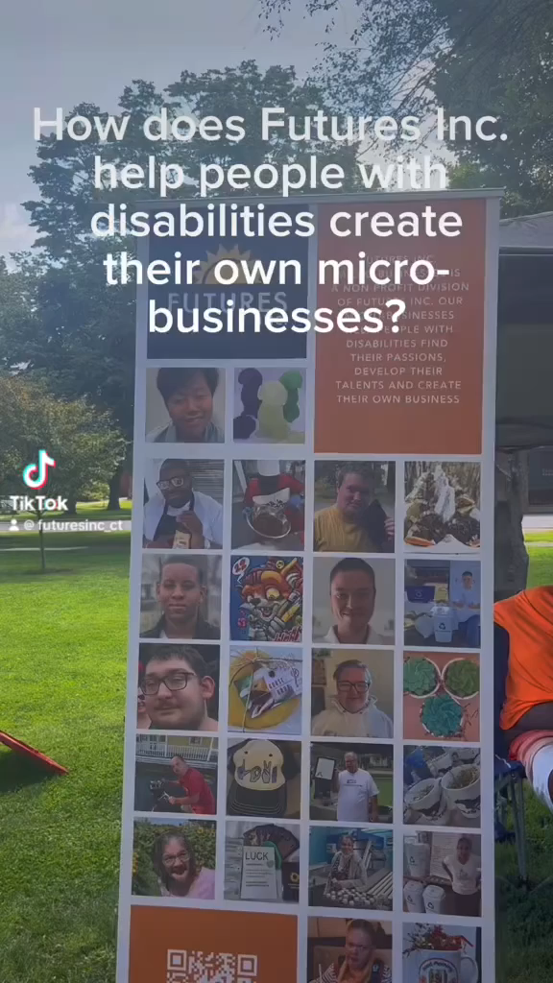
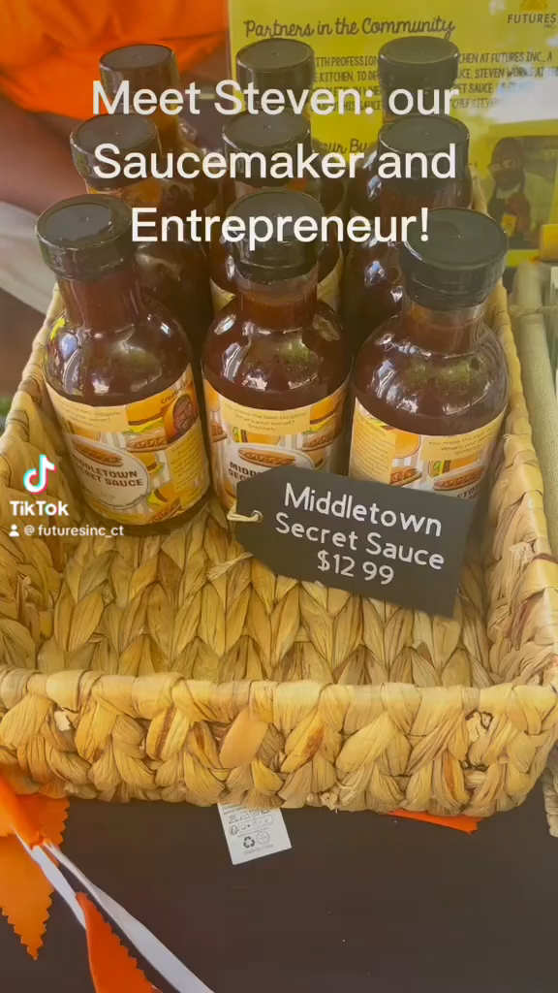

Slide 13
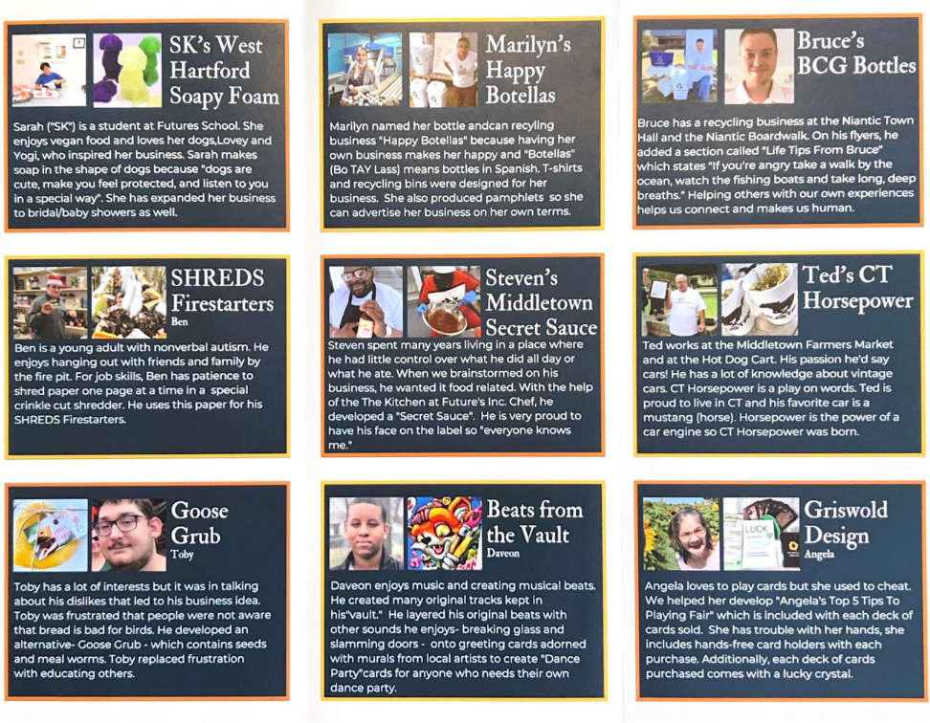
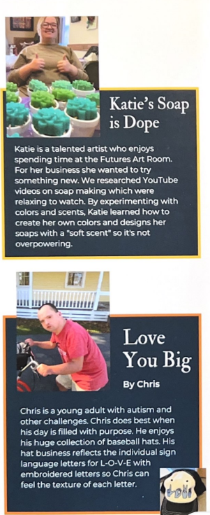
Micro-Businesses at Futures
Notes:
Conversation with Darlene about micro-businesses. (Darrell and Brian)

Slide 14
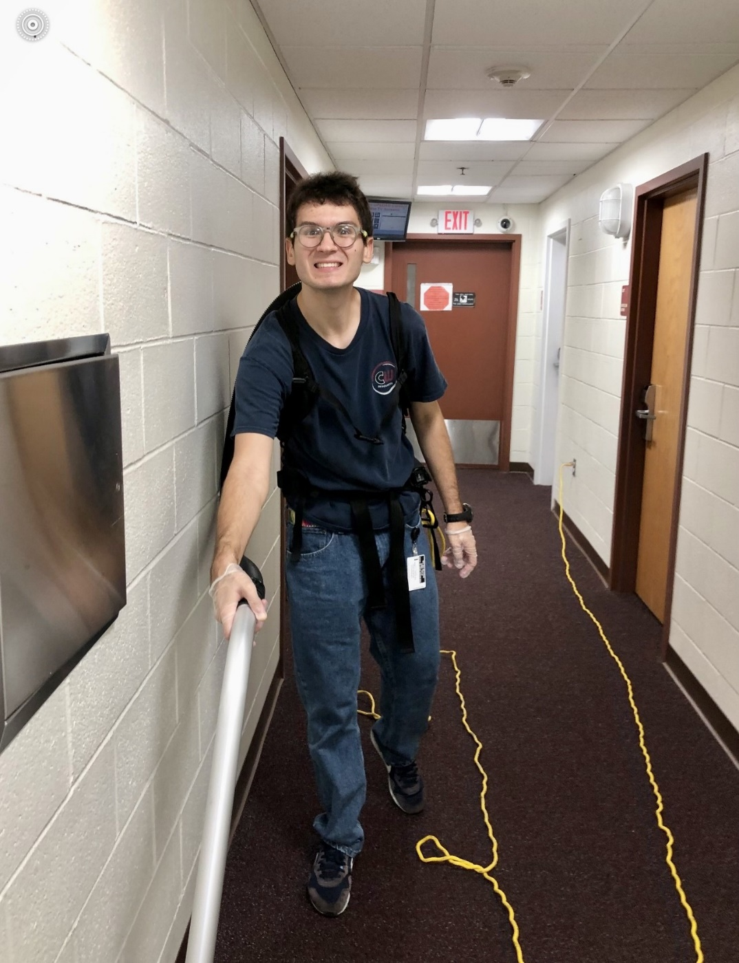
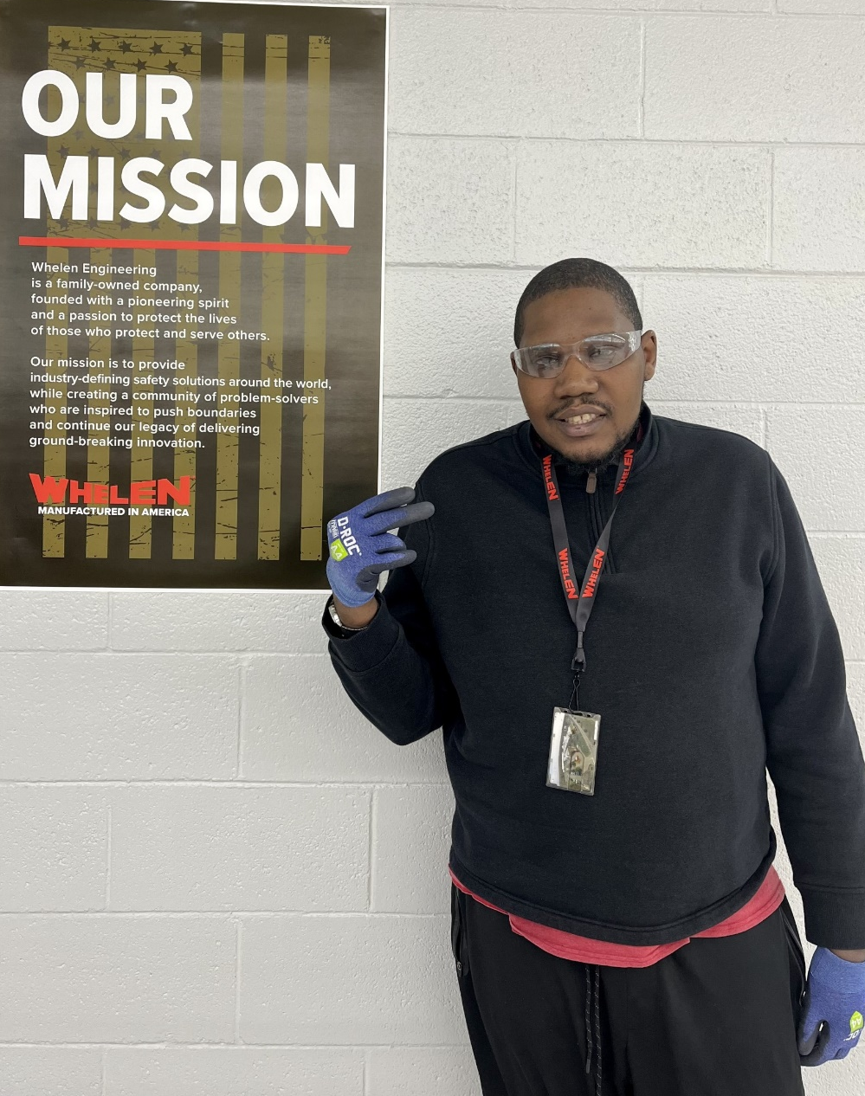
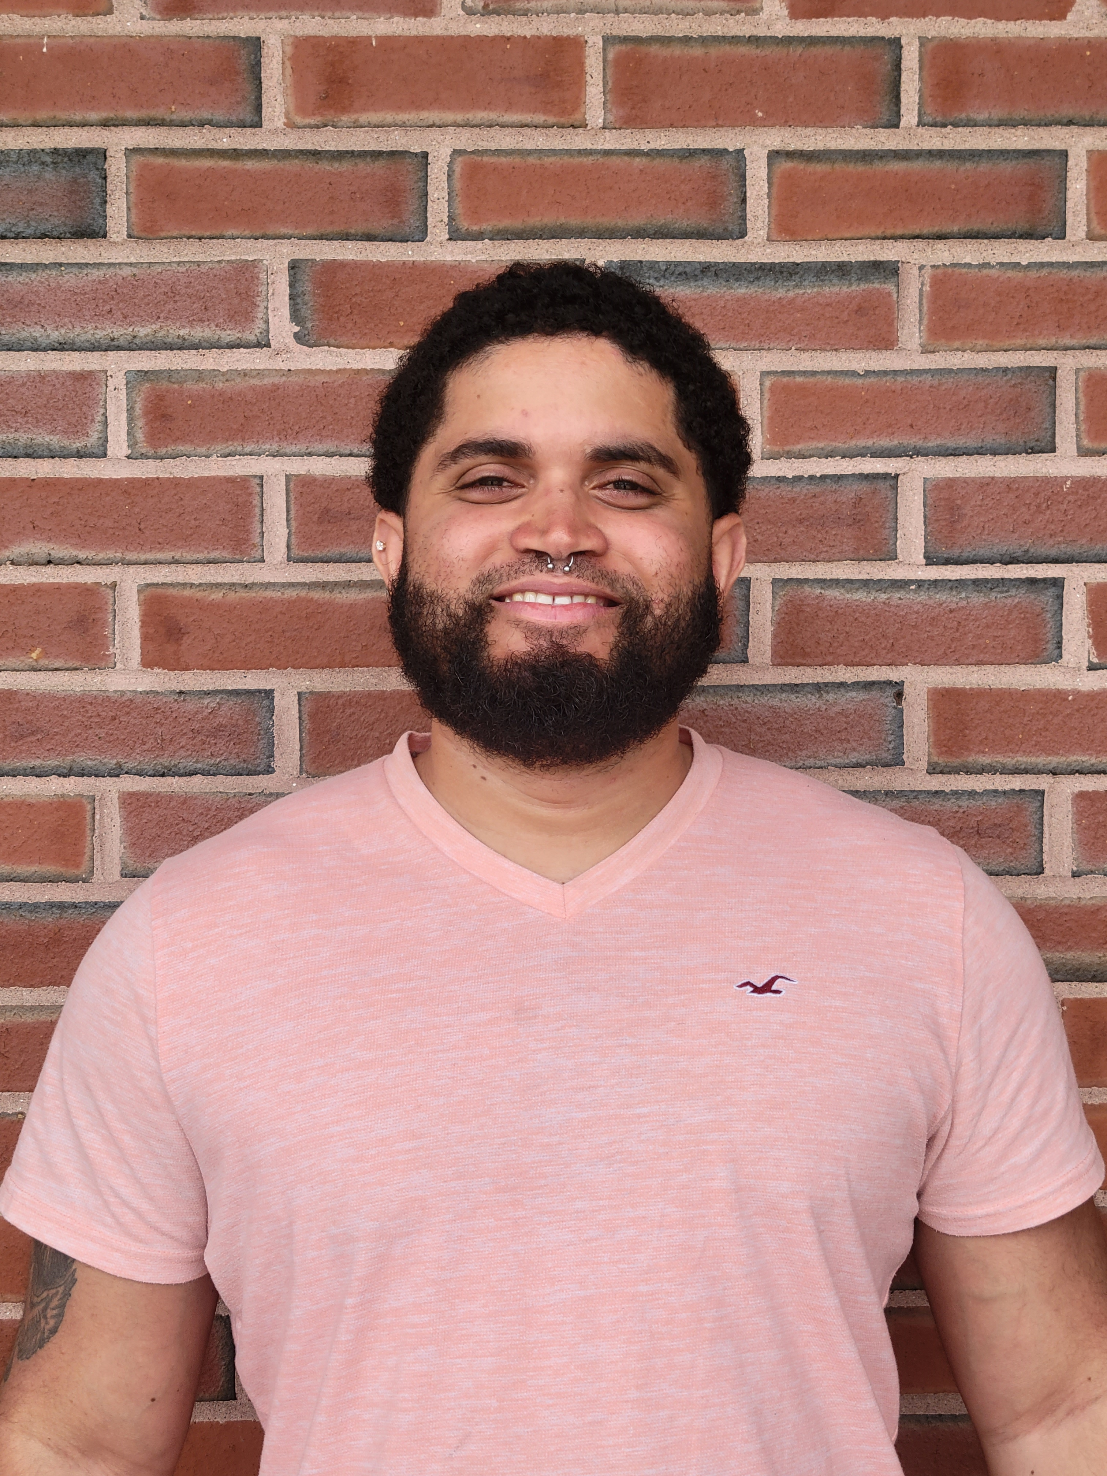
Group supported employment
Success Stories
Whitaker
Edwin
Mike

Slide 15
Group Supported Employment (GSE)
Supported employment in a competitive employment environment where a group of participants are working under the supervision of a permanent employment specialist (job coach)
Services are provided in the community or a facility-based program to focus on developing meaningful skills in the areas of:
  Work
  Socialization
  Community participation.
Participants may be disbursed throughout the company among workers without disabilities or congregated as a group (with efforts toward interaction with nondisabled coworkers).​
Notes:
Group supported employment is much like individual supported employment, but in a group setting. Group supported employment is also known as GSE. Individuals may need or benefit from employment supports in a group setting; typically, the job coach or employment specialist provides instruction and support in a group modeled way. Individuals may have peer to peer coaching or task that are connected to what each worker is doing, in turn helping them to gain skill. Once an individual is one step closer to being more independent, providers agencies are incentivized and encouraged to transition those individual into individual supported employment, also known as ISE. These supports may be provided in a facility or community-based environment. The focus is to develop meaningful useful skills for the workplace, community, and social lives as well. In some GSE’s individuals can be stationed anywhere throughout the employer working near workers without disabilities and or some cases use small congregate setting, again, goals and objectives gearing towards inclusion and integration. Individuals have engaged in mobile work crews where individuals in GSE perform work in a variety of different locations and visit different work sites during the day with their employment support staff/supervisor.

Slide 16


Employment All Stars
Whitaker
Mike
Employer: U.S. Coast Guard Academy
Job Position: Environmental Worker
Job Coach: Elissa
Employer: Whelan Engineering
Job Position: Independent Contractor
Years employed: 4
Job Coach: Salawne
Whit’s Career Stats
Second chances are possible!
Strengths and Skills
Meticulous cleaner | Embraces new challenges
Cultivates relationships with colleagues | Resilient, adaptable, and passionate about his job
Mike’s Career Stats
Strengths and Skills
Conscientious, determined & dedicated Sorting | Interacts respectively with co-workers Task sharing
Whit is nothing short of a “breath of fresh air.” - Elissa

Slide 17





EDWIN
EMPLOYMENT All STAR
Employers:
Village Market (2days/wk.) McQuade’s (3days/wk.)
Job Title: Store Associate
Hours: Approximately 5hrs./day
Job Duties: “A little bit of everything!”
What I like most about my jobs:
My co-workers and making money!
Fun Facts
Dream career: Body Builder
I’m a gamer – I love my PlayStation.
I passed my Driver’s test!
Dream truck: Ford F150!
I was born in Puerto Rico.
I’m bilingual - when I came to the U.S. at age 13, I didn’t speak any English.
Words of wisdom for job seekers:
“I know you can do it, buddy!”
Edwin’s Career Stats
Strengths | Skills
Sociable & friendly | Maintenance
Interacts well with co-workers | Experience in many departments; deli, seafood, etc.
Dedicated and reliable | Cart management
Notes:
Questions for Edwin:
Can you tell us a little about where you work? And some of your job duties?
What is your favorite thing to do at work?
What do you do for fun? Any hobbies you participate in?
What would be your dream job?
Are you into sports? Have a favorite team?
Bonus Questions- What would you tell other individuals who would want to have a job like you?

Slide 18




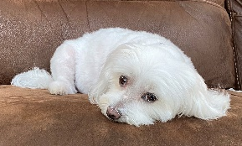
Customized employment
Trever
Customized Employment Lead
Avid Gardener
Wynter

Slide 19



Customized Employment
Customized Employment (CE) is an alternative method of finding competitive integrated employment for individuals with significant intellectual or developmental disabilities.
CE focuses on the strengths, skills and abilities of the individuals and the unmet needs of employers.
It is a highly structured, person-centered process, carried out over time.
Customized Employment Brochure
Notes:
Customized Employment (CE) is an alternative method of finding competitive integrated employment that focuses on the strengths, skills and abilities of individuals with significant disabilities and the unmet needs of employers. It is a highly structured, person-centered process, carried out over time in three separate phases. It serves as a sperate service model with more intensive creative and specifically modified supports to help the individual achieve their self-directed employment option. The service is job seeker driven.
An individual completes CE services when they have been successfully placed in a competitive integrated employment position for a minimum of 90 days (employed 3 months). The individual then transitions to natural supports or an individual supported employment service. ADS job seekers who will need extended services will be transitioned to another Extended Services funder if the job seeker is not mutually served by DDS.

Slide 20


CE Differences
CE is a new employment service model for ADS and DDS as well as most community provider agencies that:
Requires direct service staff to have an active CE Certification to offer service.
Presumes that all individuals can work.
Designed to ensure the process is job seeker driven by focusing on what the job seeker wants.
Requires greater participation of family, personal networks, and extended supports.
Notes:
Customized is a new employment service model for ADS and DDS as well as most community provider agencies. Unlike other services, direct support staff must have an active CE Certification in order to offer the service. This is because the service is highly structured, in depth, and intensive. The service is Designed to ensure the process is job seeker driven by focusing on what the job seeker wants and presumes that all individuals can work.
Unlike other services, CE requires a large amount of participation of family, personal networks, friends, community members, and extended support groups. As I will review in the next slide, the Job-Discovery phase allows the time for direct service staff to get to know the job seeker and their likes, dislikes, skills, and abilities. The first phase of the service is solely focused on this piece, getting to know the job seeker and their goals for their future.

Slide 21
CE Pathways
CE is a good strategy for those who need more intensive support than typical individualized or group models and who may need to utilize more intensive discovery strategies for career and job direction.
CE is effective for individuals with complexities that make it difficult to utilize traditional job search strategies.
Group Supported Employment (GSE)
Individualized Day Vocational (IDV)
Employment Transition Services (ETS)
Work Based Learning
Trial Work Experiences
Industry Specific Training Placement Programs (ISTPP)
Individualized Employment Supports (ISE)
One-Time Employment Incentives
Other DDS Employment Experiences
Work Attachments
On the Job Training
Notes:
Customized Employment is a good strategy for those who need more intensive support than typical individualized or group models and who may need to utilize more intensive discovery strategies for career and job direction. CE is effective for individuals with complexities that make it difficult to utilize traditional job search strategies.
If an individual meets those requirements, case managers should consider whether they fit into at least one of the criteria on the screen before initiating the CE Referral Process:
As you can see, there are many routes individuals can take to gain employment such as Employment Transition Services (ETS), Group Supported Employment (GSE), Individualized Employment Supports (ISE); or even the DDS One-Time Employment Incentives. If individuals have tried one or more of the supported employment opportunities and need more intensive supports to achieve employment, the individual will be a good candidate for Customized Employment
It is very important to note that there is no specific path to Customized Employment Services. Rather, the service is an option that should be explored after the individual has tried other employment services and it has been determined that more individualized support is needed to achieve competitive integrated employment.

Slide 22

Customized Employment – 3 Phases
Job Discovery
Job Development, Negotiation, & Placement
Post-Employment Supports
Competitive Integrated Employment
Individual Supported Employment (ISE)
Natural Supports
Reach out to your case manager if you think CE would be a good option for you.
Notes:
Customized Employment (CE) is an alternative method of finding competitive integrated employment that focuses on the strengths, skills and abilities of individuals with significant disabilities and the unmet needs of employers. It is a highly structured, person-centered process, carried out over time in three separate phases. It serves as a sperate service model with more intensive creative and specifically modified supports to help the individual achieve their self-directed employment option. The service is job seeker driven.
An individual completes CE services when they have been successfully placed in a competitive integrated employment position for a minimum of 90 days (employed 3 months). The individual then transitions to natural supports or an individual supported employment service. ADS job seekers who will need extended services will be transitioned to another Extended Services funder if the job seeker is not mutually served by DDS.

Slide 23
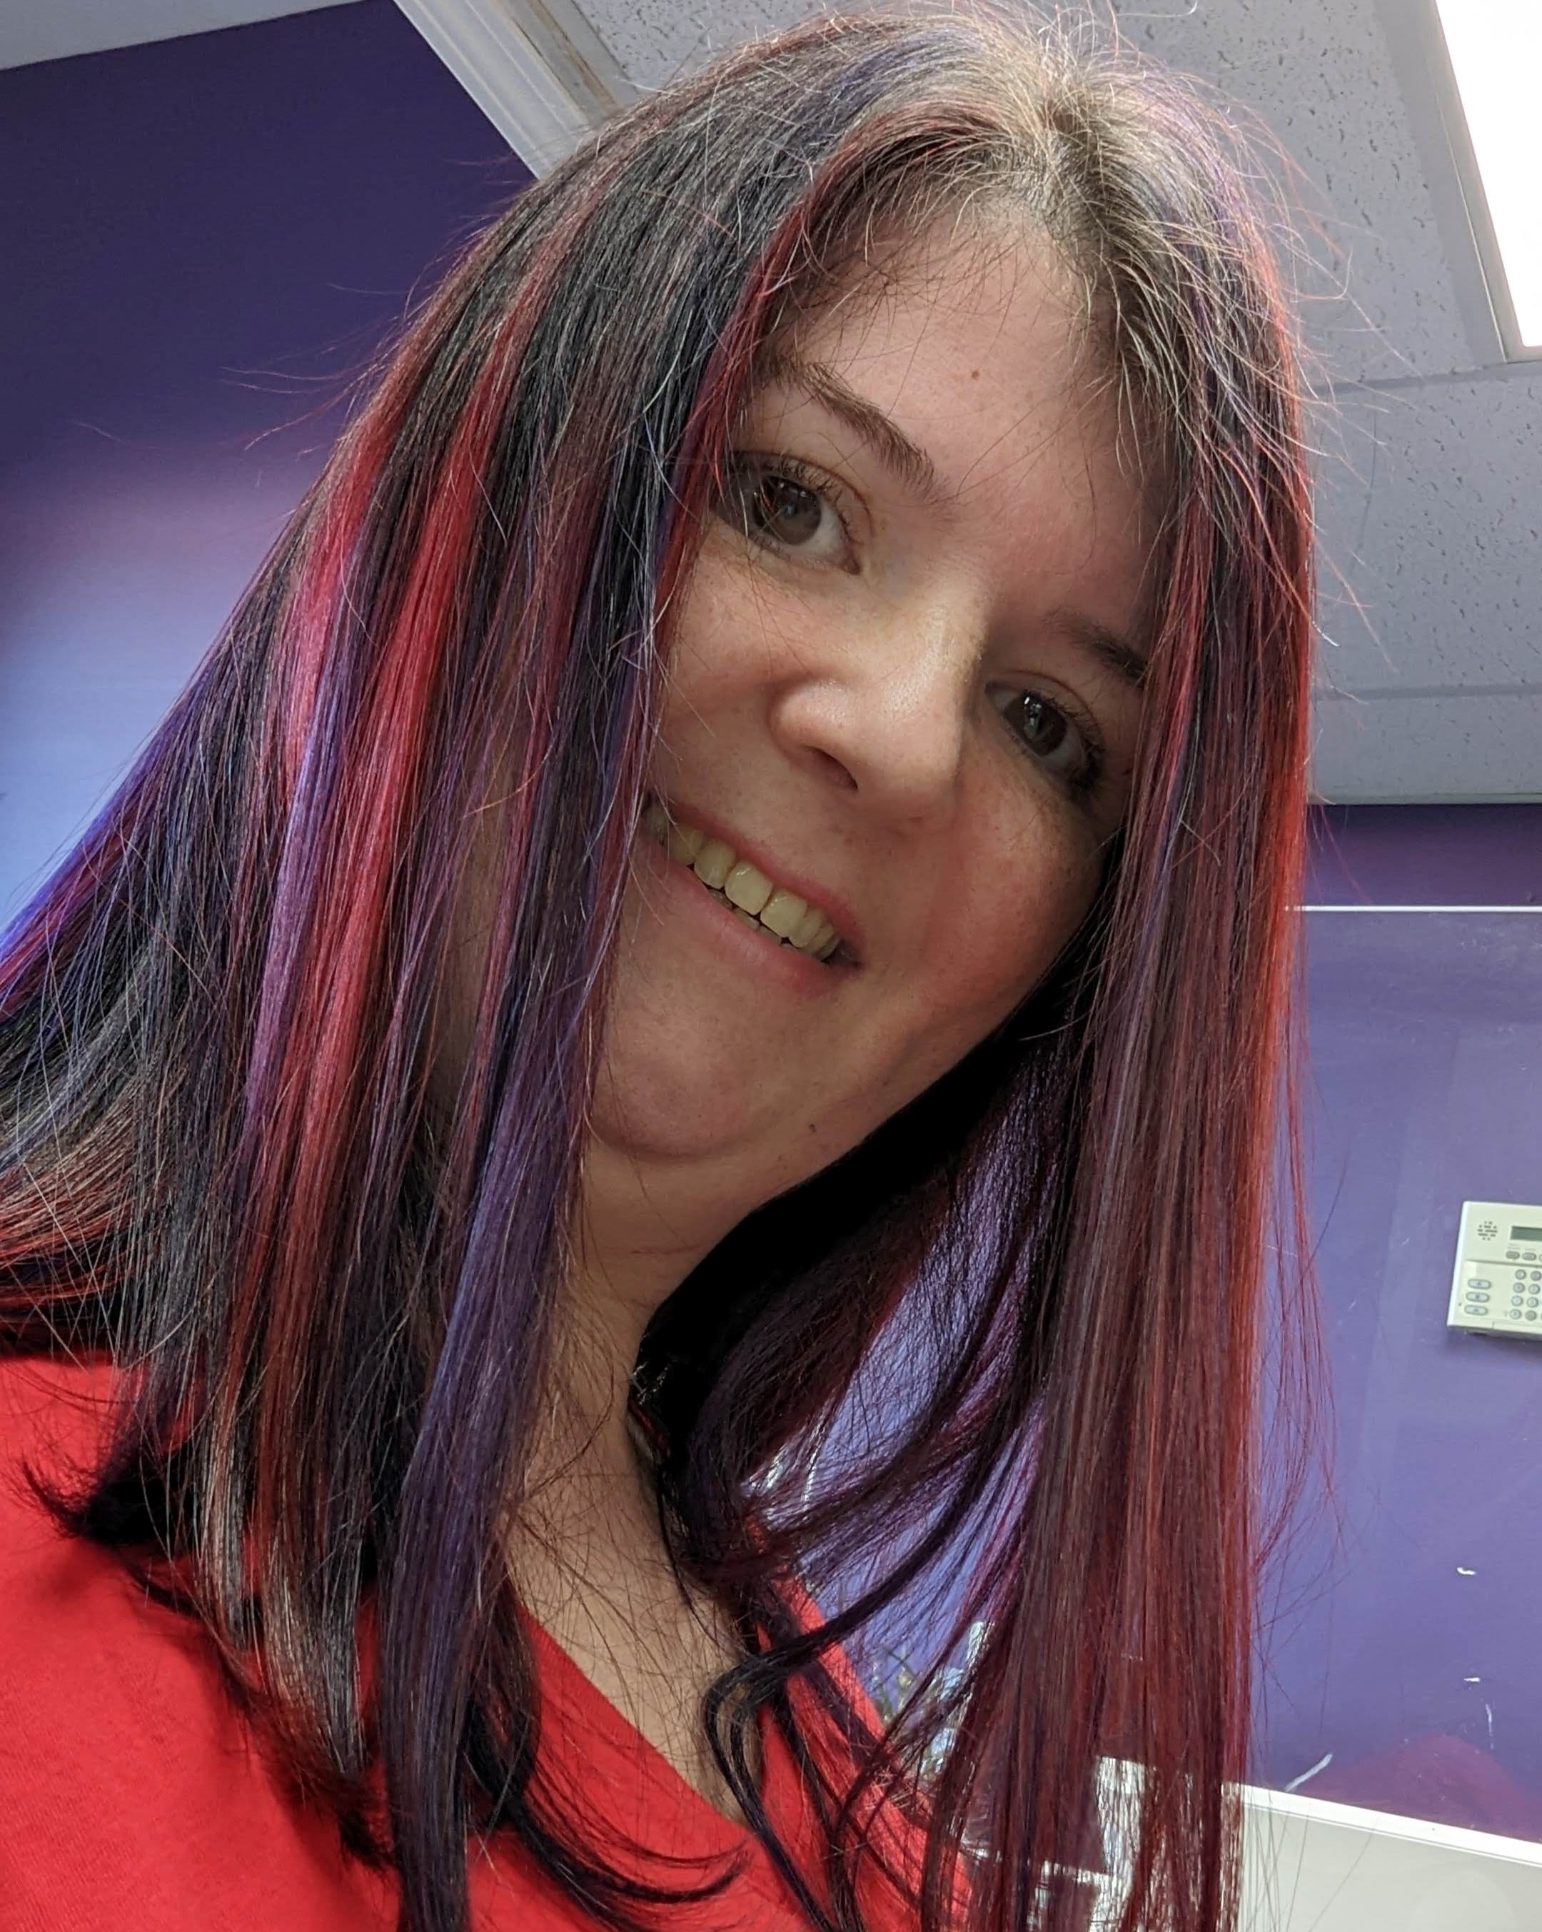
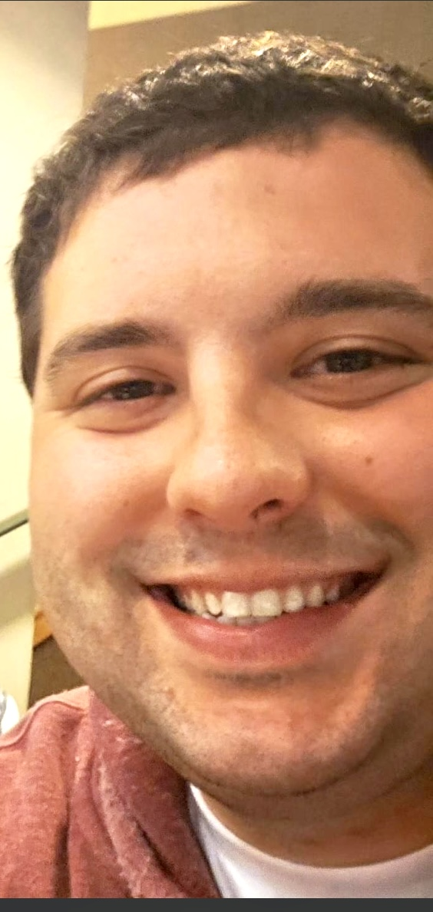
Individual Supported employment
Success Stories
Bri
Brent

Slide 24

Individual Supported Employment (ISE)
Who is a good candidate?
Any DDS eligible individual interested in competitive integrated employment (CIE) regardless of their current service type.
ISE includes:
assisting individuals find and apply for jobs
supports to help individuals in competitive work settings
job coaching support once work is secured ​
This service is designed to provide support and supervision but is not intended to provide ongoing long term 1:1 support to help a person complete their work activities.
ISE Brochure (ct.gov)
Notes:
In this slide we will review and define Individual supported employment also known as ISE. Individuals in this service model may benefit from job development and coaching on a competitive integrated worksite. Individuals may use ISE to search and apply to positions as well as job coaching hours once a position is obtained. Individuals may also use ISE support to support a plan or pathway to self-employment. It is worth noting ISE is not intended to be a long-term support. Ince an individual has shown consistency in the maintaining of a position and duties, it is expected that a fading process being to help the individual reach as much independence as possible and build reliance on natural supports. Recently, by way of the strategic planning committees' individuals no longer have a cap to ISE hours of support in an effort to support strong services and Competitive integrated employment.

Slide 25



DID YOU KNOW?
I began swimming with Special Olympics 6 years ago and won first place three times!
In 2018, I was crowned Miss Amazing at the CT Pageant and was sent to Nationals.
For the talent show portion of the event, I signed the song “Rise Up” by Audra Day.
My dream is to buy a house with my husband, Chris.
I’m a gamer – I love PlayStation!
Bri’s Career Stats
Bri
Employment All Star
Job Duties | Skills
Answers main phone line | Self-Advocacy
Greets visitors | Persistence
Manages office supplies, U.S. Mail, postage, recycling, and copiers | Works well with others Peer to Peer mentoring
Filing, PRC scanning, and more! | Self-directs supports
Employer: State of Connecticut Department of Developmental Services (DDS)
Job Title: Clerk/Typist
Hours: Full-time
Years Employed: 9 years
2014-began as a General Worker
2019-promoted to Clerk/Typist
What I like most about my job: My co-workers and being busy!
“Never say never!”
“Find something that makes you happy!”
“Have confidence in yourself!”
Notes:
Questions for Bri:
Can you describe what your day at work looks like?
How did you become a clerk/typist? Was there a process?
What makes you happiest about going to work?
Do you utilize a job coach? If yes, how does the coach help you?
Do you have a future goal you would like to achieve?

Slide 26





BRENT Employment
All STAR
Employer: Ace Hardware
Job Title: Stocker and Store Associate
Years on the job: 5
What I like most about my job: My co-workers make my day!
Dream Job: Disc Jockey at a radio station
I have my own Facebook radio show.
Follow me @ wbjb101
I enjoy playing country music and oldies from the 60s and 70s.
I love to travel. Disney is my favorite destination.
I’m a hockey fan!
Fun Facts!
Brent’s Career Stats
Strengths | Job Duties
Technology | Stocking items
Customer Interaction | Helping customers find what they need and answering questions
Checking Inventory | Using my phone to scan for inventory
Notes:
Questions for Brent:
What does your day look like at ACE?
What is your favorite job duty at ACE?
How did you end up having a Facebook radio show?
What is your dream career/job?
What makes you happiest about having a job?

Slide 27
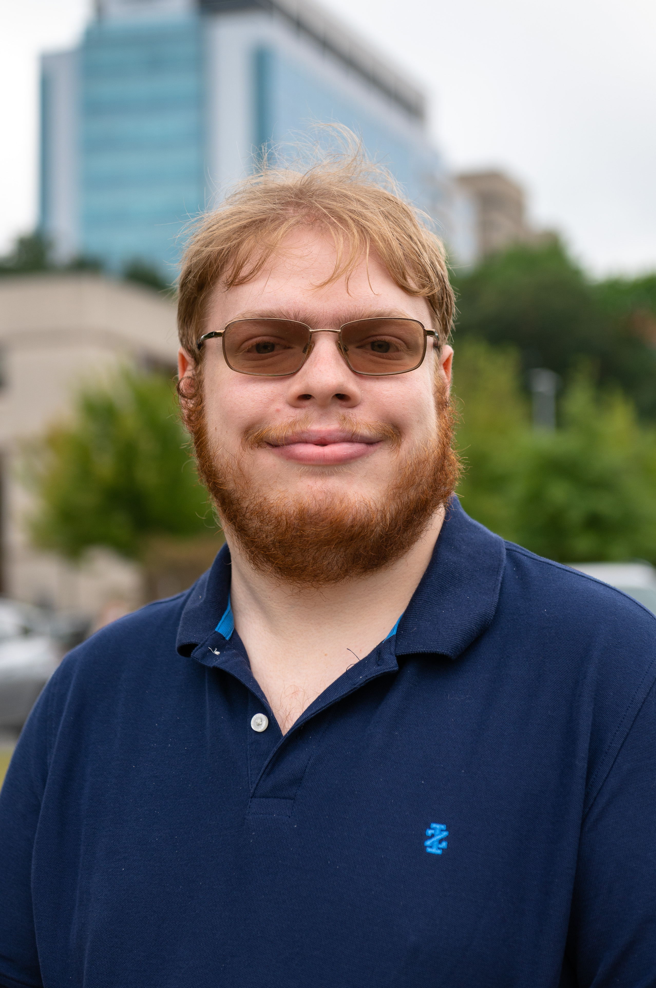
Project search
Success Story
Brett

Slide 28
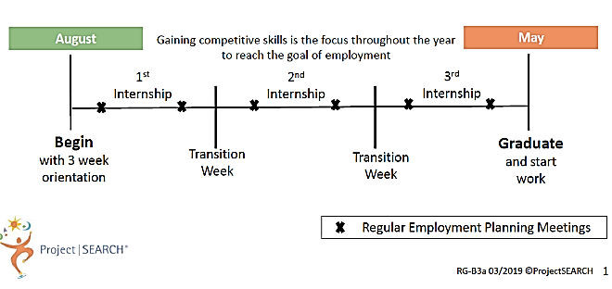
Project SEARCH
9-month internship training program, available to school transition age students and young adults eligible for DDS services, who need more intensive employment skills training
Businesses across the state serve as Project SEARCH host sites with programs run by:
  DDS Provider Agencies
  School Partners
The host business provides access to an on-site training room and access to business departments to provide three separate internship rotations.
10-week rotations
Project SEARCH Brochure

Slide 29
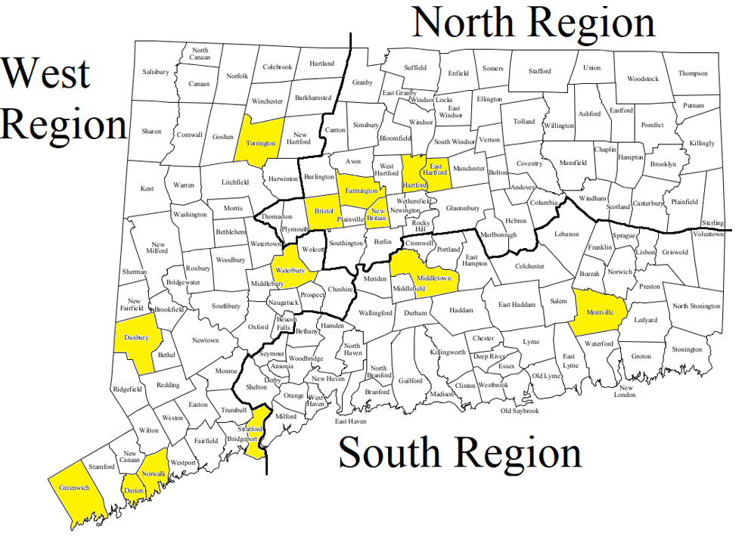
Project SEARCH Host Sites
DDS
Host Business
DDS Qualified Provider
CT has 14 Project SEARCH Sites
Project SEARCH Contact List
Ex: DDS, Greenwich Hospital, Qualified Provider = Project Search
Notes:
Here is a list of Project SEARCH sites in CT. The Mohegan Sun site is noted, but is currently on hiatius. In CT DDS is the leading state agency supporting Project SEARCH and its commitment has led to a rapid expansion in available programs. In both last year and this year, DDS funded licensing fees for up to 3 new programs. We are projected to have at least 14 Project SEARCH programs by the 2023-24 year.

Slide 30
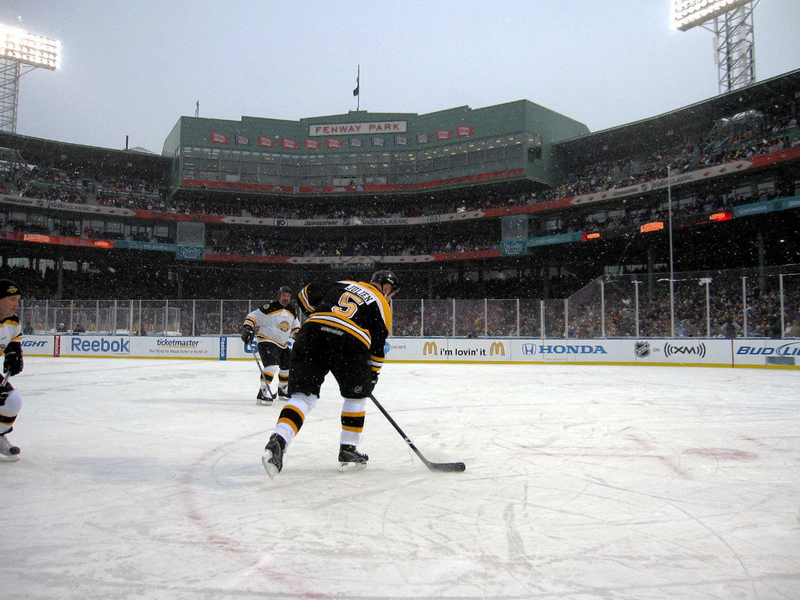



“I also mop the bottle room floor when it’s getting close to the end of my shift because nobody wants a sticky and dirty floor when doing the bottles now would they?”
Employer: Price Chopper
Job Position: Maintenance and “helping out with whatever is needed.”
Hours Worked: 20hrs./week
Good advice!
Brett
Employment All Star
Fun Facts!
I like traveling with my family.
Hockey is one of my favorite sports.
I graduated from Project SEARCH in June.
I also enjoy watching movies, such as Disney’s Robin Hood, which just turned 50 years old as of a week ago!
Brett’s Career Stats
Strengths | Skills
Adaptable & Helpful | Customer support
Self-starter | Cart Management
Attention to detail | Bottle room machinery oversight; maintenance
This Photo by Unknown Author is licensed under CC BY-NC-ND

Slide 31
Please click the following link to watch this video and then continue to the next slide: https://youtu.be/uAXWSBV6vE4.

Slide 32

A Special Thanks to Our Participants:
Darlene and Futures
Edwin
Bri
Brent
Brett and Sandy
Thank you for sharing your inspirational stories with us!
“May you be proud of the work you do,
the person you are,
and the difference you make.”

Slide 33

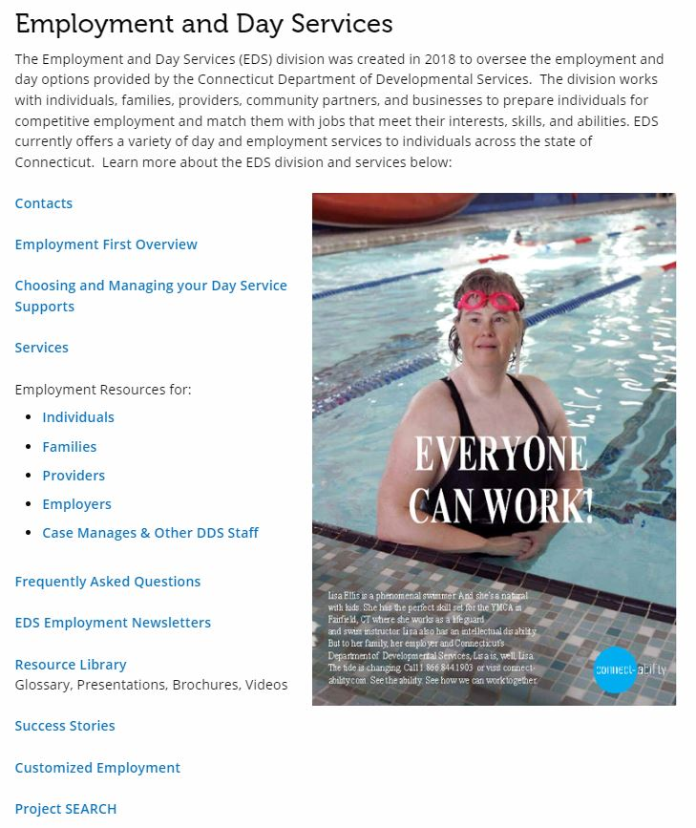
Questions?
Website:
DDS Employment and Day Services
Email:
DDS.Employment-DayServices@ct.gov

