Slide 1


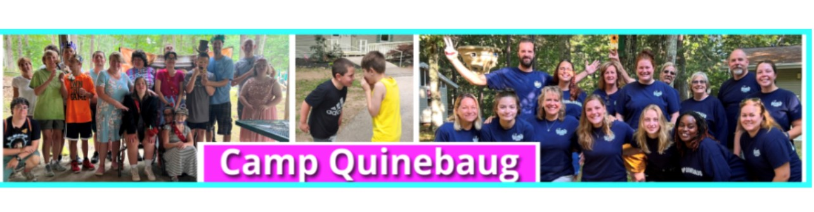

Camp Quinebaug
A Camp For All Reasons
2022 ~ 2023

Slide 2

Camp Q provides activities that include, but are not limited to the following: swimming, boating, fishing, nature enrichment, arts & crafts, sports, history, science, socializing, and forming meaningful relationships ~ all within a fully handicapped accessible summer camp.
Camp Q is a barrier-free outdoor experience that helps to promote personal growth and foster independence for children and young adults with disabilities.
Our camp provides medical & social supports necessary for campers who might otherwise be excluded from recreational camp settings. Campers are encouraged to try new experiences to gain self-confidence, learn cooperation, appropriate communication, and increase personal independence in a safe and fun environment. Often, many campers form new and long-lasting friendships
Camp is a special place where kids can just be themselves and focus on their “abilities”, not their disabilities. Camp Q provides a sense of freedom in an environment where anything is possible. Camp is a place of “ yes I can”
Our campers often do not want camp their camp experience to end. They look forward to returning each year; often looking to have a more supporting role to new campers, as they mature. Veteran campers realize the benefits and enjoy teaching new campers about the magic that is Camp Q!

Slide 3
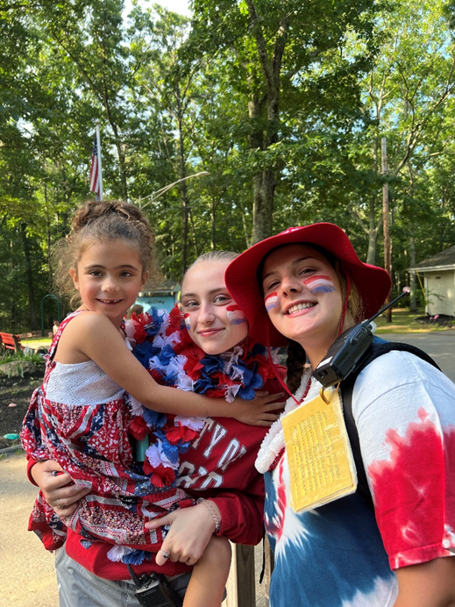
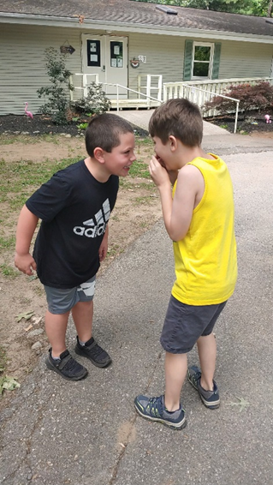
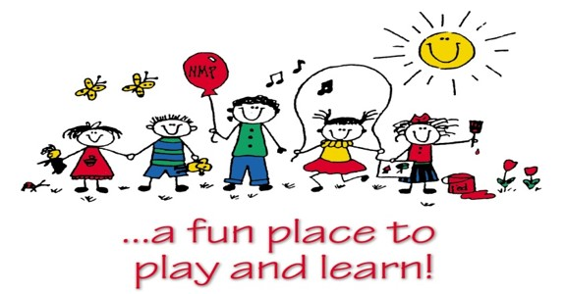
Celebrating Independence Day
New Friends

Slide 4
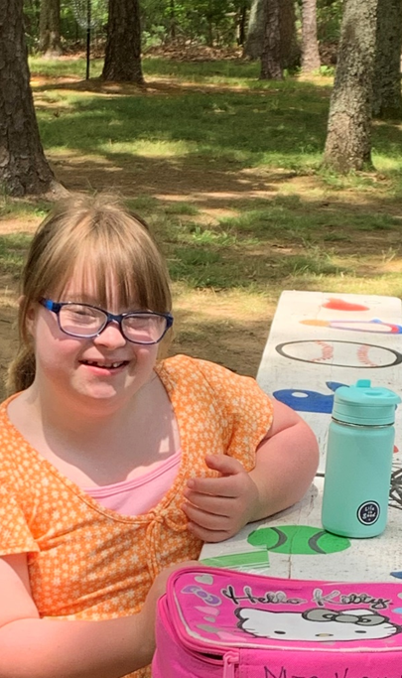
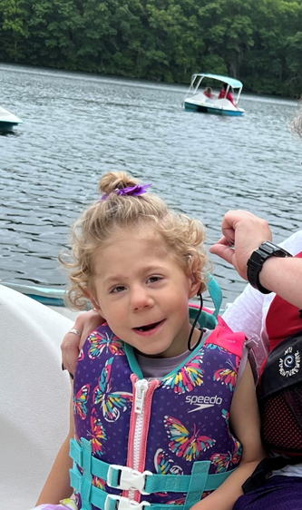
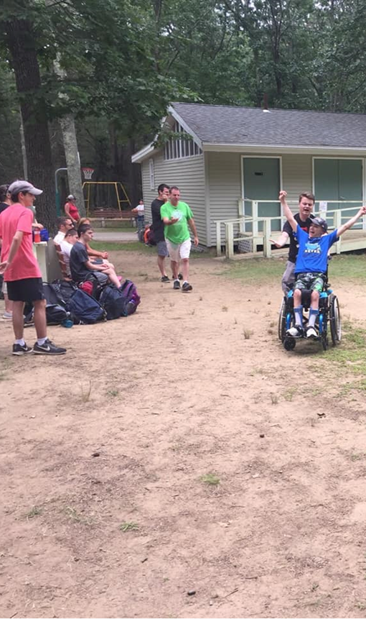
Outdoor Fun!

Slide 5
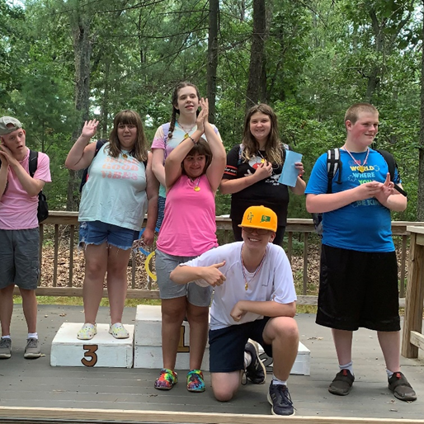
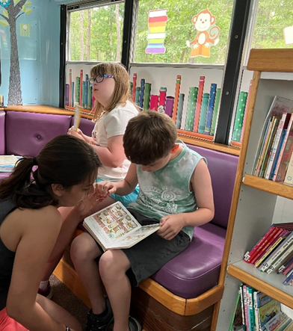
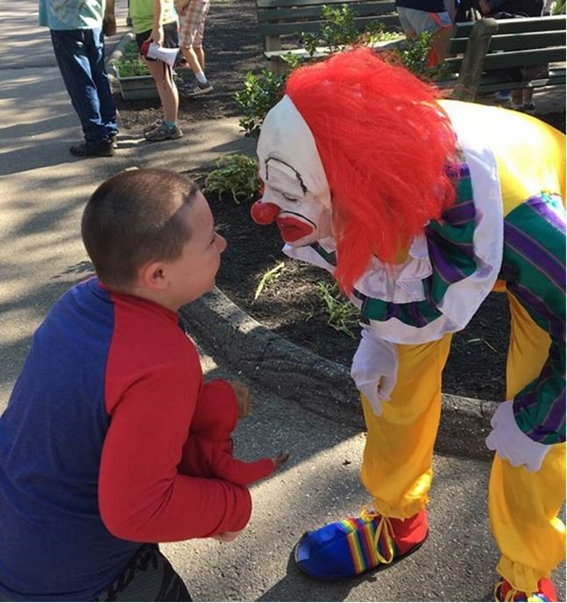

The Discovery Bus
Library on Wheels
Carnival Clowning
Olympic Medal Ceremony

Slide 6
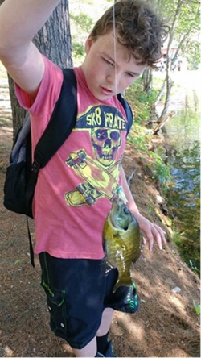
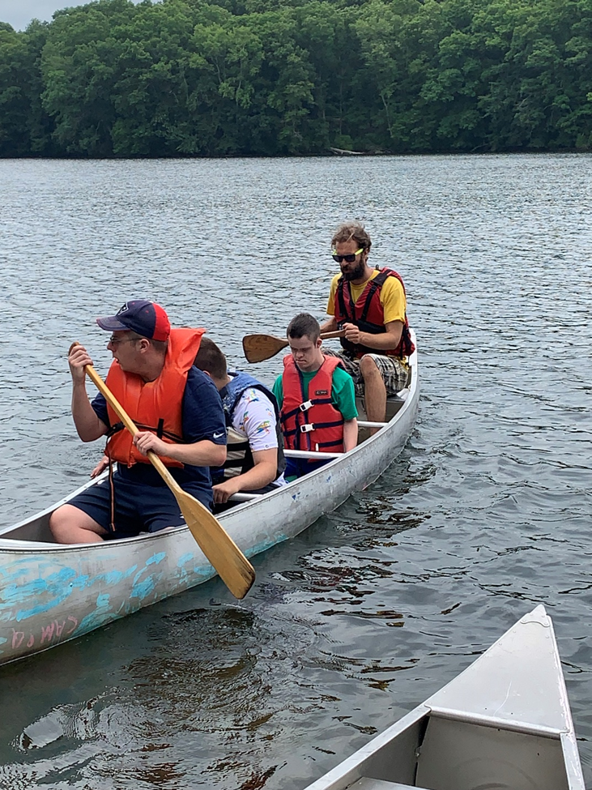
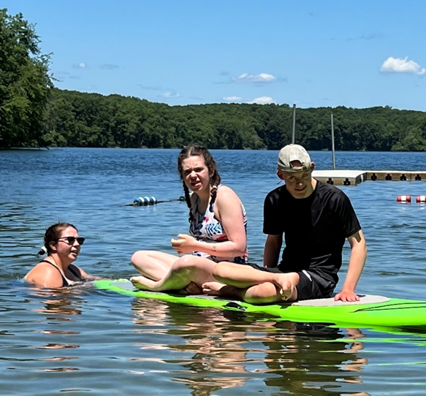
Fishing, Boating & Swimming

Slide 7
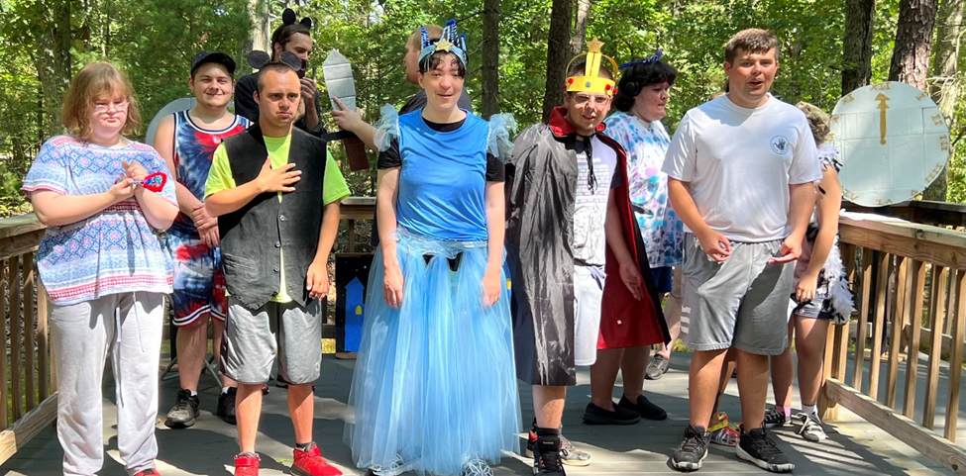
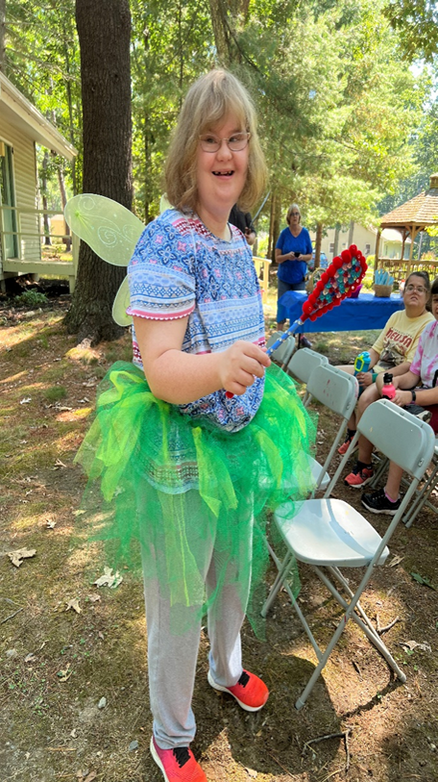
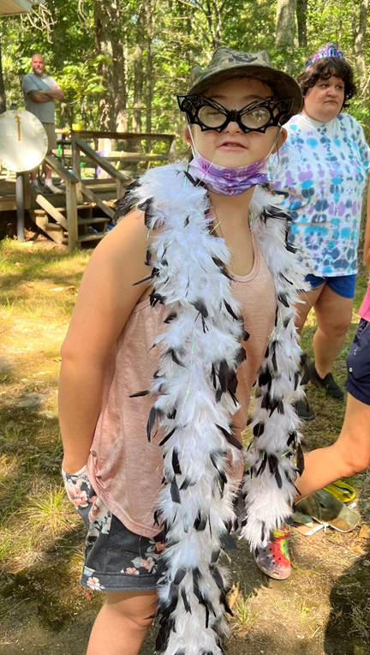
Camp Q Presents ~
~ CINDERELLA ~

Slide 8
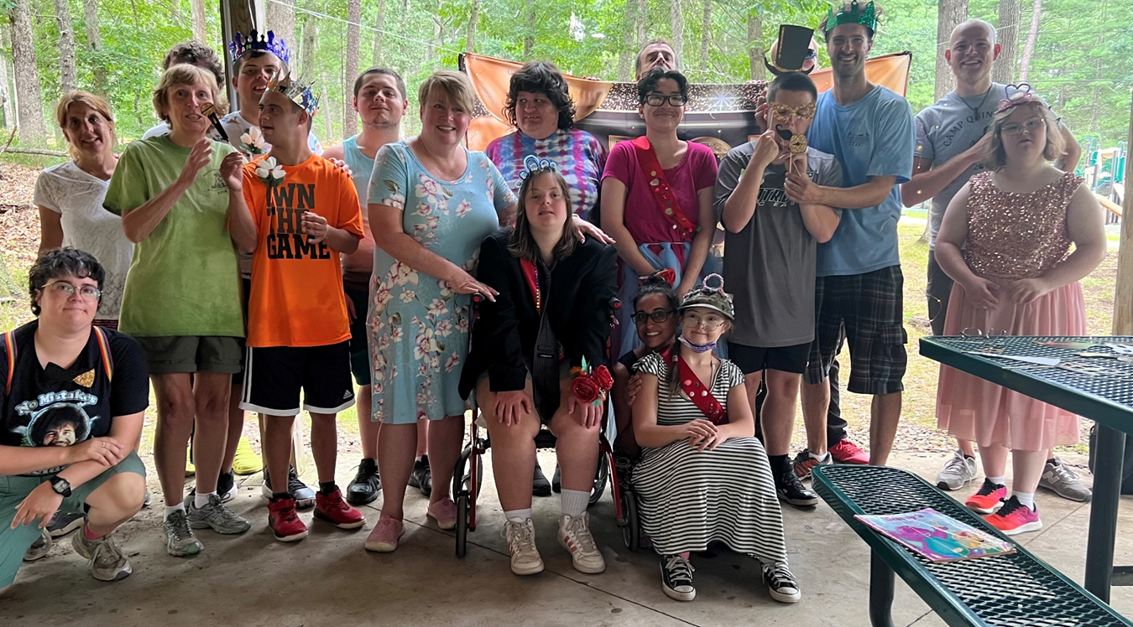
The Camp Q Prom

Slide 9
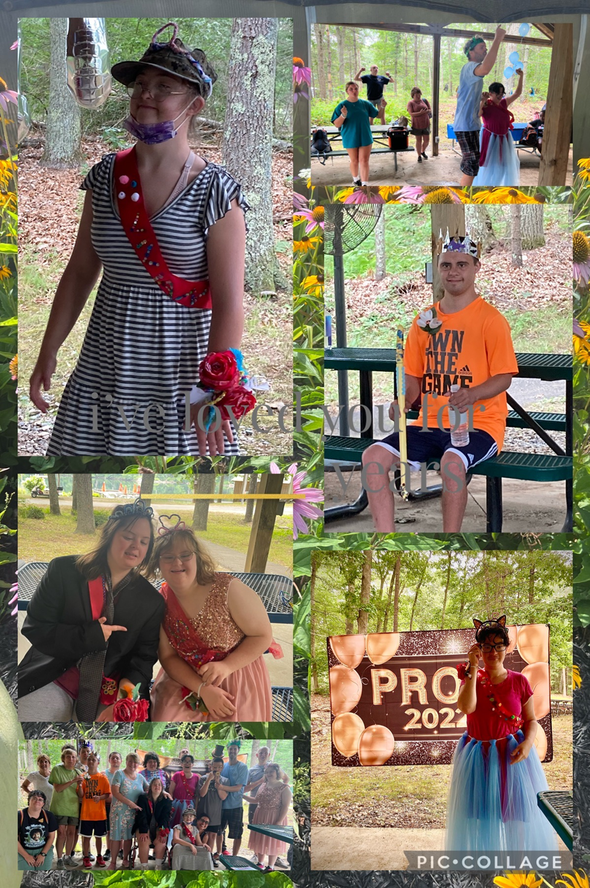

Slide 10
