Slide 1
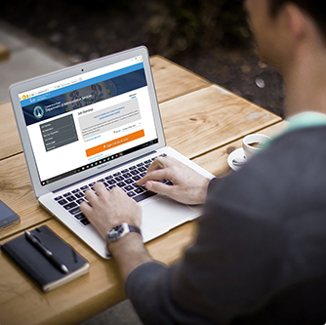
How To Create a JobAps Account

Slide 2

Where Do I Begin?
Locate a device
Set up an e-mail account
Register for the Online Employment Center

Slide 3

Locate a Device
Options could be:
    Mobile phone
    Tablet or computer
    Public library
    State of CT DAS computer kiosks, 450 Columbus Blvd, Hartford (street entrance)
    American Job Center locations
    Friends and family

Slide 4
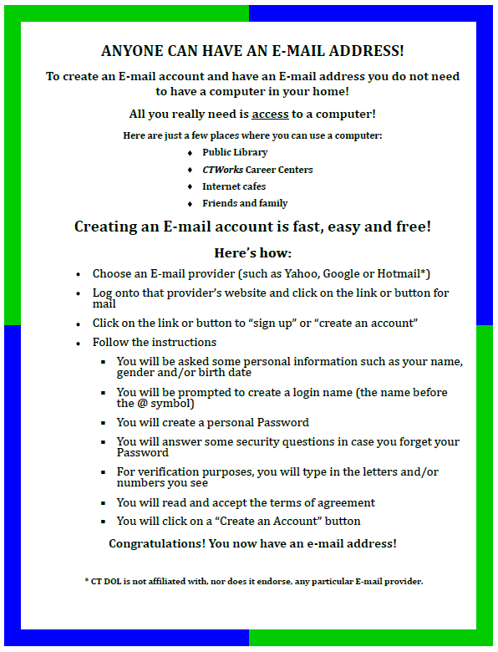
Set Up an E-mail Account
You will need an email address as all correspondence is handled through email.
Set a professional tone with your e-mail address. Avoid edgy, controversial, or potentially offensive references. Consider something similar to these examples:
will.jones@hotmail.com or will.jones528@hotmail.com
felicia.t.ortega@gmail.com or felica.t.ortega122@gmail.com
adams.michael@yahoo.com or adams.michael1130@yahoo.com
Note: The document to the right is located on the CT Department of Labor website:
http://www.ctdol.state.ct.us/progsupt/unemplt/M1A/Createe-mail.pdf

Slide 5
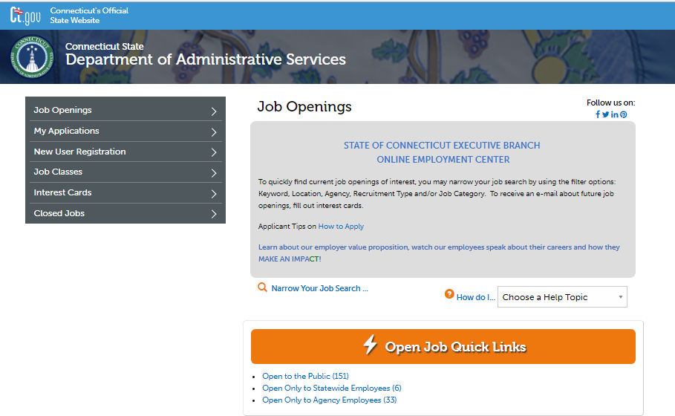
Register for the Online Employment Center
Select
New User Registration

Slide 6

What Information do I Need to Register?
First Name
Last Name
Middle Initial
First 3 Letters of Last Name at Birth
Last 4 Digits of Primary Phone Number
Your Most Recent Zip Code Number
Last 4 Digits of Your Social Security Number
Month of Birth
Day of Birth
E-mail Address
Create a UserID – up to 10 characters
Create a Password – 8 characters minimum; must include both letters and digits
Write down your UserID & Password for future use

Slide 7
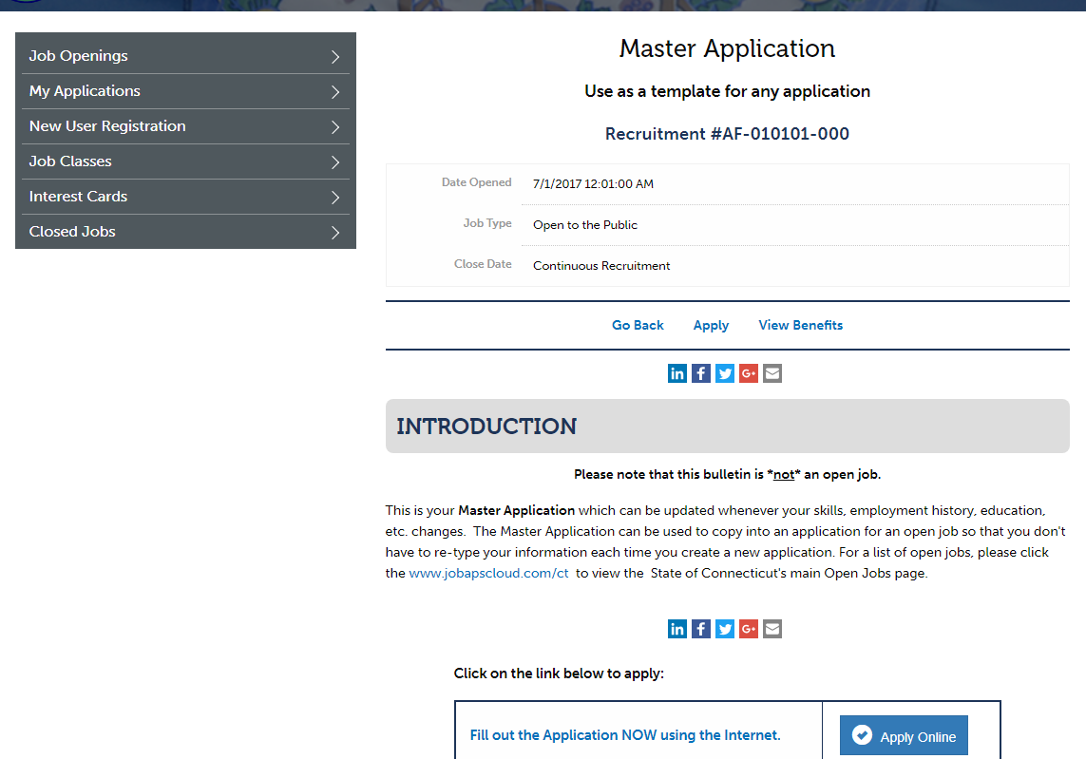
Step 1 – Create Account
Click
New User Registration

Slide 8
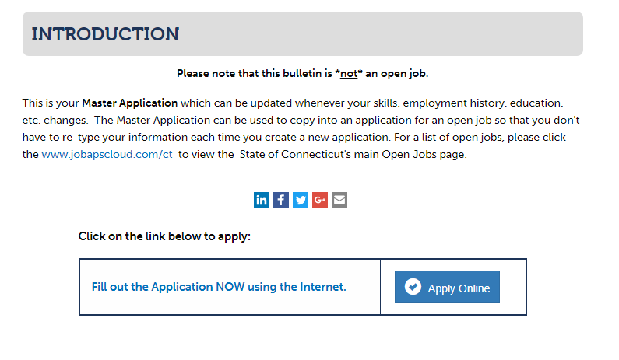
Step 2 – Create Account
Read the Introduction
Click Apply Online

Slide 9
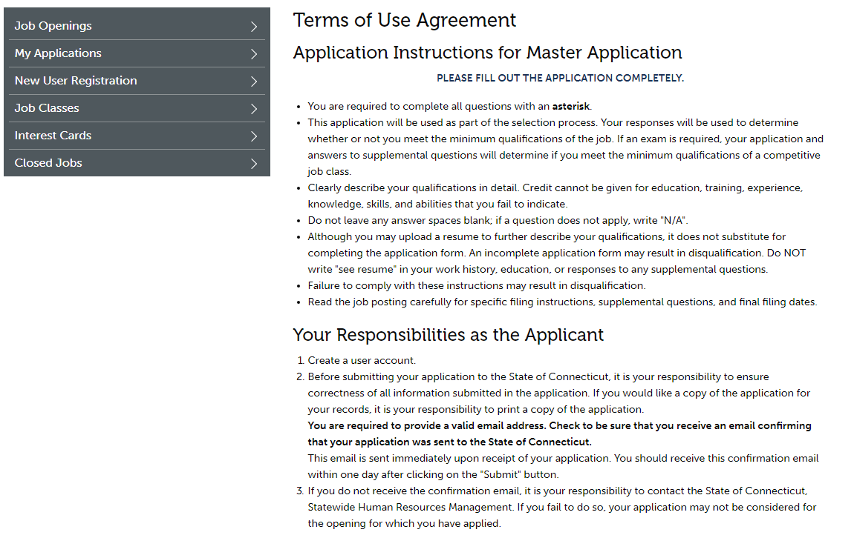
Step 3 – Create Account
Read the Terms of Use Agreement.
Read Your Responsibilities as the Applicant

Slide 10
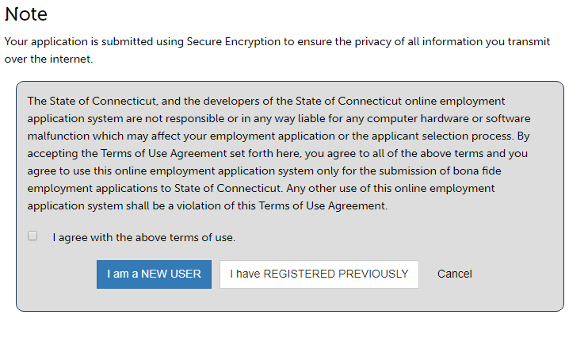
Step 4 – Create Account
Continue reading and then accept the Terms of Use Agreement.
1) Read the Note
2) Check the
I agree box then click
Note: In accordance with the Terms of Use Agreement, you
can create only 1 (one) profile on the OEC.

Slide 11
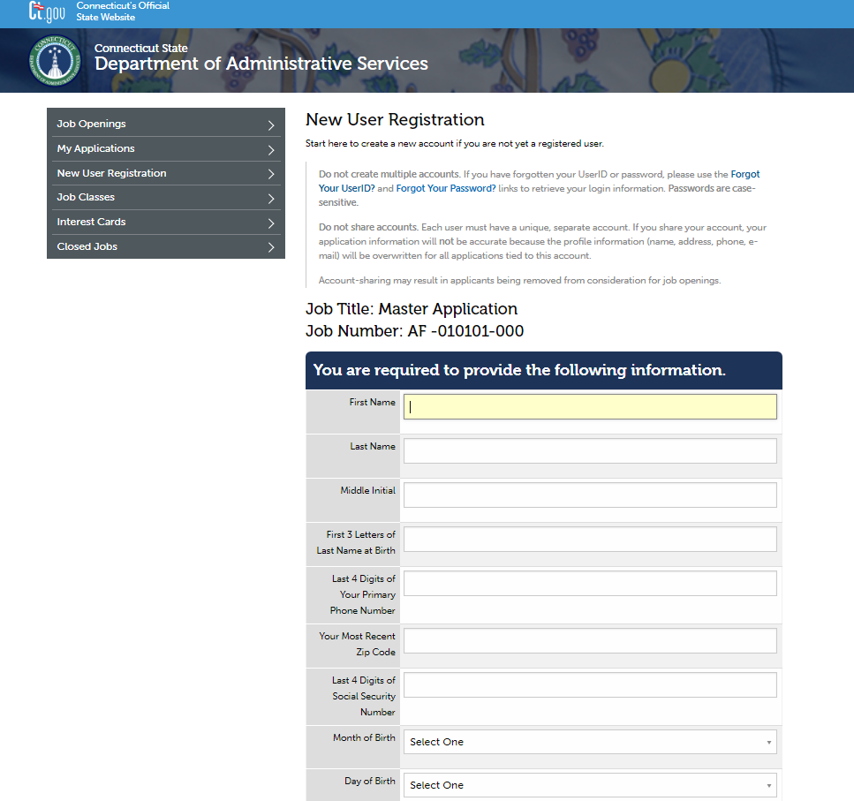
Step 5 – Create Account - New User Registration Screen
Type in Information

Slide 12
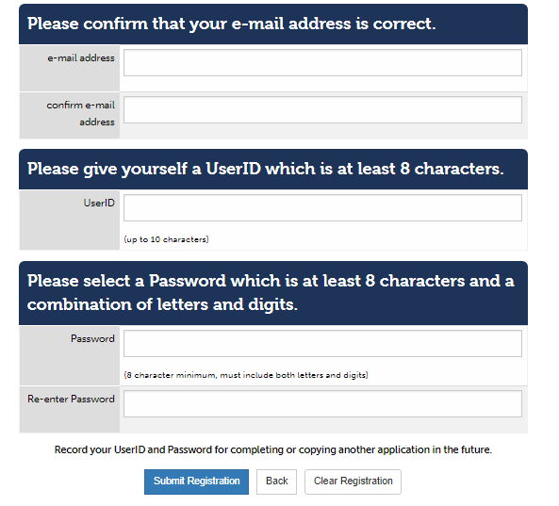

Step 6 – Create Account - New User Registration Screen
Important: Write down your UserID and Password for future use. UserID’s and passwords are case sensitive.
If you are having trouble registering the first time, try a different UserID as the one you are trying may already be taken.

Slide 13

Now that you have an account set up, you can:
View and Apply for Job Openings
Request to activate Mandatory Rights, if eligible
Request to place your name on a Statewide Transfer list (non-mandatory), if eligible
Request to Rescind your Resignation or Retirement, if eligible

